Slide 1
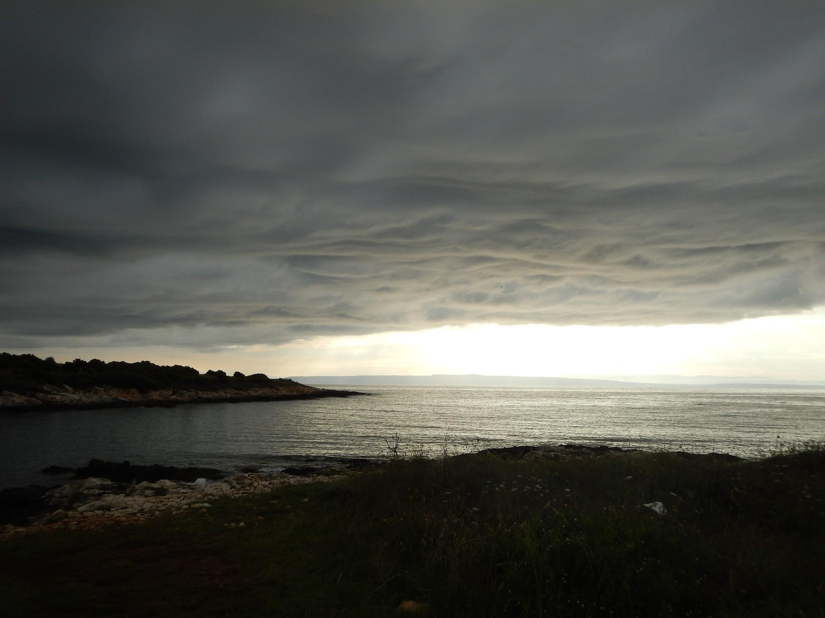
Aphasia Book Club
SESSION #11
11/22/24

Slide 2
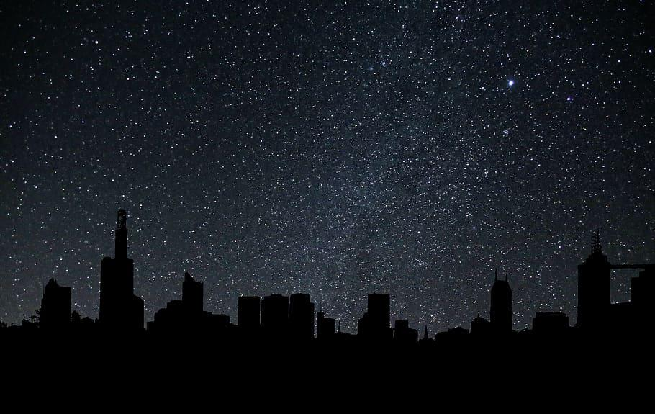

AGENDA
F
WEEKLY CATCH-UP 🦃
story summary
HW & DISCUSSION
CROSSWORD
NEXT WEEK
Pages 226-end

Slide 3

no meeting next week
for the holiday break,
We won’t be meeting on fri., 11/29
BUT FIRST…

Slide 4
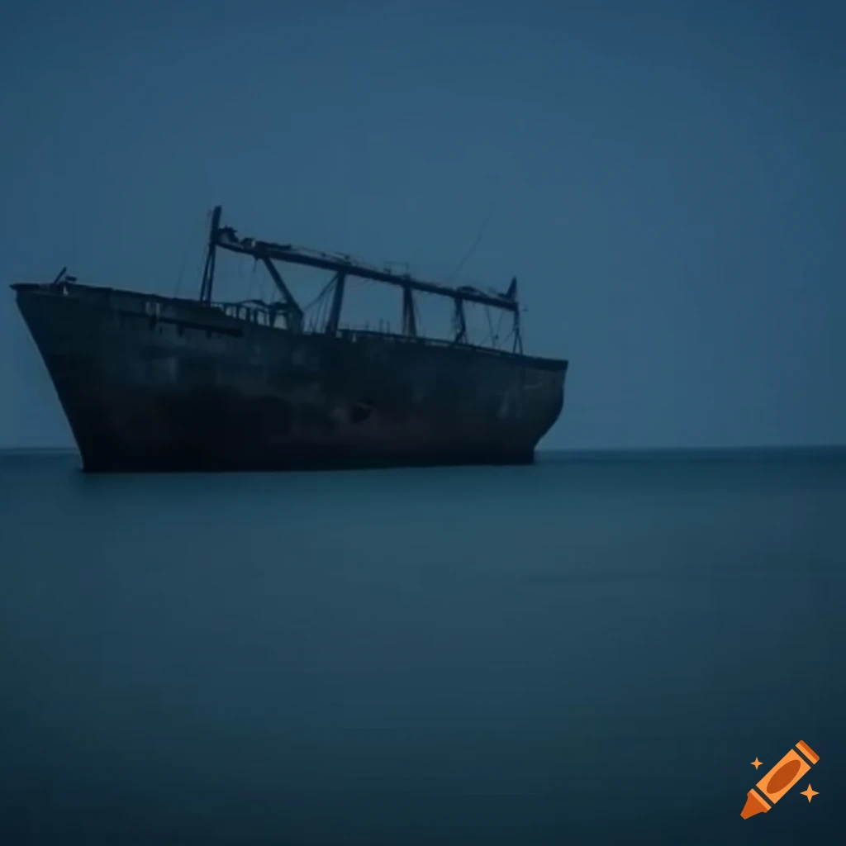
STORY SUMMARY
The man searches an abandoned ship and finds many things.
The man and boy are caught in the rain and dark trying to find their shelter.
The man and boy discuss how many people might be left in the world.

Slide 5
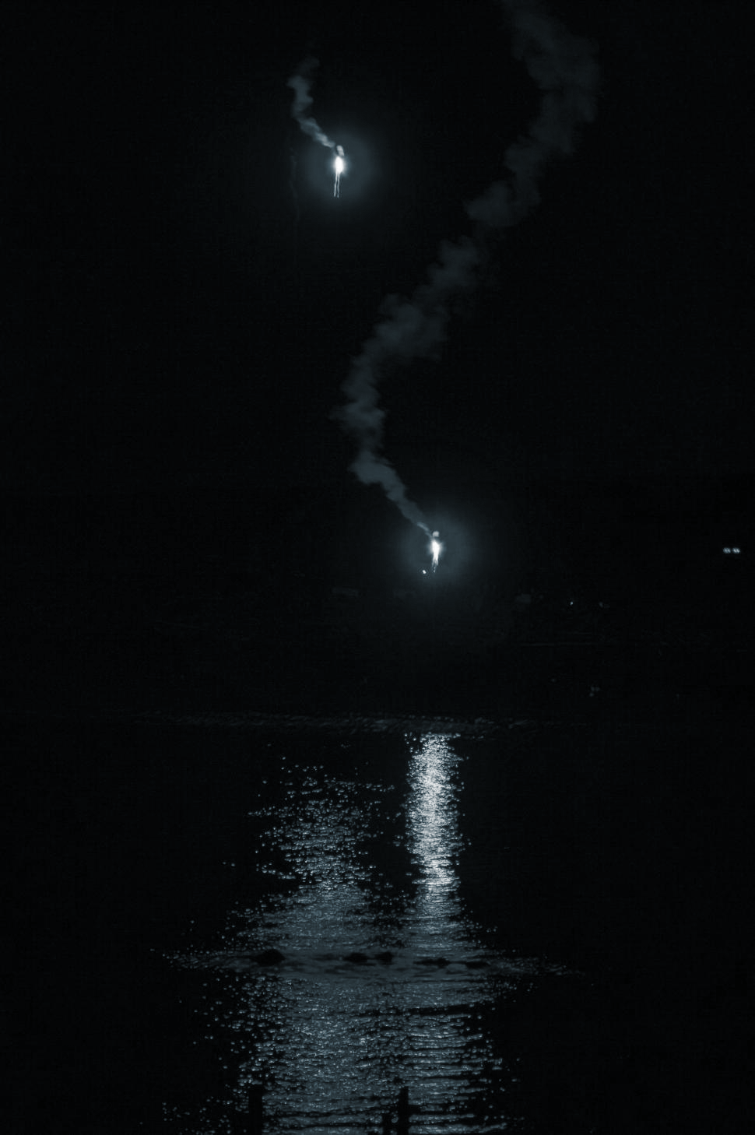
STORY SUMMARY
The boy wonders if the good guys or God might see their flare.
The boy gets very sick and vomits. The man does everything in his power to help him recover.
The man is sick with fear that he will lose his boy.

Slide 6
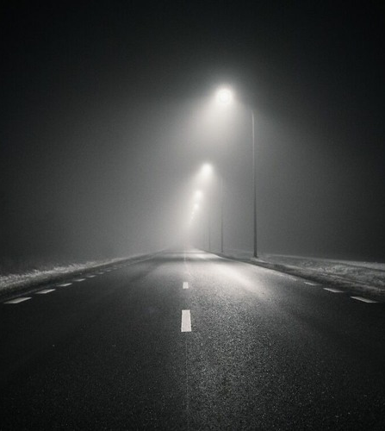
STORY SUMMARY – the ending
A thief steals their belongings. The father chases down the thief.
The father gets shot in the leg with an arrow.
The father dies and the boy stays with him.
The boy returns to the road and is invited to join a small group of people.

Slide 7

HW & DISCUSSION

Slide 8

ON PAGE 232…
The boy accidentally loses something valuable to him and the man, and they have to turn back and look for it. They lose precious daylight because of this.
a.) What crucial thing did they lose and what does this object represent to you in the story?
b.) Do you have something in your life you can’t live without or is a symbol of something important to you?

Slide 9

ON PAGE 241…
The boy and man discuss a flare gun found on an abandoned ship. The boy remarks, “...there’s no one to signal to. Is there?”
a.) Reflect on a time you felt like the boy, when there was “no one to signal to.” What made you feel this way?
b.) What are the ways you have overcome loneliness in the past? What tends to help/not help you? Why is loneliness hard to talk about?

Slide 10
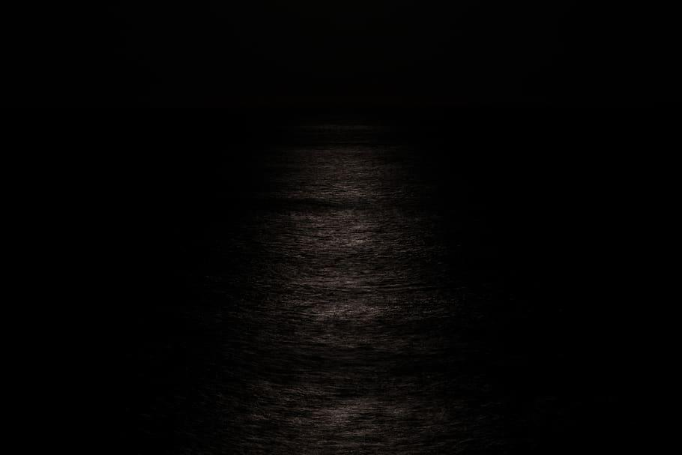

ON PAGE 228…
While searching the abandoned ship, the man discovers something that “was the first thing he’d seen in a long time that stirred him.”
a.) What did he find? Why are pieces of history so valuable, especially in the man’s world? Why does he seem to revere it so much?
b.) When was the last time something (a work of art, a story, anything) really “stirred” you? How do you encourage a healthy sense of wonder in your life?

Slide 11
ON PAGE 246…
After shooting off the flare gun on the beach, the boy and the man discuss the possibility of someone seeing the signal. The concept of God is brought up briefly.
a.) Why do you think the boy and the man haven’t discussed God in the story up until now? Does it seem like the boy wants to talk about God?
b.) Do you think it would be better for the man to believe in God for his son’s sake? What would you do?

Slide 12
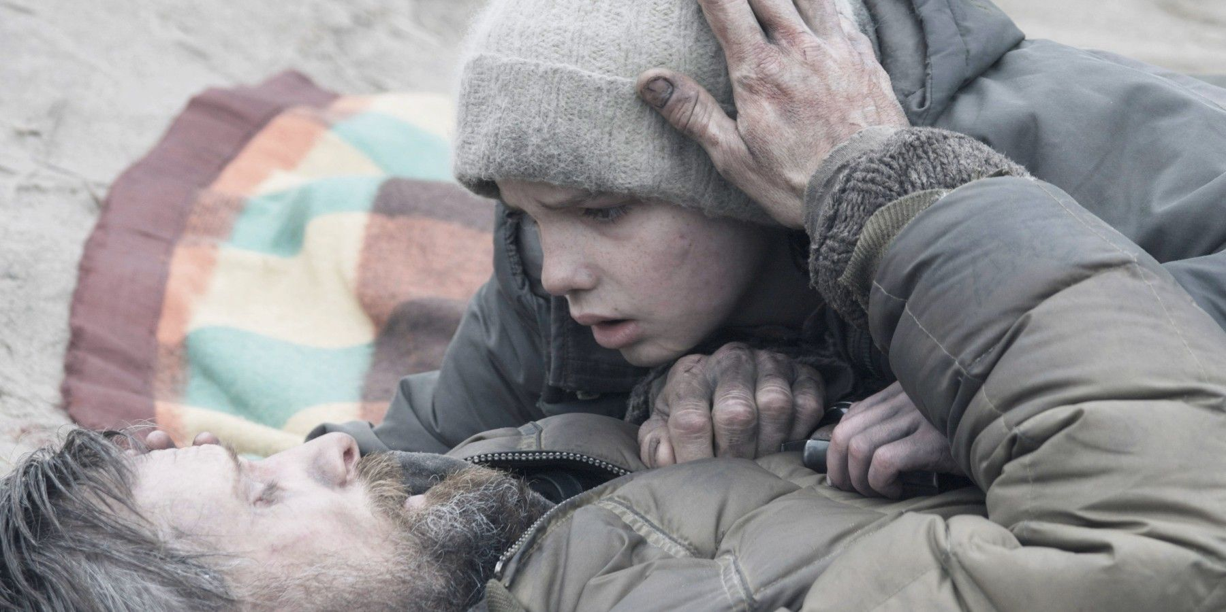
ON PAGE 250…
The boy falls ill, and the man does everything in his power to nurse him back to health. At one point, the man, “walked out on the beach to the edge of the light and stood with his clenched fists on top of his skull and fell to his knees sobbing in rage.”
a.) Have you ever been in a situation where you felt helpless when someone you cared about was in trouble? Write some details about your experience.
b.) Why does a lack of control bring out the worst in us (anger, fear, sorrow, etc.)? If you are a parent, how would you comfort the man in this moment?

Slide 13
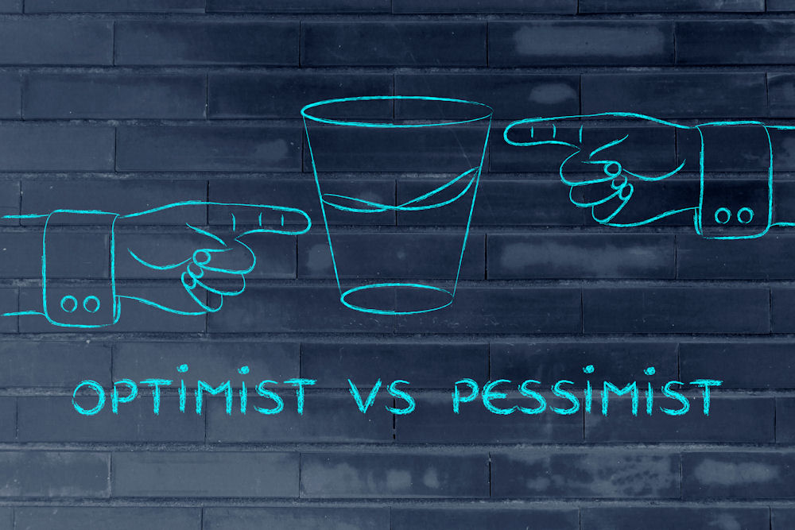
ON PAGE 268…
The man is trying to be positive for the boy, but the boy is focusing on the negative.
Are you usually optimistic or pessimistic in your own life? Give an example.

Slide 14
At the end of the book
a) What are your opinions about the ending of the book? Did it end how you expected? If you got to choose another ending, what would you want to happen?
b) What are two things you liked and disliked about this book? Would you recommend it to someone else? Why or why not?

Slide 15
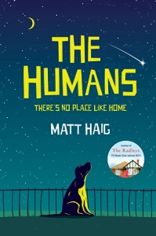



So... what next?

Slide 16
Genre: memoir
Synopsis: Educated is a 2018 memoir by the American author Tara Westover. Westover recounts overcoming her survivalist Mormon family in order to go to college, and emphasizes the importance of education in enlarging her world.

Slide 17
Genre: science fiction, dystopian
Synopsis: The story, set in a dystopia in 2045, follows protagonist Wade Watts on his search for an Easter egg (clues) in a worldwide virtual reality game, the discovery of which would lead him to inherit the game creator's fortune and the game itself.

Slide 18
Genre: mystery, thriller
Synopsis: The premise of this book is that a young maid, Molly, who works in a luxury hotel, walks into a room where a wealthy and regular guest is dead in his bed. Suspected murder. Because of her abnormal behavior and mannerisms and her proximity socially and physically to the scene, Molly is the prime suspect.

Slide 19
Genre: science fiction, dark comedy
Synopsis: The Humans follows an unnamed narrator, who is a member of an intelligent life form far more advanced than we are. He is sent to Earth to destroy information that humanity as a species is not equipped to handle.

Slide 20
So... what next?

Slide 21
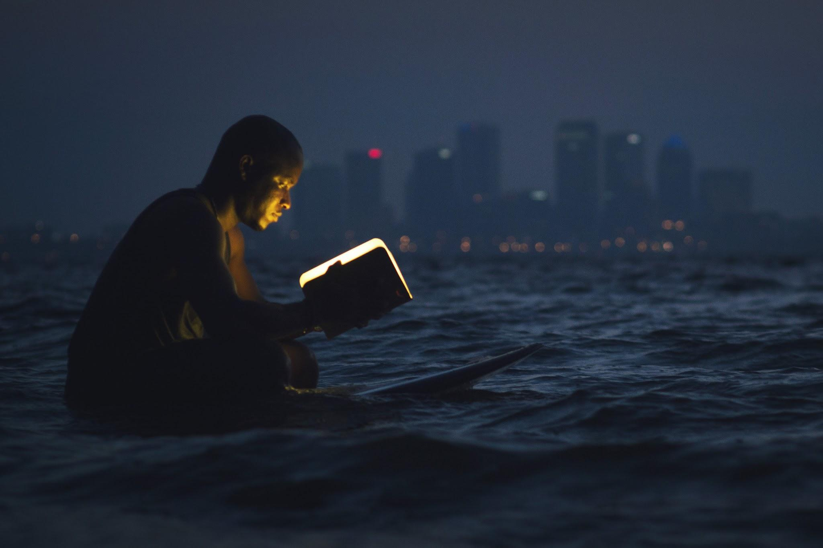
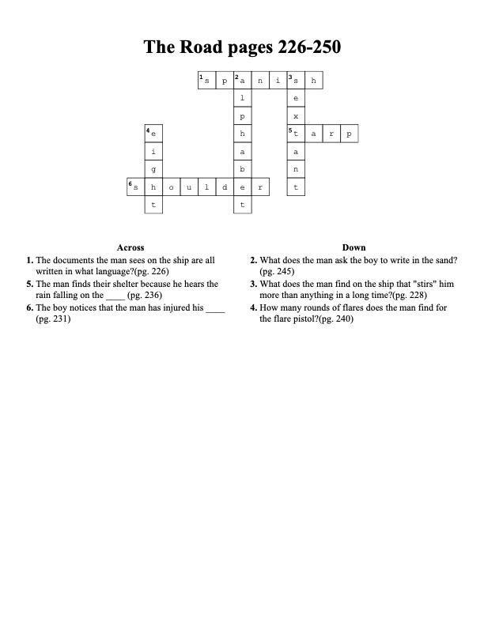
CROSSWORD
Notes:
Put screengrab of crossword puzzle solutions here.

Slide 22
NEXT TIME FRI., 12/6
Party on 12/6!
Was there A QUOTE that you liked throughout the book?

