Slide 1

Aphasia Book Club
Session #4
9/27/24

Slide 2

AGENDA
WEEKLY CATCH-UP
STORY SUMMARY
WORKSHEETS
CROSSWORD
VOCAB SPEED ROUND
NEXT WEEK
Pages 51-73

Slide 3

STORY SUMMARY
(1/2)
Pages 51-73
The boy suggests that he wants to die.
A flashback reveals that the man’s wife took her own life some time ago.
A stranger threatens the life of the boy, forcing the man to shoot him dead.

Slide 4
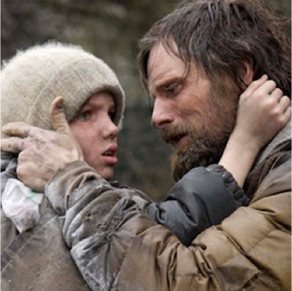
STORY SUMMARY
(2/2)
Pages 51-73
The man & boy flee a group of men who wish them harm. They discover their cart has been robbed.
The man discovers evidence of cannibalism.

Slide 5

WORKSHEETS

Slide 6

CROSSWORD
Pages 51-73

Slide 7

let’s think of 5-6 difficult words..
Pages 51-73
Notes:
1.) Obsidian
2.) Macadam
3.) Rachitic
4.) Cheroot
5.) Laquered
6.) ???

Slide 8
NEXT WEEK
READ PAGES 74-102
HOMEWORK
FIND A QUOTE that you like!
Pages 74-102

