Slide 1
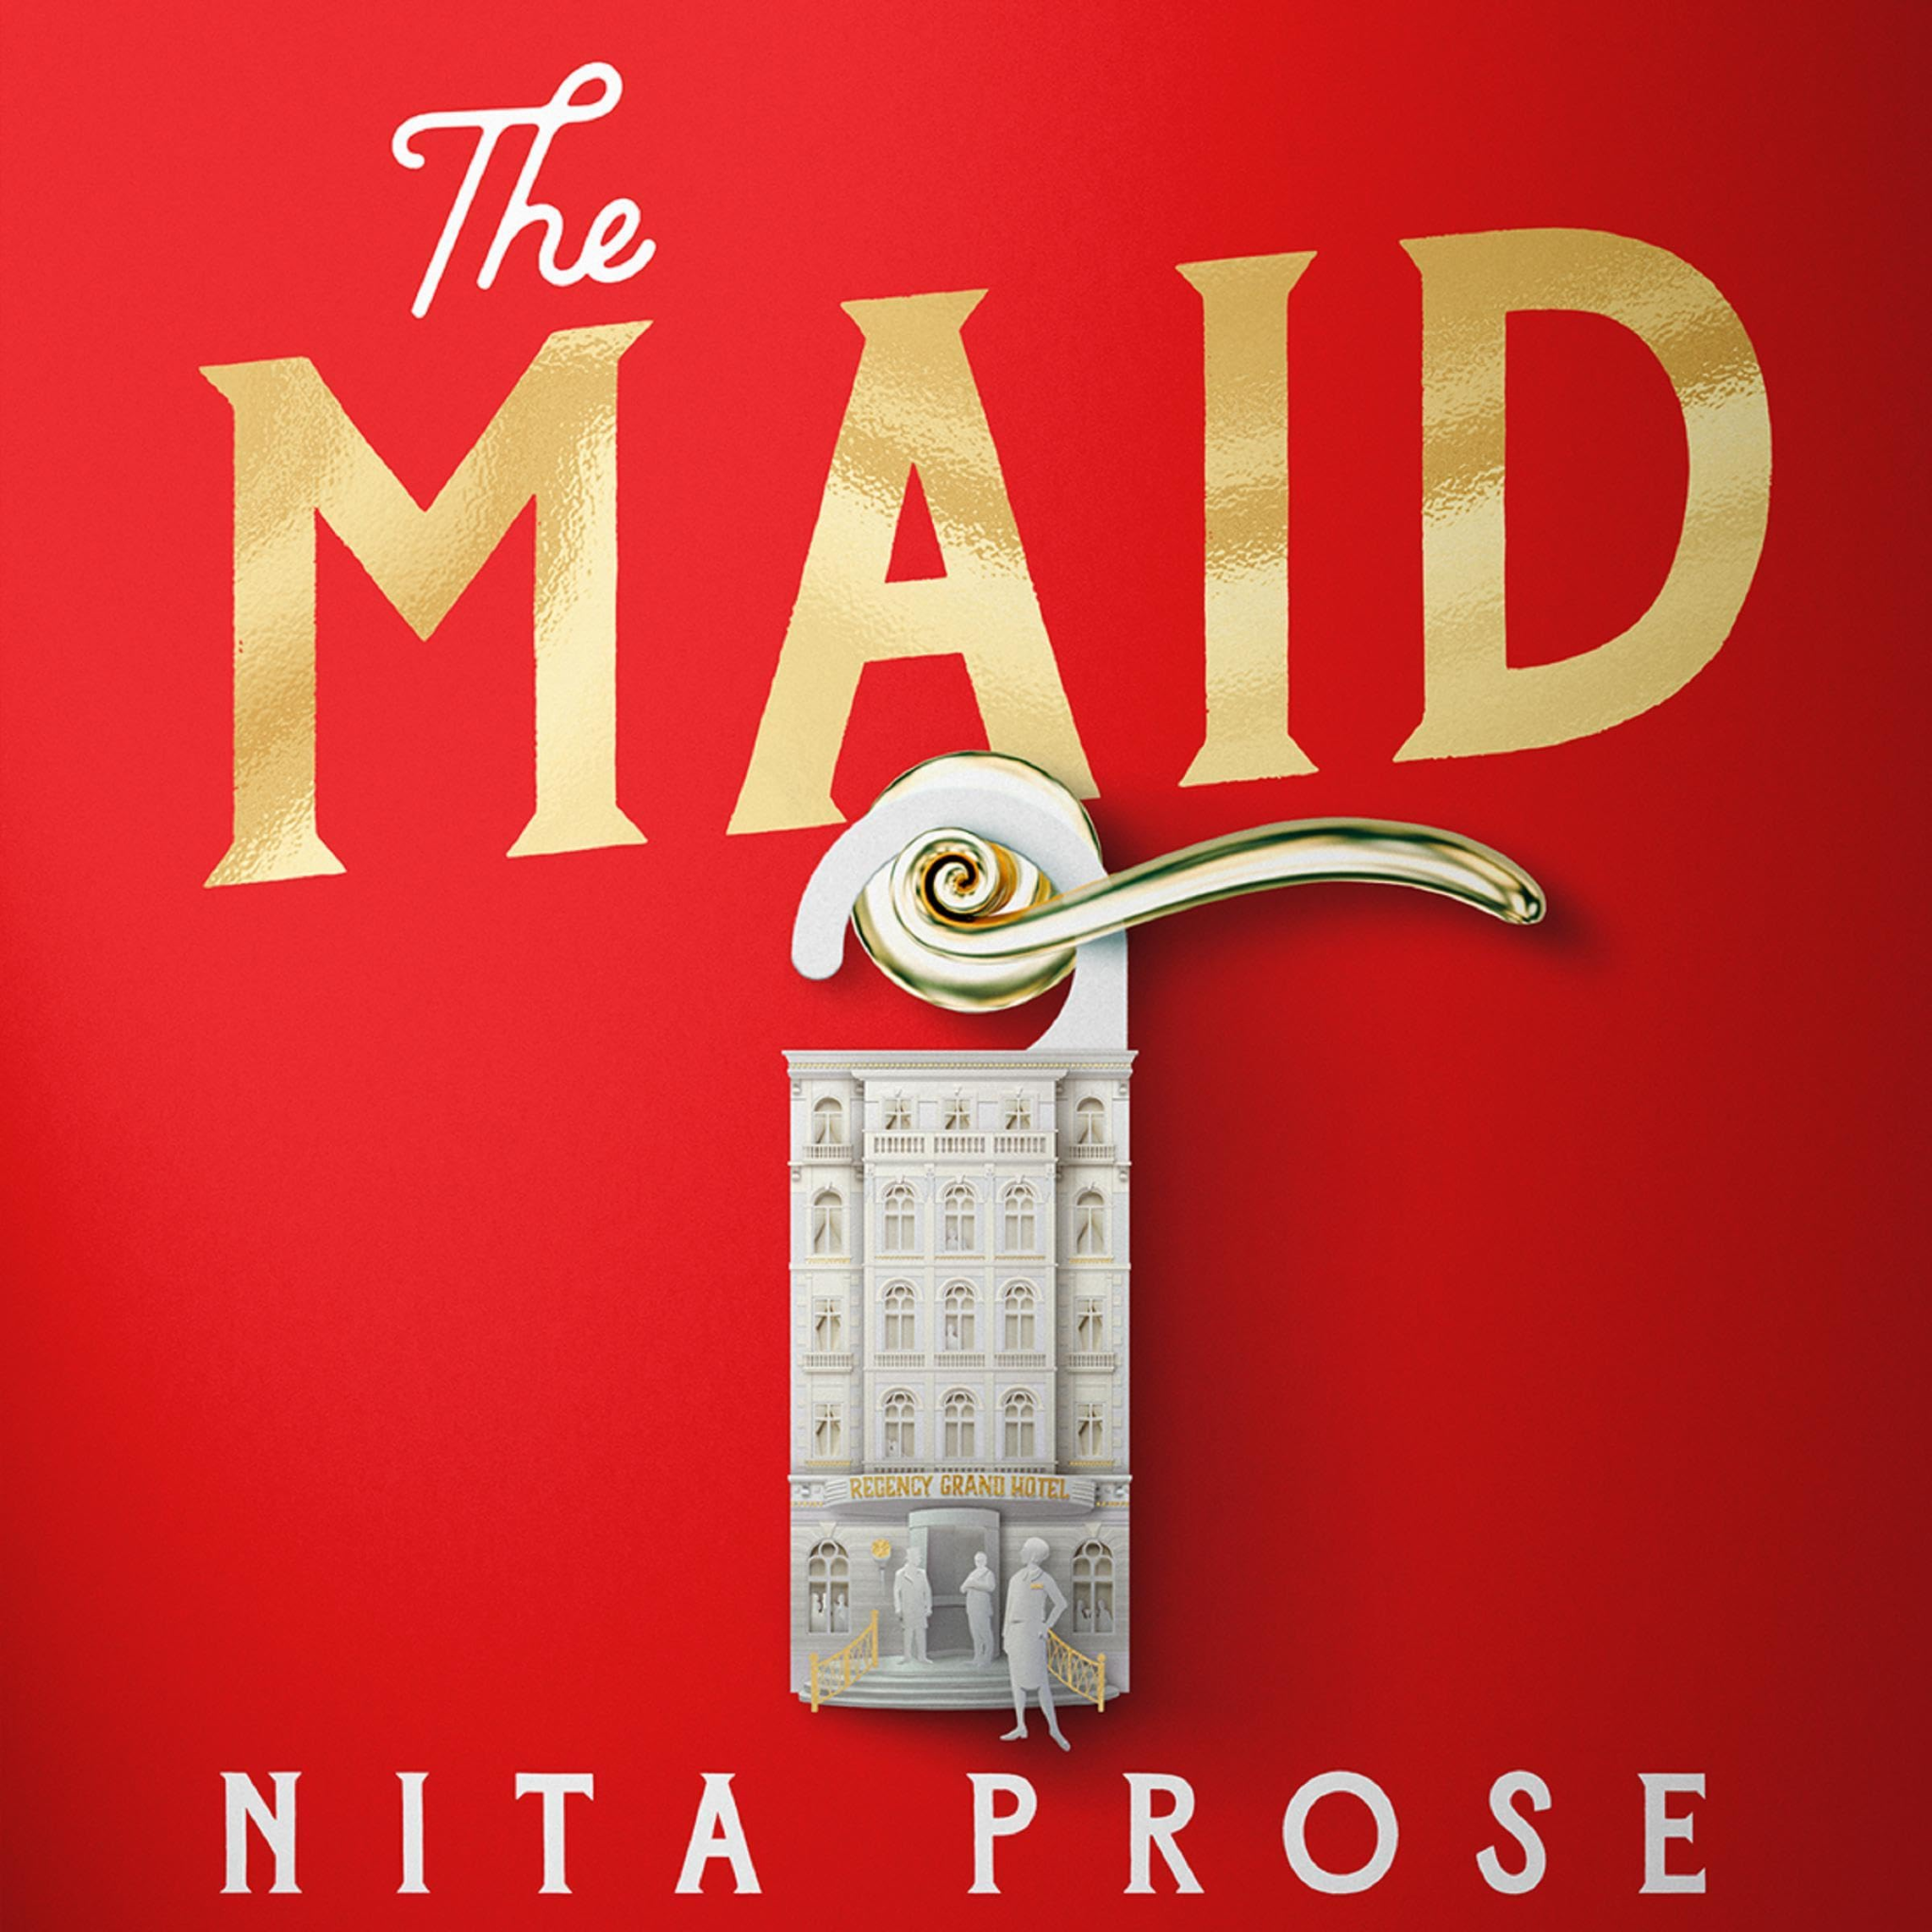
Chapters 19, 20, 21
Friday, April 11th

Slide 2
Reading Schedule Change!
The week of April 18th-24th, we are finishing the book!
That week, please read Ch. 25 to the end.

Slide 3

Character List
Molly
- Narrator; maid at the hotel
Mr. Snow
- Hotel manager
Mr. Black
Wealthy businessman who is a regular guest at the hotel
Giselle Black
- Mr. Black's second wife
Mrs. Black
- Mr. Black's first wife

Slide 4

Character List (cont.)
Victoria Black
Mr. Black’s daughter
Mr. Preston
Hotel Doorman
Rodney Stiles
- Hotel bartender; Molly’s current crush
Cheryl (“Chernobyl”)
- Molly’s lazy, cheating supervisor
Detective Stark
Detective investigating Mr. Black’s death.

Slide 5
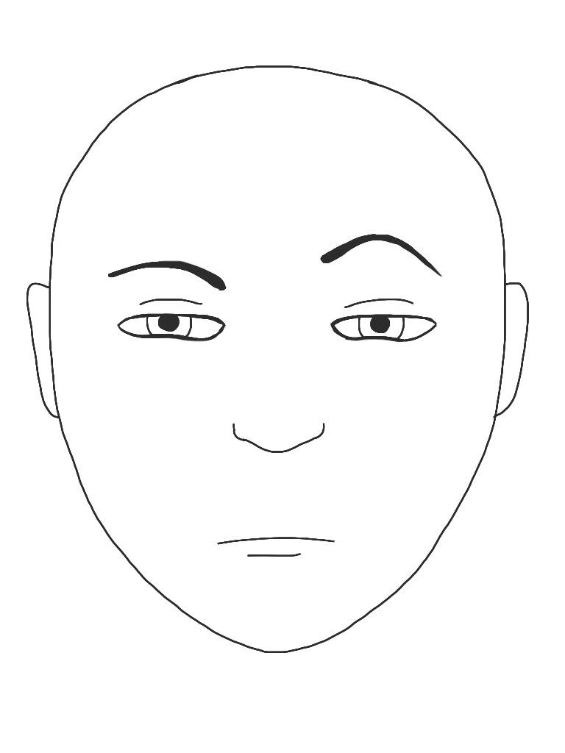
Character List (cont.)
Sunshine & Sunitha
- Molly’s fellow maids
Juan Manuel
Hotel dishwasher having financial problems
Mr & Mrs. Chen
- Regular guests at the Regency Hotel
Charlotte
Mr. Preston’s daughter and Molly’s lawyer
Wilbur Brown
Molly’s ex-boyfriend who stole all of her money
Mr. Rosso
Molly’s annoying landlord.

Slide 6
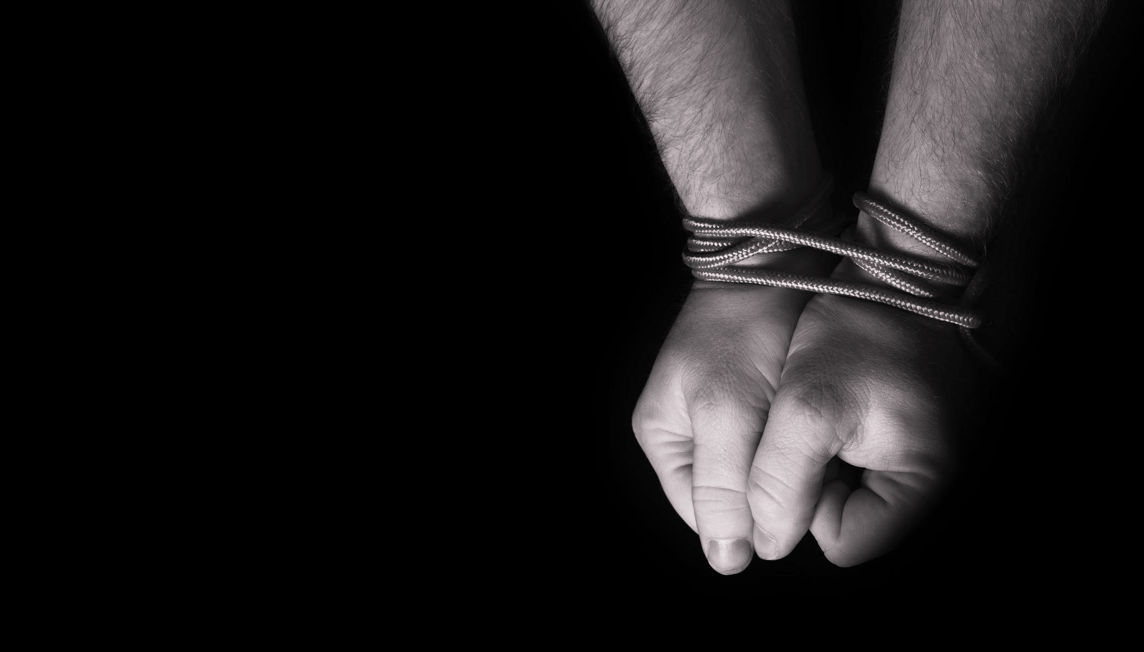
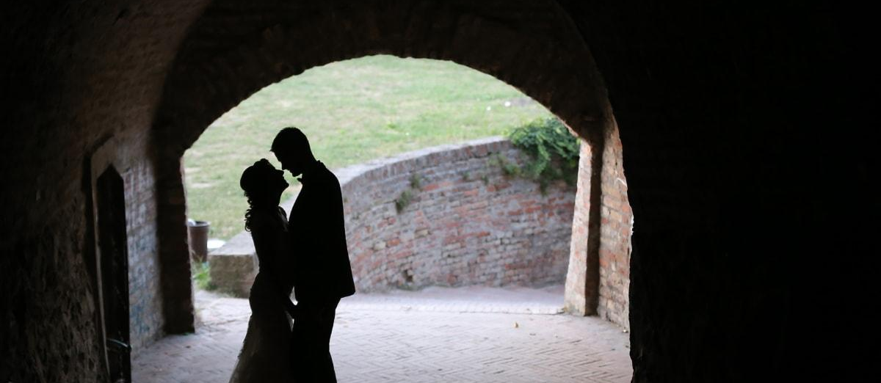



Slide 7
Summary - Ch. 19
Juan Manuel arrives at Molly’s apartment. He reveals that Rodney manipulated him into handling drugs because of his vulnerable immigration status; Rodney also threatened his family back in Mexico.
Juan Manuel reveals the long-term abuse suffered by Rodney and his cronies.
Molly wants to contact Rodney and explain herself but is told that is a bad idea.
Juan Manuals shows photos of a secret relationship between Giselle and Rodney.
The group, including Juan Manuel, agrees to create a plan to outwit the true killer and seek justice.

Slide 8
Summary - Ch. 20
Molly expresses doubt about her ability to carry out her part of the plan but is reassured by her friends.
Juan Manuel reassures Molly that sometimes negative actions are necessary for good outcomes.
Molly texts Rodney to lure him into a trap; he responds to her quickly saying he will meet her at the Olive Garden.
Despite feeling anxious, Molly’s friends offer her support before she leaves to carry out the first step of their plan.

Slide 9
Summary - Ch. 21
Molly arrives at the Olive Garden, nervous for her meeting with Rodney.
Molly tells Rodney a fake story about the police investigation regarding Mr. Black's death; she says the police now believe he was murdered and that the murder is tied to his will because Giselle didn’t receive anything.
Molly’s comments make Rodney uncomfortable and make him believe that he may be a potential suspect now.
Rodney is desperate to hide evidence; he asks Molly to clean the suite before the police arrive to “protect Juan Manuel” from being deported. Molly suggests he clean the room instead using her trolley.
Rodney leaves feeling doubtful and scared; Molly feels empowered and in control.

Slide 10
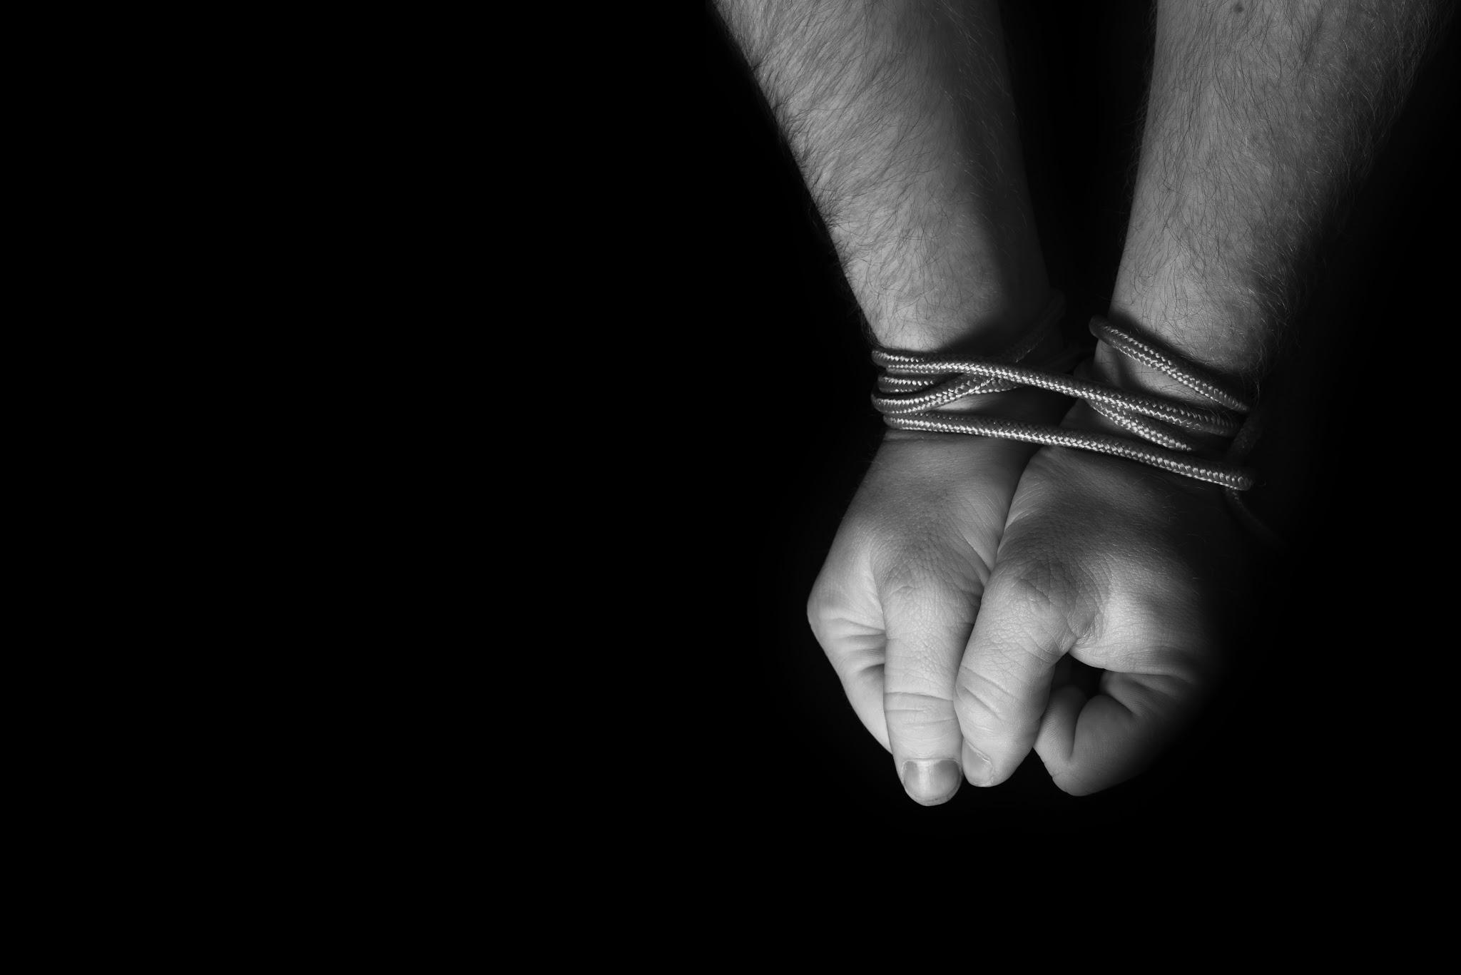
Question 1
What do we find out about Juan Manuel’s difficult situation? Why did he feel he had to work with Rodney? (Pgs. 201-203)
Can you think of a situation when someone tried to manipulate you?
How did you feel?
How did you resolve the problem?

Slide 11

Question 2
Molly is anxious about the trouble she’s in, but she also feels something else when Charlotte, Mr. Preston, and Juan Manuel are with her in the apartment (Pg. 200). What is this feeling? Why do you think she feels this way?
Can you think of a time when you felt two opposite emotions at the same time?
What happened to cause these emotions?

Slide 12
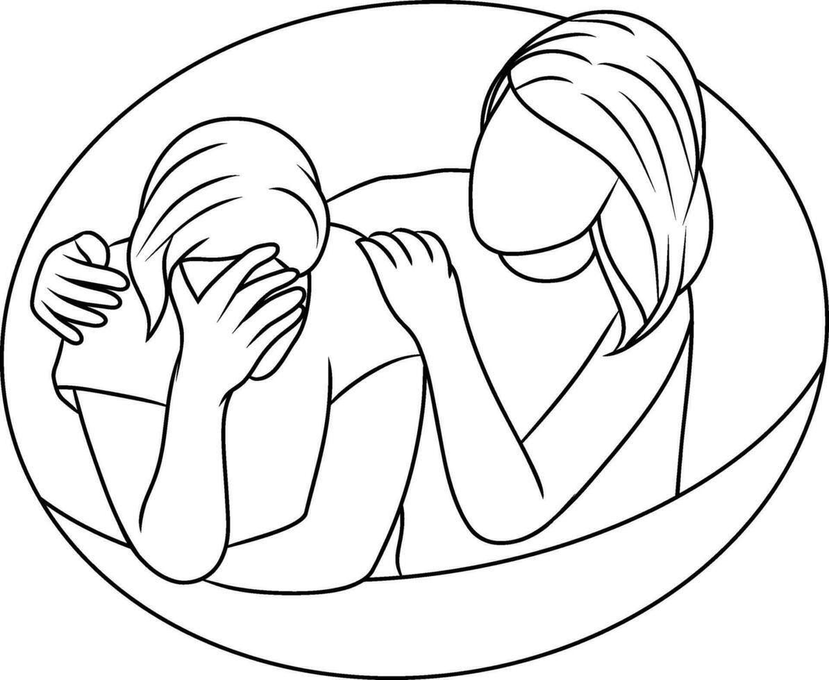
Question 3
In Chapter 20, Molly initially feels unsure and doubtful about the plan.
Given what we know about Molly, why do you think this situation is especially hard for her, even though it might clear her name? (Pg. 206)
When you feel doubt, what or who helps you find encouragement?

Slide 13

Question 4
During their meeting at the Olive Garden, how does Rodney react to Molly’s comments? (Pgs. 211-214).
What are some signs that someone is lying to you?
Think of an example from your life. There are no wrong answers!

Slide 14

Question 5
As Molly and Rodney finish their meeting, she makes Rodney pay for the meal and says, “It really is a shame you don’t like jigsaw puzzles… I don’t think you quite know the pleasure one feels when suddenly, all the pieces come together.” (Pg. 214).
What does Molly mean by this? Why is this important for her character?
Have you ever figured something out after struggling with it for a long time? What was it?
How did it feel when “all the pieces” finally came together?

Slide 15


PUT YOUR DETECTIVE HATS BACK ON.
Any changes to our suspect list?

Slide 16
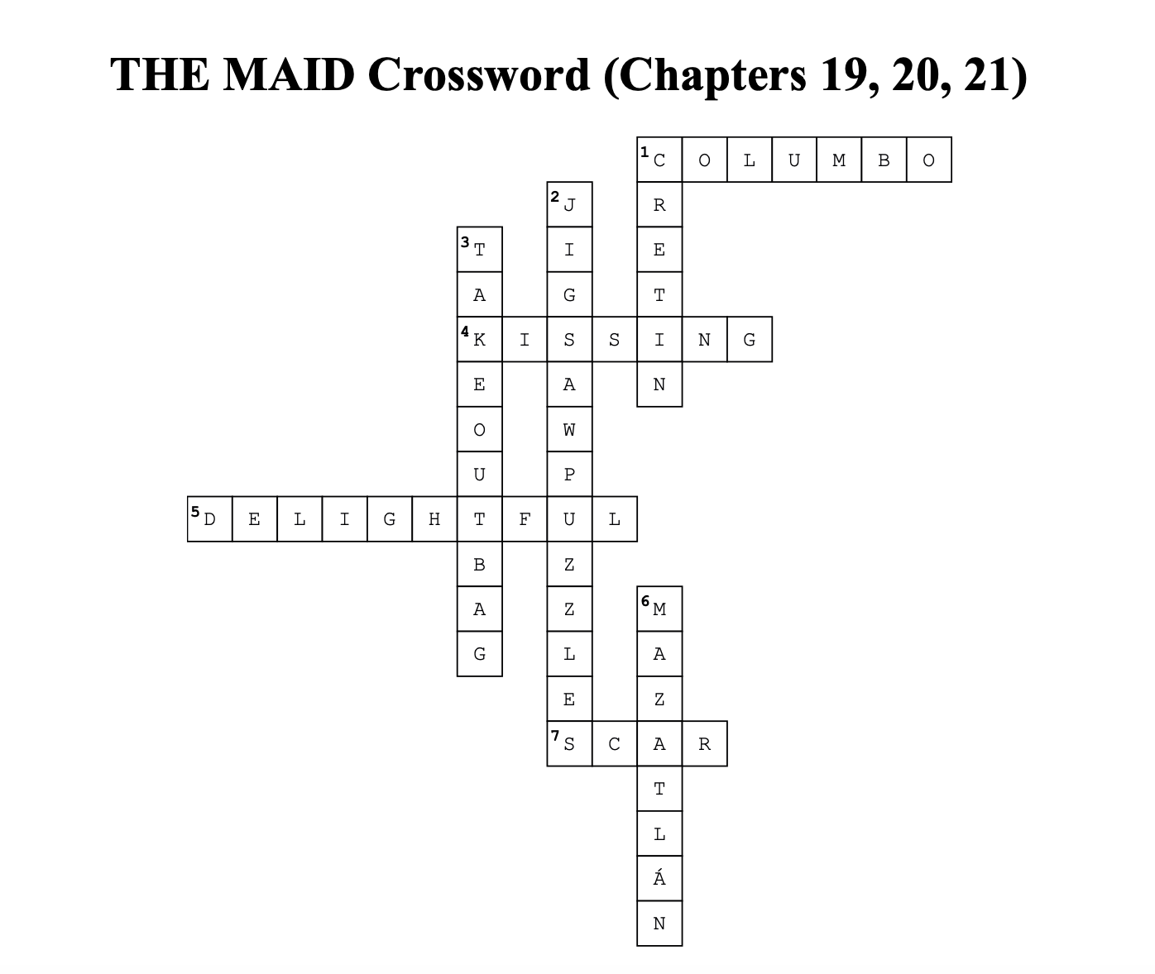

Slide 17
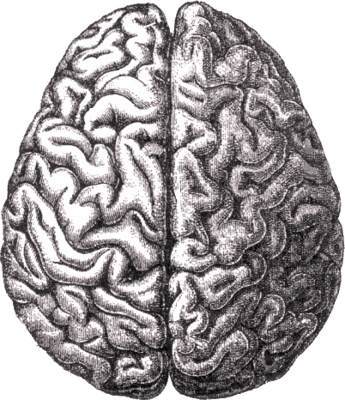
Was there any vocab or terminology that was difficult to understand?

Slide 18

Next week: Chapters 22, 23, 24
Any new suspects or predictions … ?

