Slide 1

THE MAID
Chapters 6 & 7

Slide 2

Character List
Molly
- Narrator; maid at the hotel
Mr. Snow
- Hotel manager
Mr. Black
Wealthy businessman who is a regular guest at the hotel
Giselle Black
- Mr. Black's second wife
Mrs. Black
- Mr. Black's first wife

Slide 3
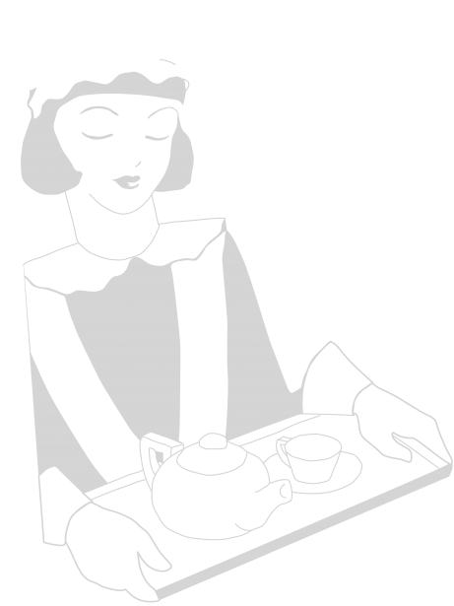
Character List (cont.)
Victoria Black
Mr. Black’s daughter
Mr. Preston
Hotel Doorman
Rodney Stiles
- Hotel bartender; Molly’s current crush
Cheryl (“Chernobyl”)
- Molly’s lazy, cheating supervisor
Sunshine & Sunitha
- Molly’s fellow maids
Juan Manuel
Hotel dishwasher having financial problems
Mr & Mrs. Chen
- Regular guests at the Regency Hotel
Detective Stark

Slide 4
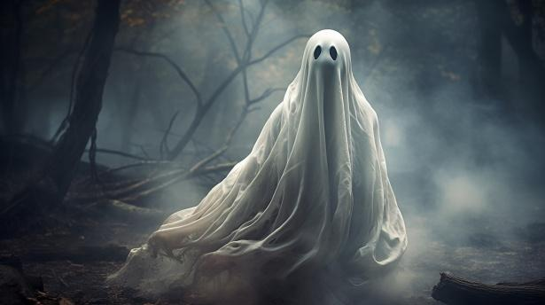

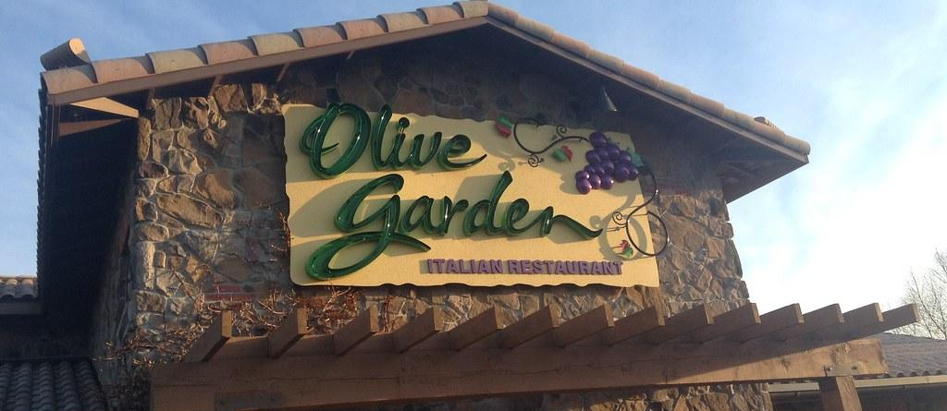


Slide 5
Summary
Molly has a nightmare about Mr. Black’s corpse in her living room.
Molly’s landlord, Mr. Rosso, confronts her about her overdue rent
Mr. Preston, the Doorman at the hotel, expresses his concern for Molly after finding the dead Mr. Black
Mr. Snow addresses the negative press the hotel is getting in the wake of Mr. Black’s death; he questions Molly about seeing any suspicious activities, which she denies.

Slide 6
Summary
Mr. Snow reveals Giselle Black is still at the hotel during the ongoing investigation into Mr. Black’s death. He tells her not to share this info.
Molly tries to return to the comfortable routine of being a maid at the hotel.
Juan Manuel expresses his concern about the future of the hotel and is a bit cryptic about who is really “the boss” around town.
Molly encounters Rodney at the hotel bar, and notices his bruised eye, which he brushes off as an accident. Rodney invites Molly to meet after work to probe about the incident with Mr.. Black.

Slide 7
Summary
Molly reminisces about her past with Rodney, and recalls a particular incident in which she accidentally walked in on Rodney, Juan Manuel and two unknown men in a supposedly vacant hotel room.
At the time, Rodney showed protectiveness over her; he discreetly conveys to the other men that Molly is trustworthy and won’t tell anyone about them being in the room. Rodney invites Molly to Olive Garden later on to explain everything.
On their “date”, Rodney reveals Juan Manuel’s undocumented status as an immigrant and his precarious financial & living situation. He asks for Molly’s discretion and assistance. She gladly agrees, and compares Rodney to Robin Hood.
The night ends with an awkward kiss, and despite the imperfections of the moment, the protagonist feels elated by Rodney's affection.
Molly encounters Rodney at the hotel bar, and notices his bruised eye, which he brushes off as an accident. Rodney invites Molly to meet after work to probe about the incident with Mr.. Black.

Slide 8

Question 1
Molly misunderstands Juan Manuel when he asks, “who will be the boss now” after the powerful Mr. Black’s death. Do you think Molly’s thinking is too “black and white” in the way she views order and authority?
How might this get her, or anyone, into trouble? (Pg. 78).

Slide 9

Question 2
Molly says she can tell Rodney is “laughing with” rather than “laughing at” her. Do you agree with this? Think about evidence for both sides (Pg. 93).
Like Molly, has it ever been hard to know when people were “laughing with” or “laughing at” you?

Slide 10

Question 3
What is Rodney’s true motivation for his “date” with Molly? How does Molly perceive the interaction? (Pgs. 90-94)
Have you ever overlooked red flags when getting to know someone for the first time? When you look back, do they seem obvious now?

Slide 11

Question 4
Who seems to be particularly distrustful of Rodney? Have you ever had a bad gut feeling about someone (like someone a friend/loved one was dating)? How did you navigate or deal with that? (Pg. 89)

Slide 12

Question 5
Although she is not supposed to, Molly informs Juan Manuel about where to stay for the night and tells him that Giselle is still in the hotel while the investigation is ongoing. If Molly is such a rule follower, why does she do this? Does this make her a hypocrite? (Pg. 78)

Slide 13


PUT YOUR DETECTIVE HATS ON. Who do we suspect so far?

Slide 14
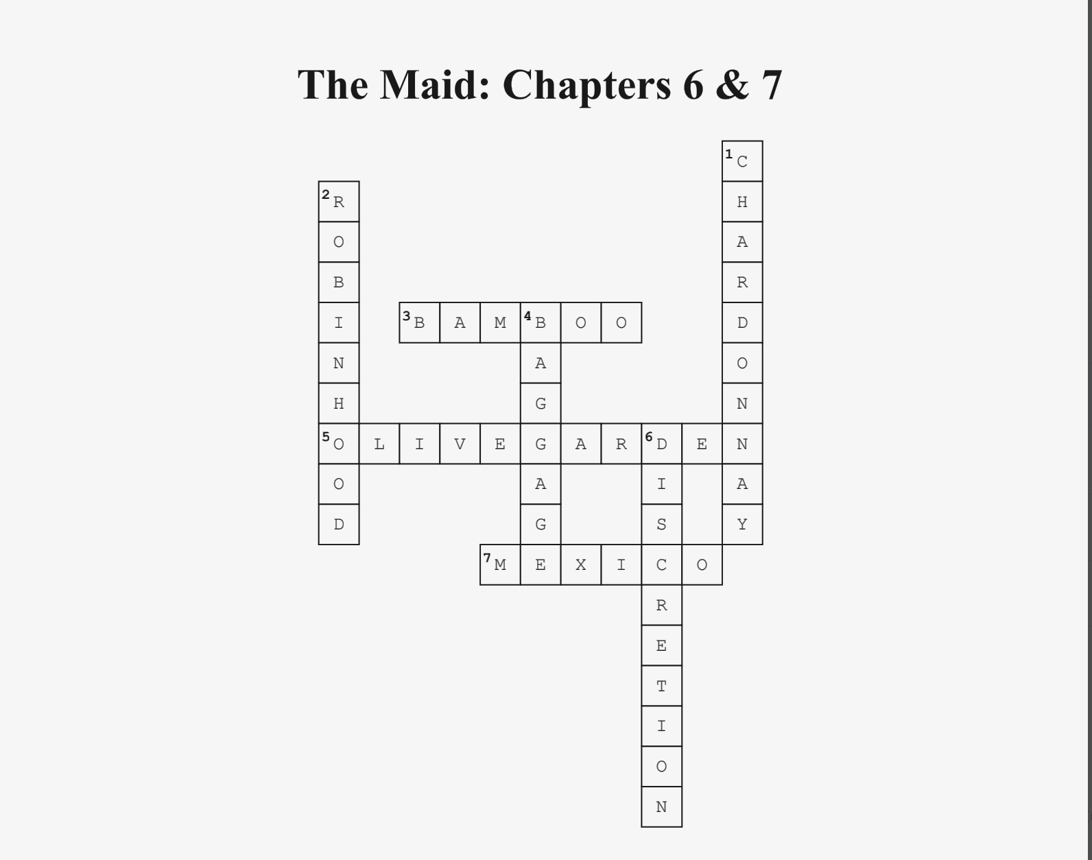

Slide 15
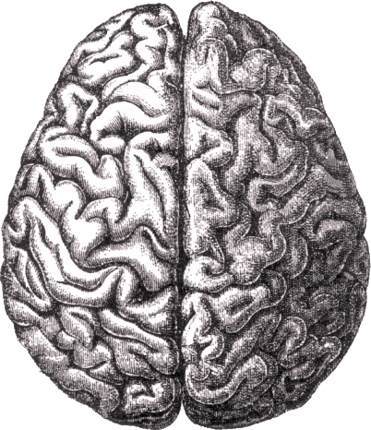
Was there any vocab or terminology that was difficult to understand?

Slide 16
Next week: Chapters 8 & 9
Any new suspects or predictions … ?

