Slide 1
Welcome!
Aphasia Group 1/14/25
Lead: Madelyn Kulman

Slide 2

Journals
Journals provide additional opportunities for language practice
Last week's prompt: What are three things you can't live without? Why?

Slide 3
Journals
This week's prompt:
What habits do you want to break?

Slide 4
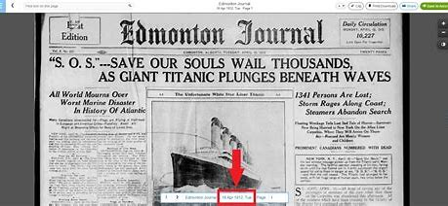
Current Events?

Slide 5
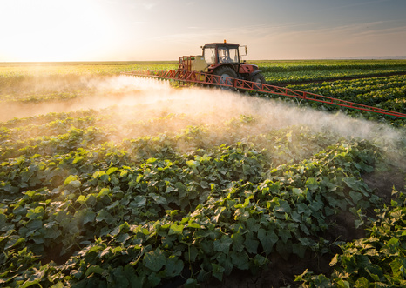
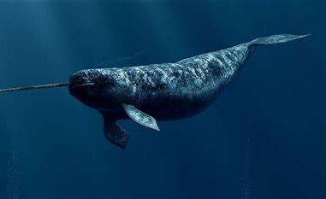
In the news..
Notes:
Report Harmful pesticides found in CT rivers groundwater / Public News Service
Rare Narwhal Footage Shows They Use Their Tusks To Explore, Play, And Forage

Slide 6
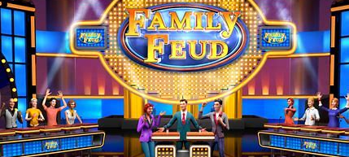
Family Fued
Notes:
THE FAMILY FEUD GAME | THE SURVEY GAME

Slide 7
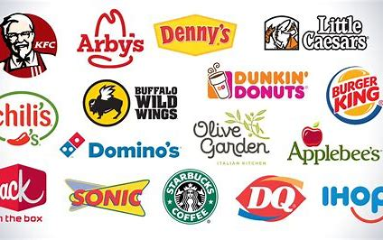
Debate
Fast Food
Good or Bad?

Slide 8
Thank you! See you next week!

