Slide 1
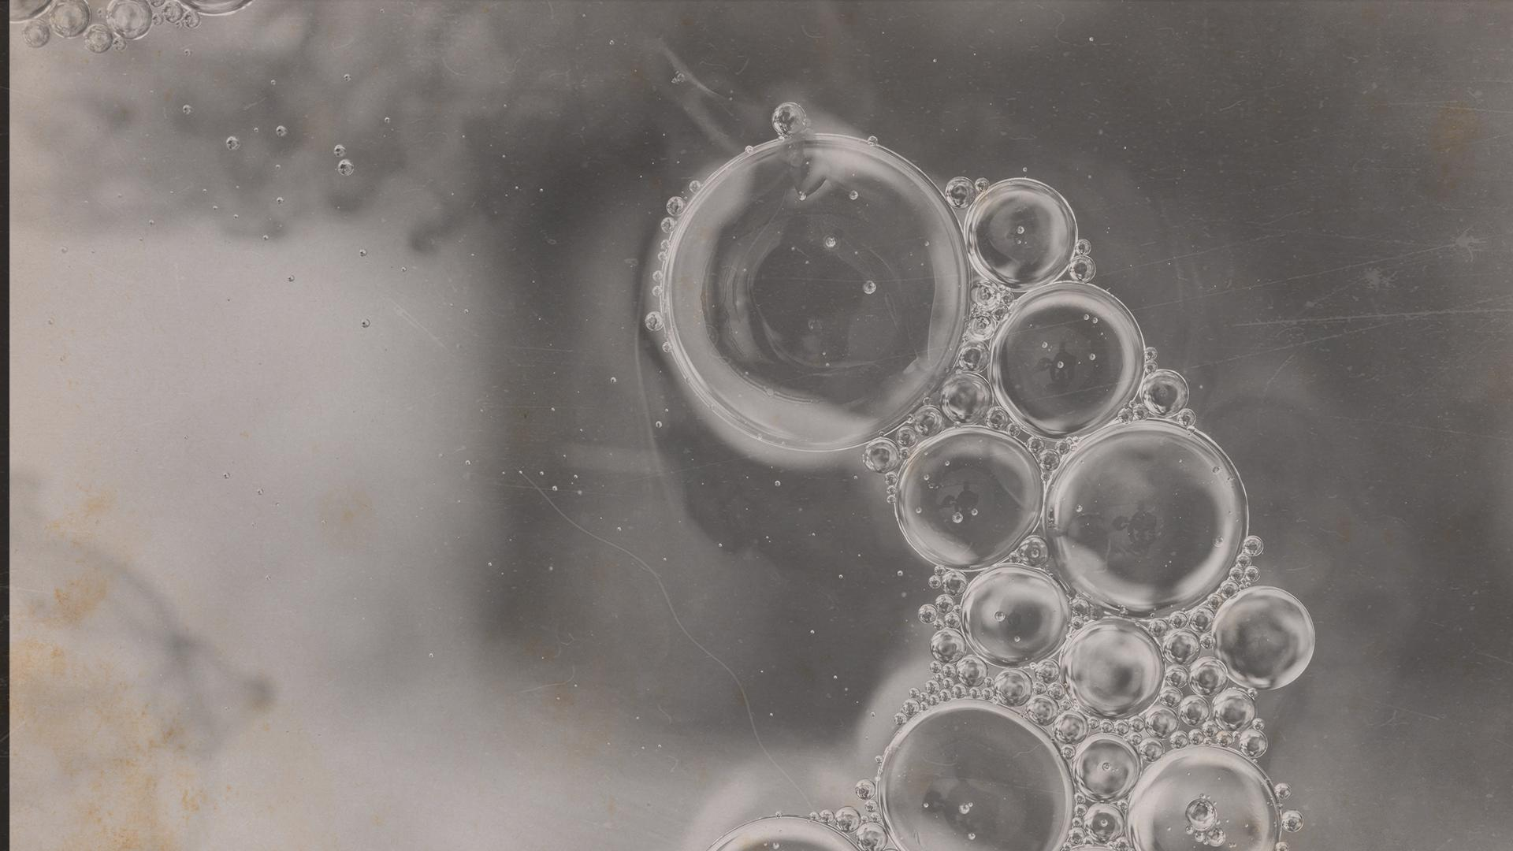
The Maid: Prologue + Chapter 1
HOMICIDE
Happy Friday!

Slide 2
Weekly check-in
How was everyone’s week?
  Highs
  Lows
  Updates

Slide 3
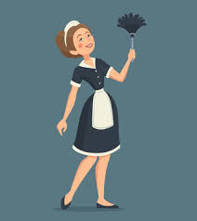

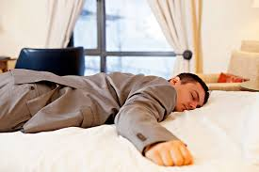
Summary

Slide 4
Summary
Molly Gray, 25, works as a maid at Regency Grand Hotel
Molly was raised by her beloved Gran, who passed away nine months ago
Molly takes pride in her work and likes her job. Her boss is Mr. Alexander Snow, the hotel manager.
Molly has discovered a hotel guest, Mr. Charles Black, dead in his bed
There are some possible clues with his body:
    There are blue pills on the table and floor, the safe is open with items missing, and one of the usual four pillows on the bed are gone.
    Upon realizing Mr. Black is dead, Molly calls the front desk to tell them and then faints.

Slide 5
Character List
Molly: Narrator, maid at hotel
Mr. Snow: Hotel manager
Juan Manuel: Hotel dishwasher
Mr. Black: Wealthy businessman who is a regular guest at the hotel, was found dead
Giselle Black: Mr. Black’s second wife

Slide 6
Question 1
How does Molly, describe herself in Chapter One? What was your first impression of Molly?
Reflecting on your own experiences, do you believe that first impressions of people can evolve over time? Have you ever had a situation where your initial judgment of someone changed?

Slide 7

Question 2
Molly takes pride in her work as a maid and finds comfort in the routine of it (page 9). What does this say about her character? Do you think your work/job played a significant role in your own identity?

Slide 8
Question 3
What aspects of Molly's character make you feel empathetic toward her?
Do you feel connected to Molly in any way? What do you wish society knew about aphasia and communication?

Slide 9
Question 4
How does Molly react to discovering Mr. Black’s body (page 16)? What are your initial thoughts about the circumstances of Mr. Black’s death? How do the details in the room suggest foul play or an accident?
When faced with difficult or shocking situations, how do you typically react? Do you think people respond differently under pressure, and what factors influence your response?

Slide 10
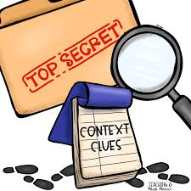
Question 5
Are there any moments in Chapter 1 that might hint at events to come or provide clues about the mystery element of the novel?

Slide 11
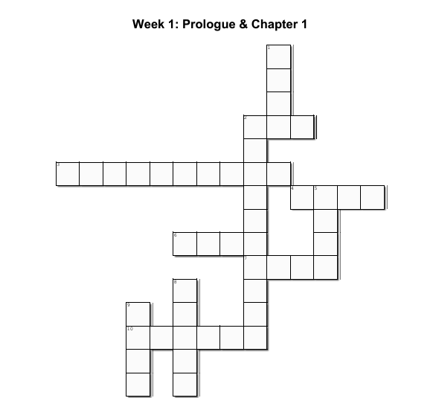
2 Across:
What did Molly drink after finding the guest dead?
T e a

Slide 12
3 Across:
What is Juan Manuel’s job?
T e a
D i s h w a s h e r

Slide 13
4 Across:
The hotel manager’s name is Mr. Alexander _______
T e a
D i s h w a s h e r
S n o w

Slide 14
6 Across:
Molly’s last name
T e a
D i s h w a s h e r
S n o w
G r a y

Slide 15
7 Across:
How many stars is the Regency Grand Hotel?
T e a
D i s h w a s h e r
S n o w
G r a y
F i v e

Slide 16
10 Across:
The wrapped soaps smell of ______ blossom?
T e a
D i s h w a s h e r
S n o w
G r a y
F i v e
O r a n g e

Slide 17
1 Down
What color pills were found next to the dead guest?
B
l
u
T e a
D i s h w a s h e r
S n o w
G r a y
F i v e
O r a n g e

Slide 18
2 Down
How old is Molly?
B
l
u
T e a
w
D i s h w a s h e r
n
t
S n o w
G r a y
F i v e
i
v
O r a n g e

Slide 19
5 Down
The number of months since Gran died?
B
l
u
T e a
w
D i s h w a s h e r
n
t
S n o w
i
n
G r a y
F i v e
i
v
O r a n g e

Slide 20
8 Down
Mr. ___ was found dead in his bed?
B
l
u
T e a
w
D i s h w a s h e r
n
t
S n o w
i
n
G r a y
F i v e
B
l
i
v
O r a n g e
c
k

Slide 21
9 Down
The number of plump pillows on the bed?
B
l
u
T e a
w
D i s h w a s h e r
n
t
S n o w
i
n
G r a y
F i v e
B
l
i
v
F
O r a n g e
u
r
c
k

Slide 22
Next Week
Chapters 2 and 3
Any predictions?

