Slide 1

The Maid
Chapters 8 & 9

Slide 2
Character List
Molly – Narrator; maid at the hotel
Mr. Snow – Hotel manager
Mr. Charles Black – Wealthy businessman who is a regular guest at the hotel
Mrs. Giselle Black – Mr. Black's second wife
Mrs. Black – Mr. Black's first wife
Victoria Black – Mr. Black's daughter
Mr. Preston – Hotel doorman
Wilbur Brown – Molly's ex-boyfriend

Slide 3
Character List
Rodney Stiles – Hotel bartender; went on a date with Molly last year and a second date after Mr. Black’s death
Cheryl ("Chernobyl") - Molly's supervisor
Sunshine & Sunitha – Molly's fellow maids
Juan Manuel – Hotel dishwasher; Molly gives him a key card because he is going through financial difficulties
Mr. & Mrs. Chen – Regular guests at the hotel whose room Molly cleans
Detective Stark – Detective investigating Mr. Black's death
Mr. Rosso – Molly’s landlord who demands his rent

Slide 4
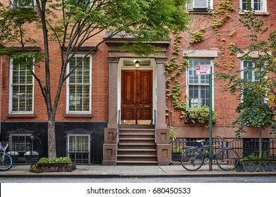

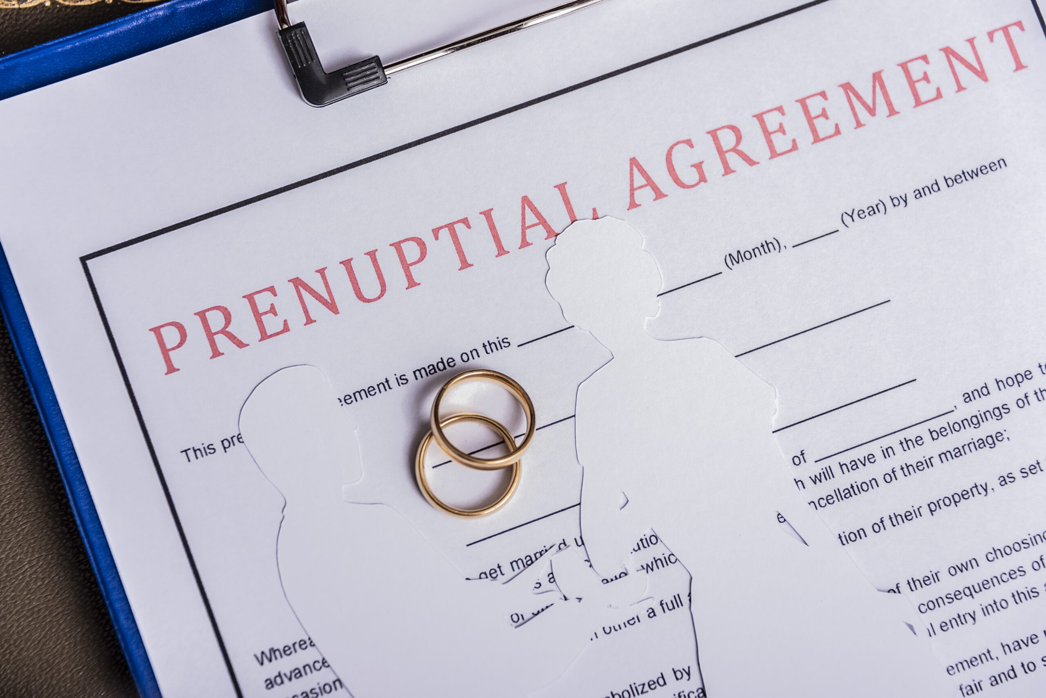
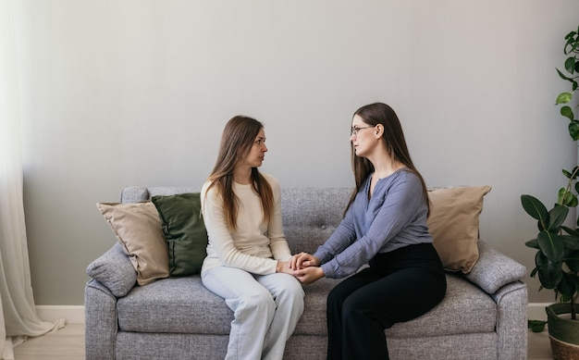
Summary

Slide 5
Summary
Molly goes on a second date with Rodney – he asks her about what she talked to the cops about
Mr. Preston warns Molly about Rodney
Giselle shows up at Molly’s front door
Giselle tells Molly she is from Detroit and didn’t always have a luxurious lifestyle
Giselle says that the police extensively questioned her and Victoria Black now owns over half of Mr. Black’s company

Slide 6
Summary
Giselle tells Molly about the fight she had with Mr. Black the day before – she asked him to cancel the prenup or put a villa in her name
During their fight, Mr. Black accused Giselle of taking advantage of him and his money
Molly ensures Giselle that she didn’t volunteer any information to the police about her and Mr. Black’s relationship

Slide 7


Question 1
Why does Rodney ask Molly on a second “date”? Why is he wondering if the cops were asking about him? How do you think Molly feels about Rodney?

Slide 8
Question 2 & 2a
What does Mr. Preston say about Rodney? What was he warning Molly about? (pg. 98)
If you could give Molly advice at this point, what would you say to her? Have you ever gotten advice that has stuck with you? Is there any advice that you wish you got?

Slide 9
Question 3
Molly mentions that Gran and her always did a puzzle around Christmas time. Are there any traditions that you always did with your family growing up? Are there any traditions that you do now with family or friends?

Slide 10

Question 4
Giselle shows up at Molly’s doorstep to confide in her (pg. 101). What do you think about this friendship? Who or what do you turn to when you need to decompress?

Slide 11

Question 5
Giselle explains social norms to Molly without being condescending. Is there anyone in your life that you saw as a mentor? Is there anyone that you mentored?

Slide 12
Question 6
Molly never knows what anyone else is thinking. She makes judgements about Giselle and her past life. Does what Giselle revealed about her life make you think differently about her (pg. 105)? Do you think it would be better or worse in your own life if you always knew what people were thinking? Why?

Slide 13
Any new suspects or Predictions?

Slide 14
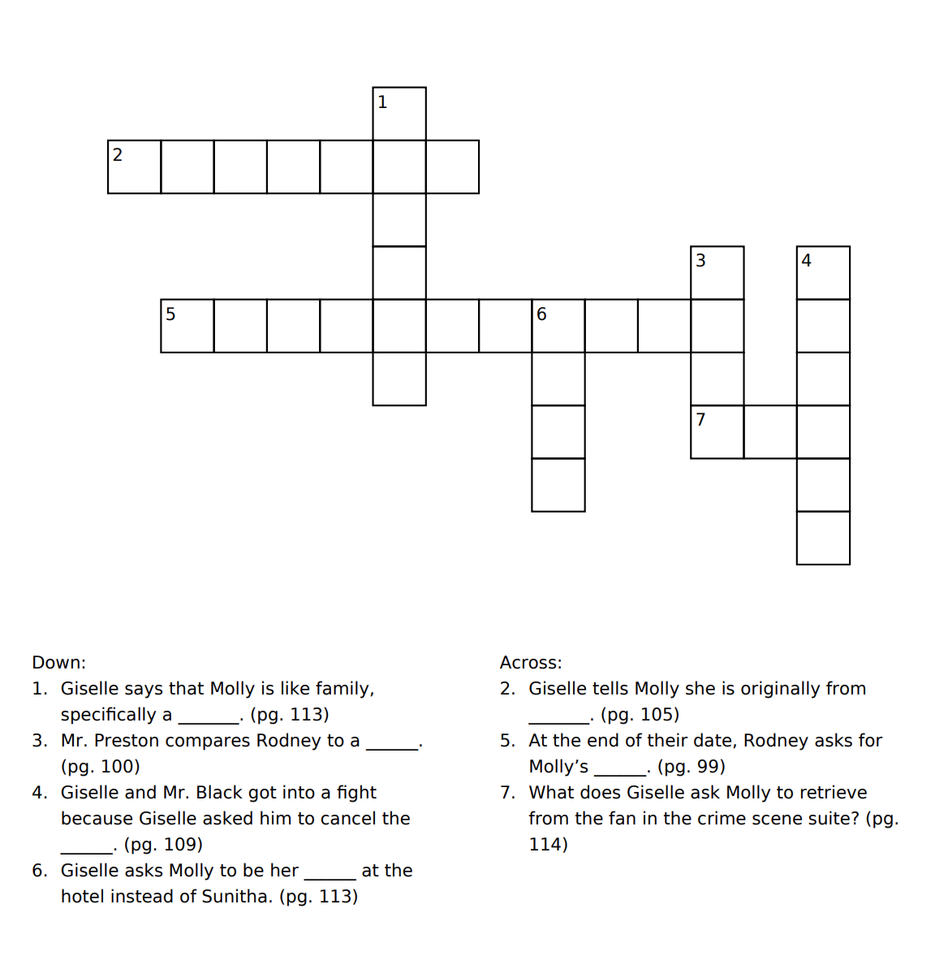
crossword

Slide 15
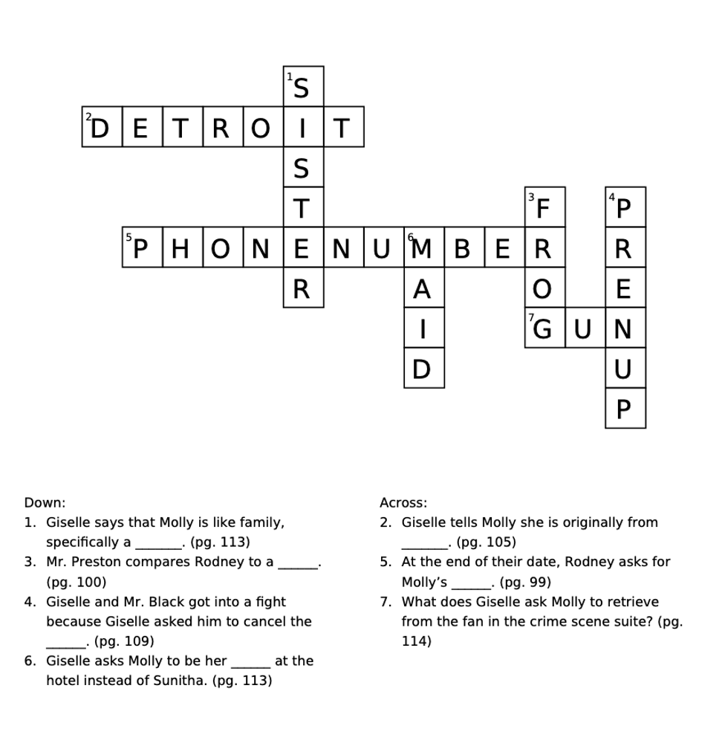
Crossword Answers

