Slide 1
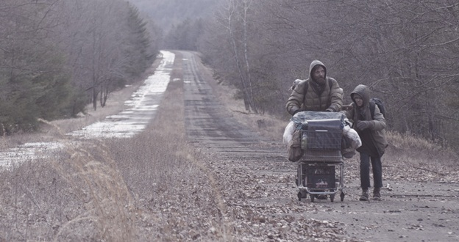
The Road
Pages 102-130

Slide 2


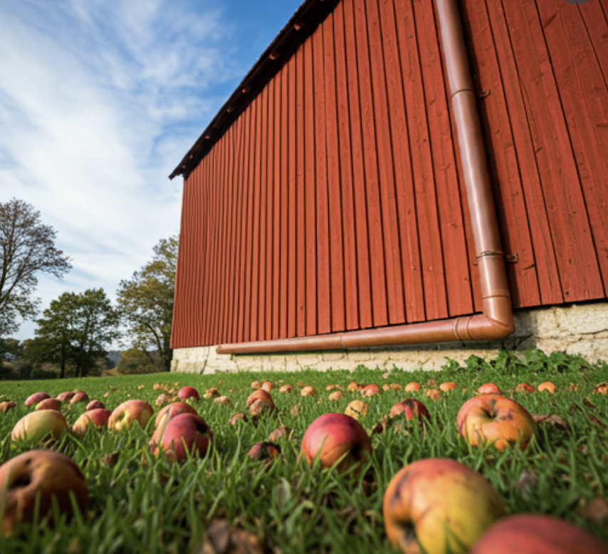
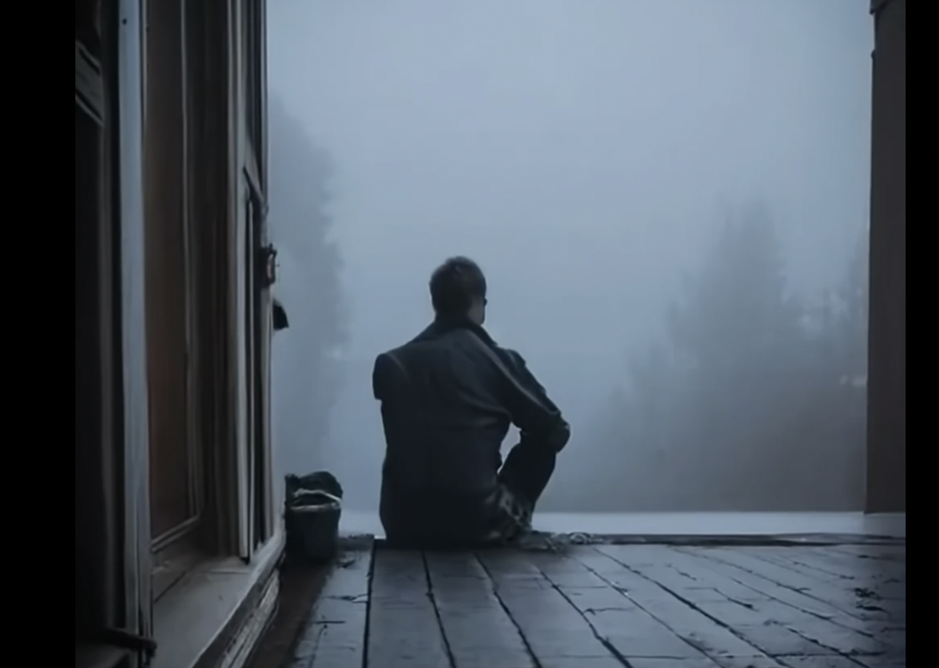

Slide 3
Summary
They go into the woods to escape people that may be coming
Find the big white house with the people inside (those in the basement and the ones that chase them)
Man and son run from the people
Hide out in the woods that night

Slide 4
Summary
Man leaves the boy asleep and finds a barn
Gets apples and water that they eat for a couple of days
They go into town and see what the world was before
They talk about how they are the "good guys"
Go through some houses and the man comes to the realization that they are in an endless universe where they are being hunted and they are on borrowed time

Slide 5
1. On page 102 the man studies his son, looking at him as he slept, “a strange beauty” he says. He seems to do everything for his son. Is there anyone in your life who you would do anything for?
1. On page 102 the man studies his son, looking at him as he slept, “a strange beauty” he says. He seems to do everything for his son.
Is there anyone in your life who you would do anything for?

Slide 6
2. On pages 105 & 106, the man and the boy see a house. Describe what the house looks like. What is still intact? What does the man think they will be able to find in there?

Slide 7
1. On page 102 the man studies his son, looking at him as he slept, “a strange beauty” he says. He seems to do everything for his son. Is there anyone in your life who you would do anything for?
3. On page 113, the people from the house are chasing the man and boy. The man and boy are hiding but they can hear their voices. The man contemplates distracting the people to save his son.
What do you think the man is thinking right now?
How would you be feeling in this moment?

Slide 8
1. On page 102 the man studies his son, looking at him as he slept, “a strange beauty” he says. He seems to do everything for his son. Is there anyone in your life who you would do anything for?
4. On page 128, the boy asks his father if they would ever have to eat anyone. The father responds that they would never and that they are the “good guys”. It seems the father and boy have morals they have held onto. Are there any morals that you have taught your children or that your parents taught to you??

Slide 9
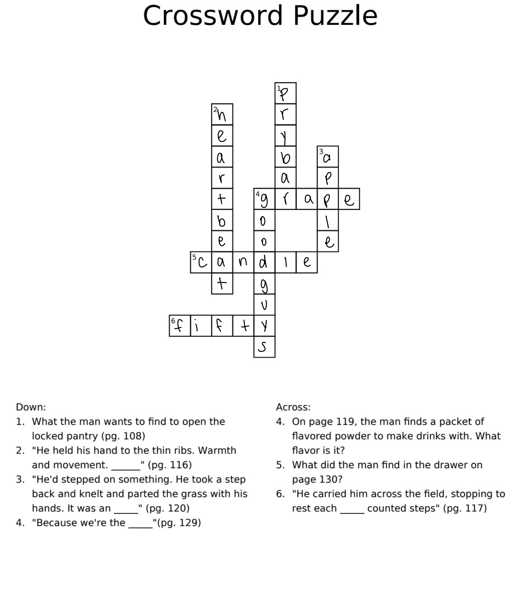

Slide 10

Are there any words or passages that were interesting or confusing?

Slide 11
Evaluation of Gait Adaptation in Post-Stroke Individuals
Presented By: Noah Davidson

Slide 12

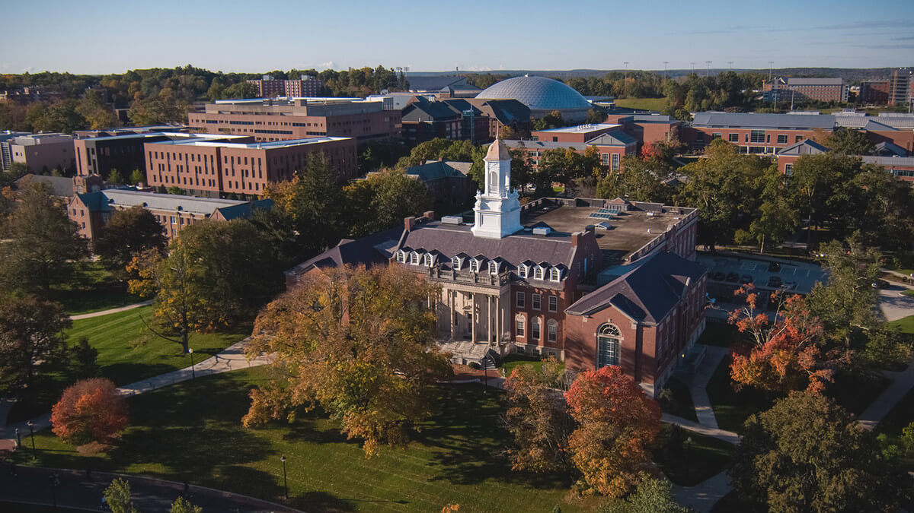
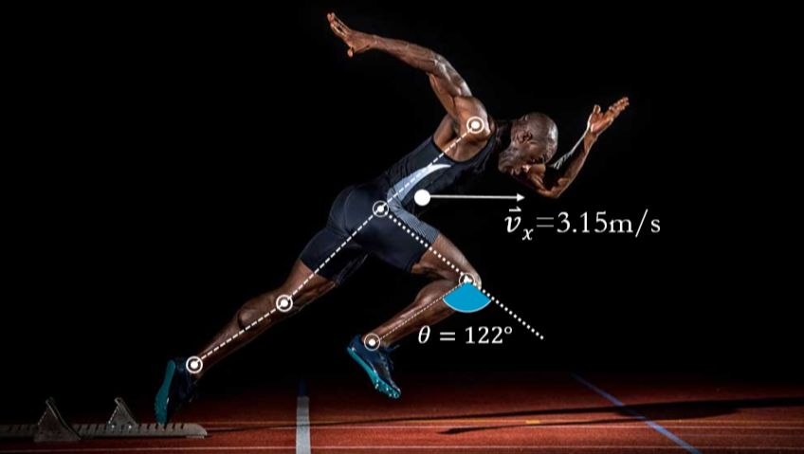
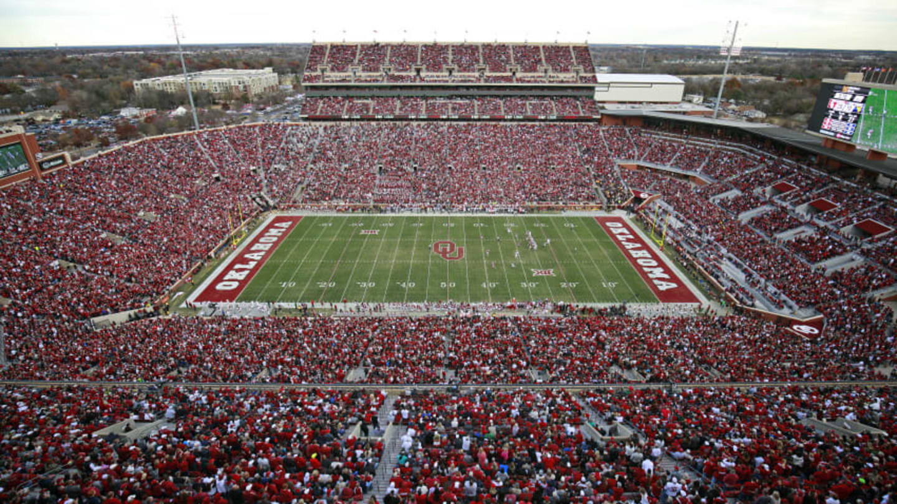


Introductions: About Me

Slide 13
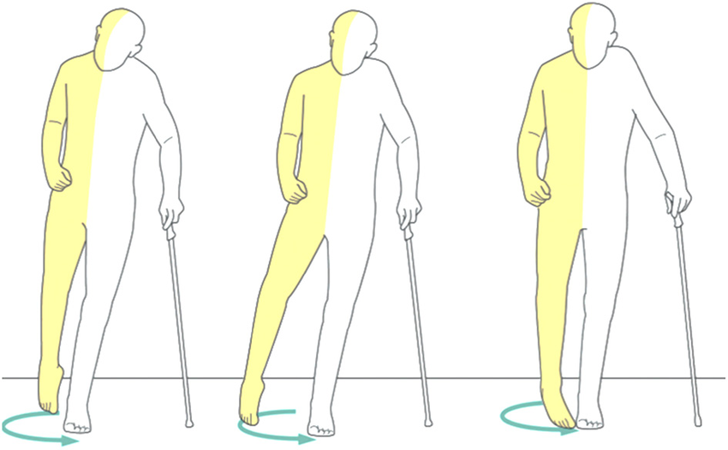


Purpose of the Study
Asymmetry
Walking Speed
Quality of Life

Slide 14

Walking Details
Twice per week, 4 weeks
Condition | Baseline 0.5 m/s | Baseline 1.0 m/s | Asymmetric | Post-Adaptation | Post-Adaptation | Asymmetric | Post-Adaptation | Post-Adaptation
Time | 3 minutes | 3 minutes | 10 minutes | 3 minutes | 3 minutes | 10 minutes | 3 minutes | 3 minutes
Treadmill Configuration

Slide 15
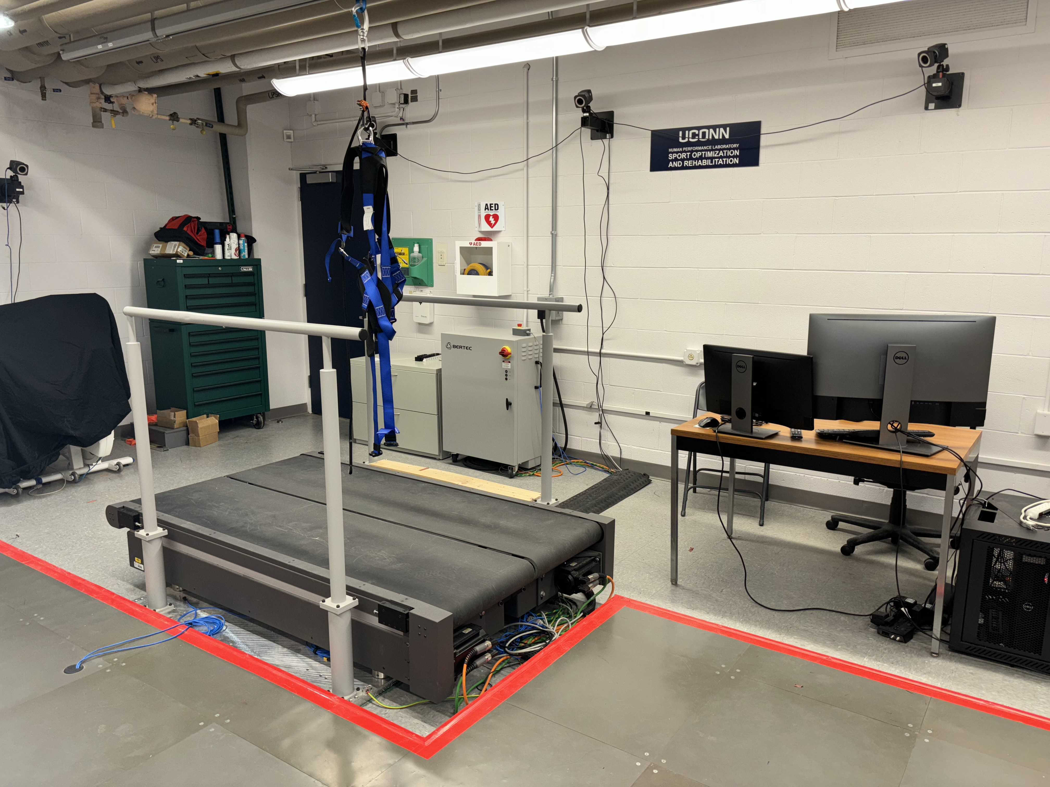
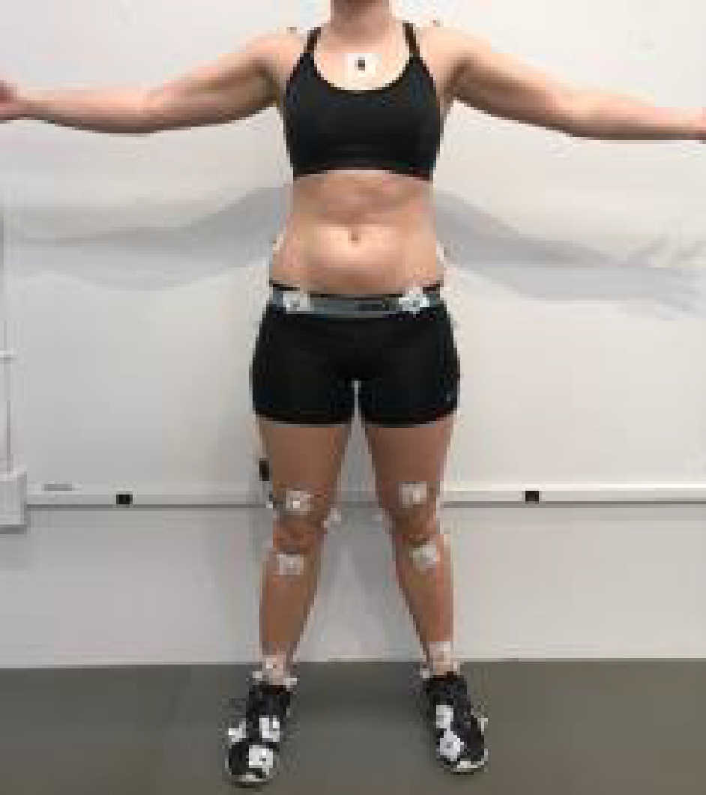
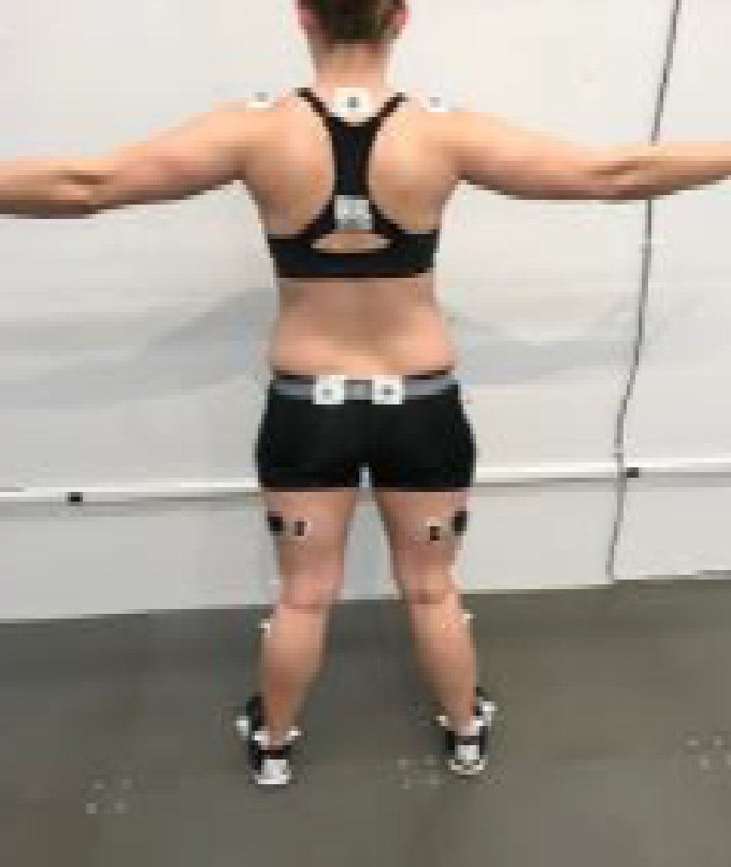
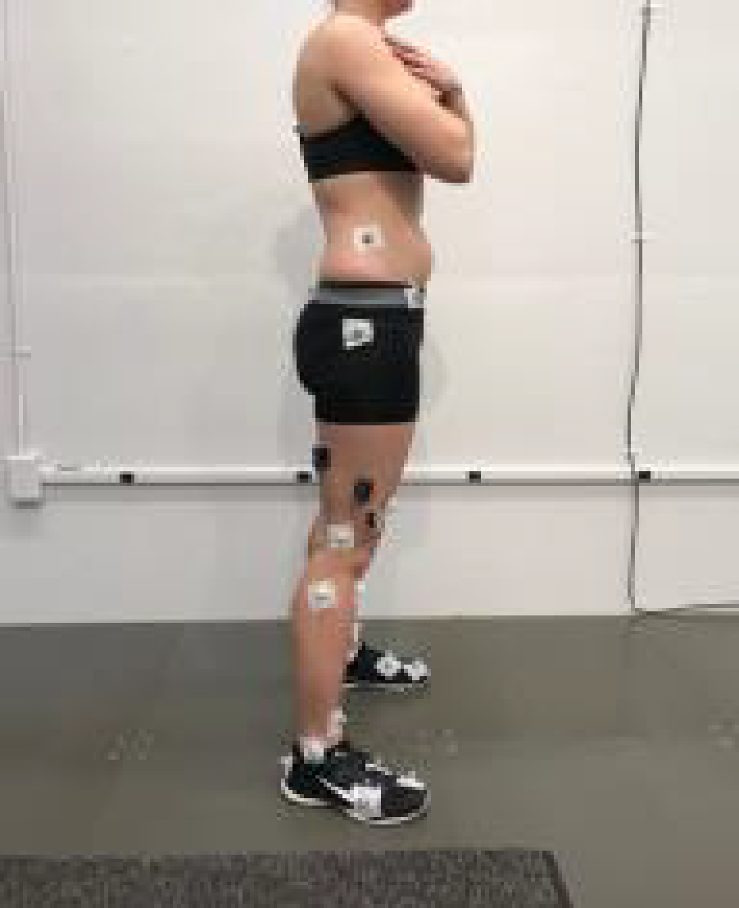

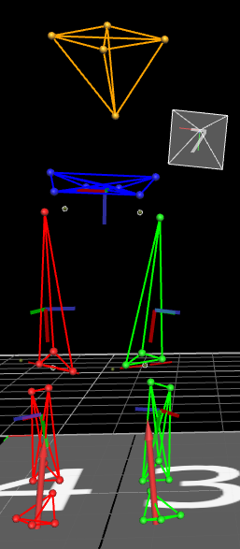
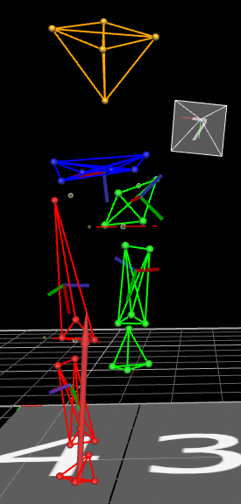
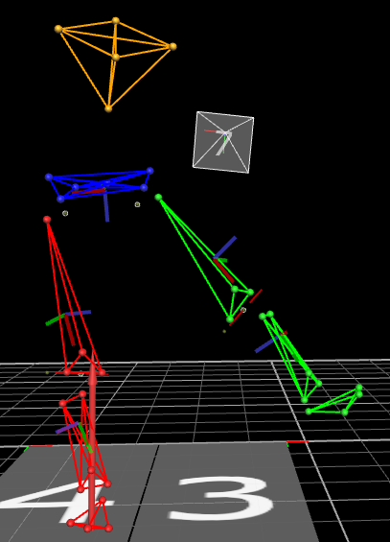
The Lab

Slide 16
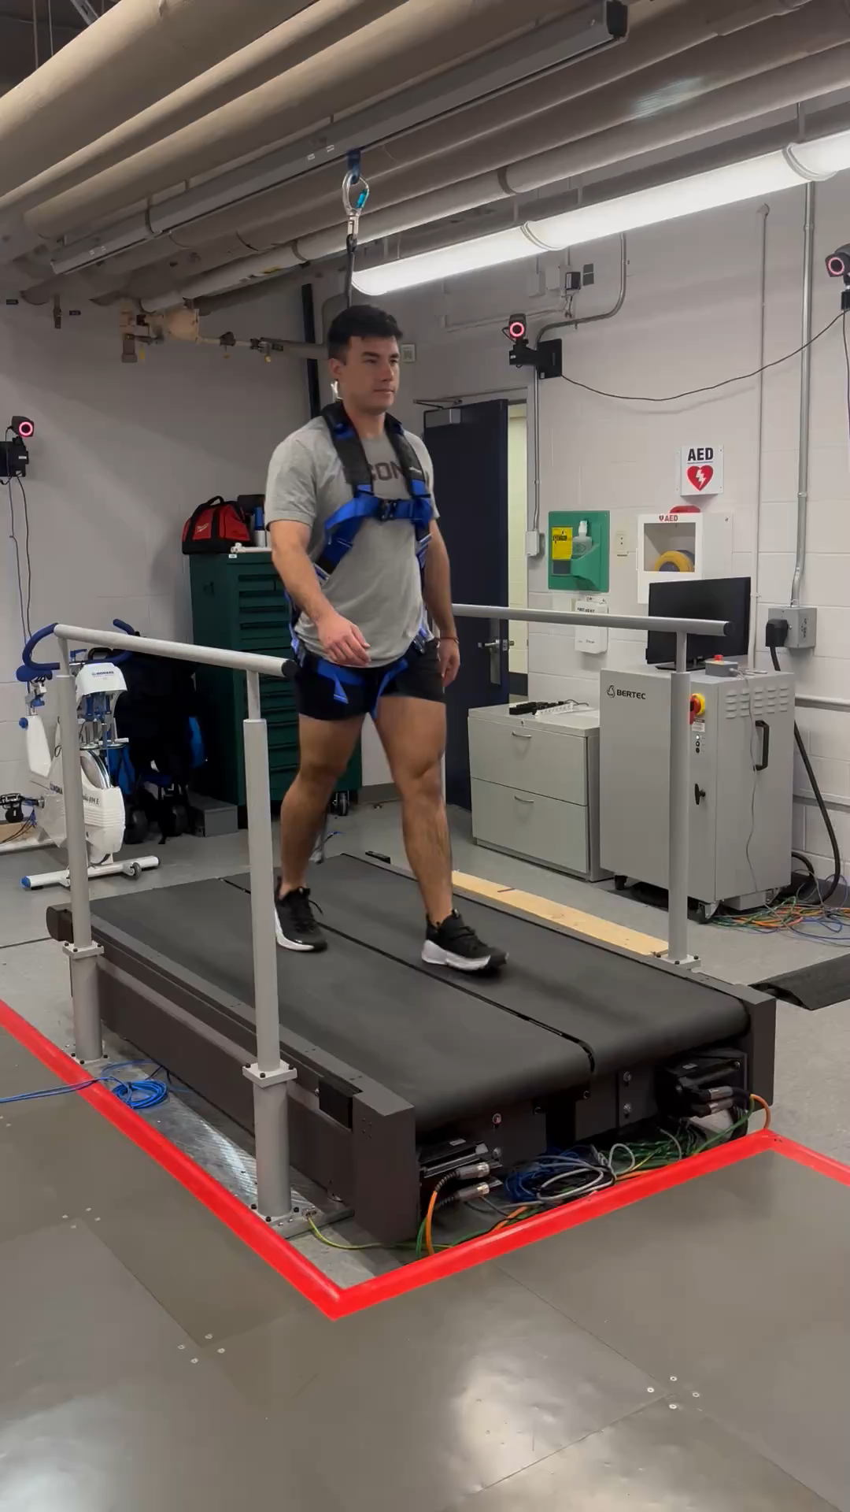
The Lab

Slide 17
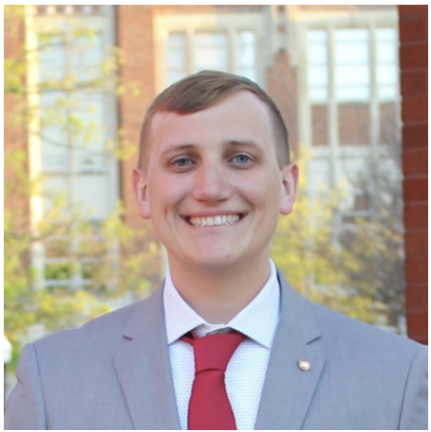

The Team + Conclusions
Noah Davidson
PhD Student
noah.davidson@uconn.edu
Dr. Kristin Morgan
Associate Professor
kristin.2.morgan@uconn.edu

