Slide 1
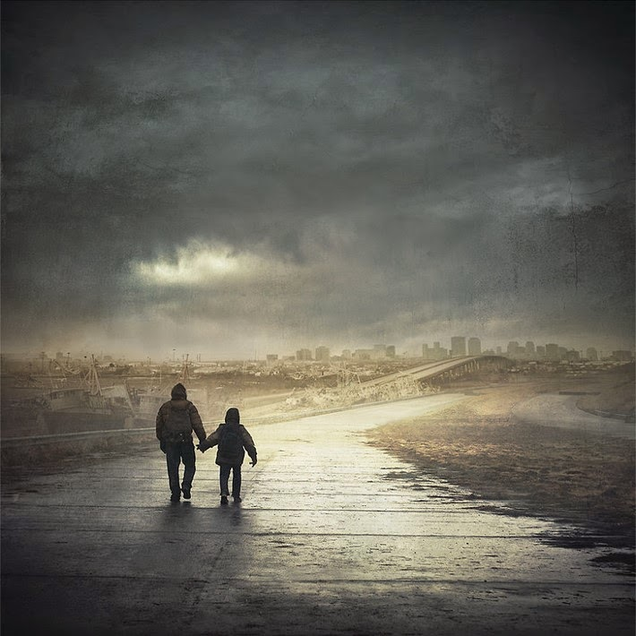
The road pages 159-175
November 1, 2024

Slide 2
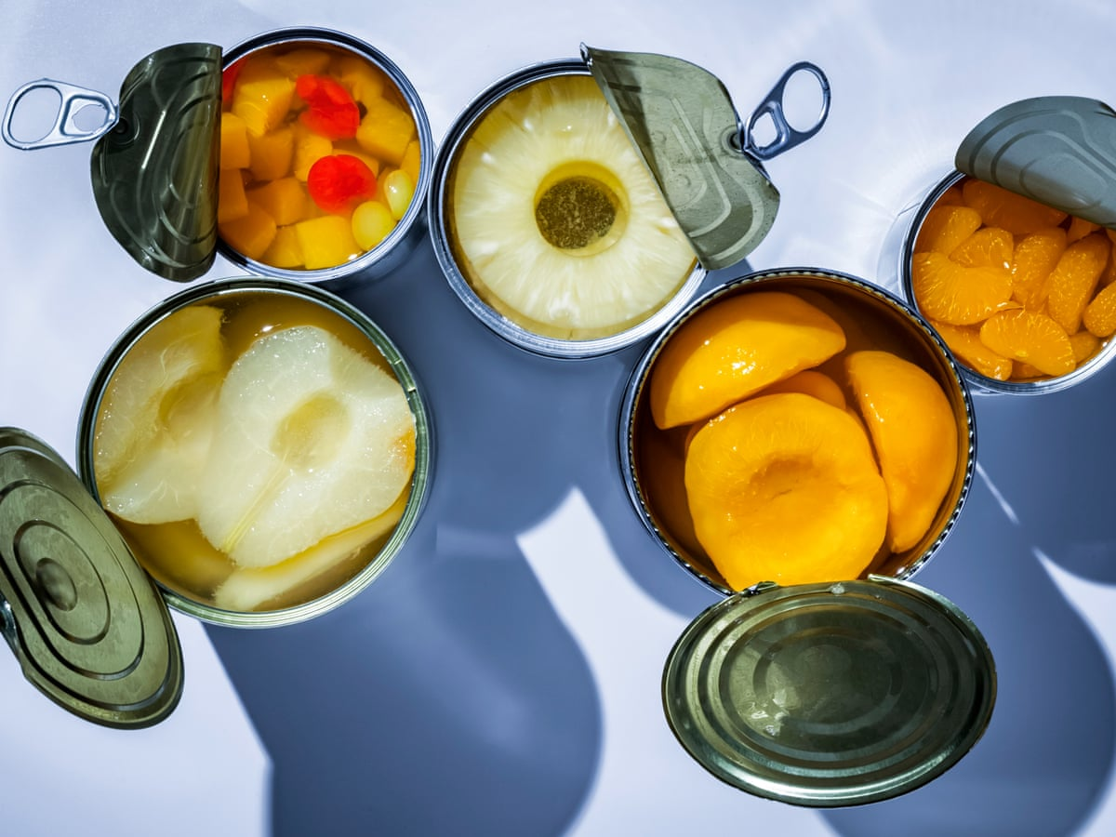
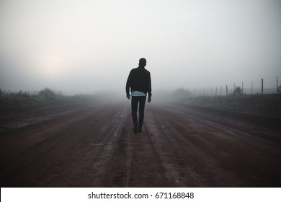
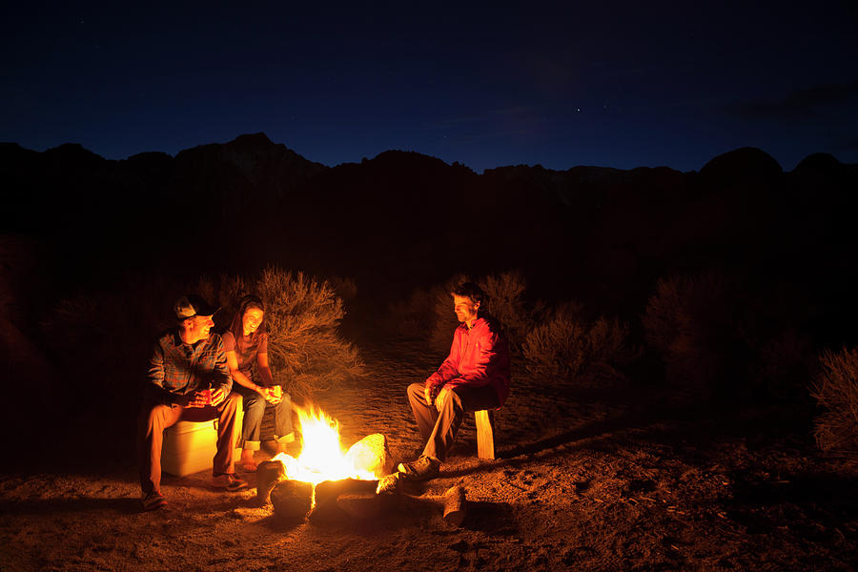

Slide 3
Summary
Man and boy encounter an old man alone
The boy wants to help the old man and gives him food
The man and boy stopped and shared a meal with the old man
The old man says his name is Ely but admits that's not his real name
The father and son argue about giving Ely more food in the morning
Ely refuses to thank the boy
The father's cough worsens

Slide 4
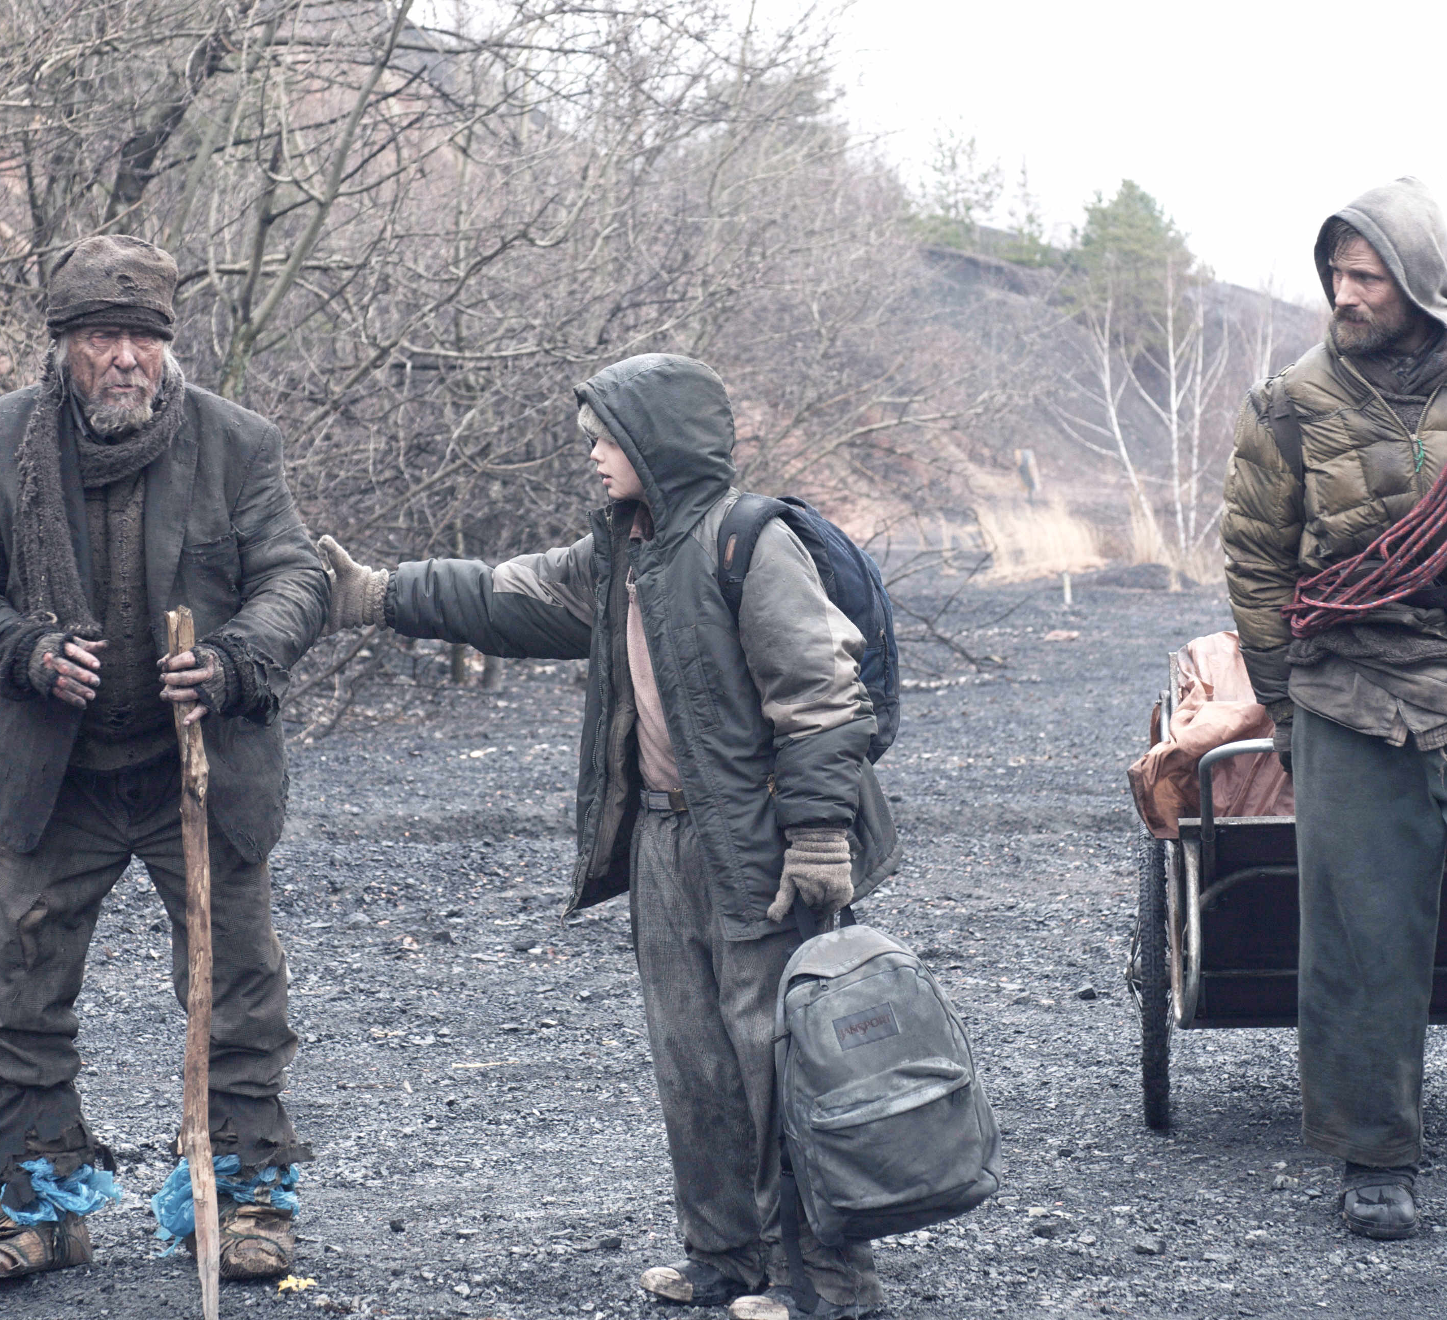
On page 161, the man and boy encounter an old man travelling alone and stop to give him food. The boy wants to help the old man, but the father is hesitant. Describe the old man. Do you think the man and boy should have stopped like they did? What would you have done in this situation and why?
Image from The Road the movie

Slide 5
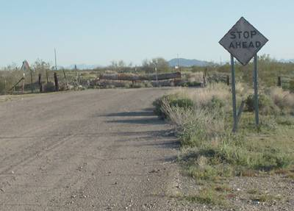
In the beginning of the book, the man walked away from a traveler on the road without stopping to help them. What do you think made the man stop this time? Is there a time that you remember helping someone? How did that make you feel? Is there a time when someone helped you?

Slide 6
On page 168 the old man says, "People were always getting ready for tomorrow. I didn’t believe in that. Tomorrow wasn’t getting ready for them. It didn’t even know they were there." What does this quote mean? How do the man and boy adapt to unexpected change in the book?
3a. Relate your life to this quote. Do you agree or disagree with this quote? How do you handle uncertainty or change?

Slide 7
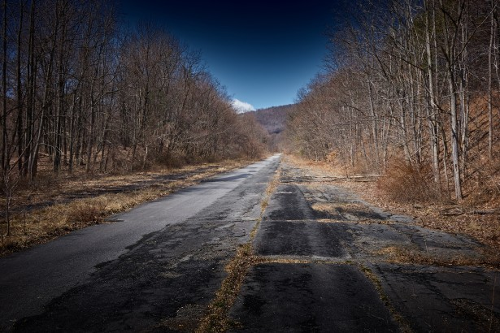
Why does the father question the old man on page 171? Why did the old man lie about his name? What is your opinion of the old man? Have you ever lied about something in your own life? Why do you think people lie or withhold the truth in certain situations?

Slide 8

The old man didn’t want to say thank you to the boy on page 173. Why do you think that is? Do you agree with that decision? Why or why not? What values are kept or lost in their society?

Slide 9
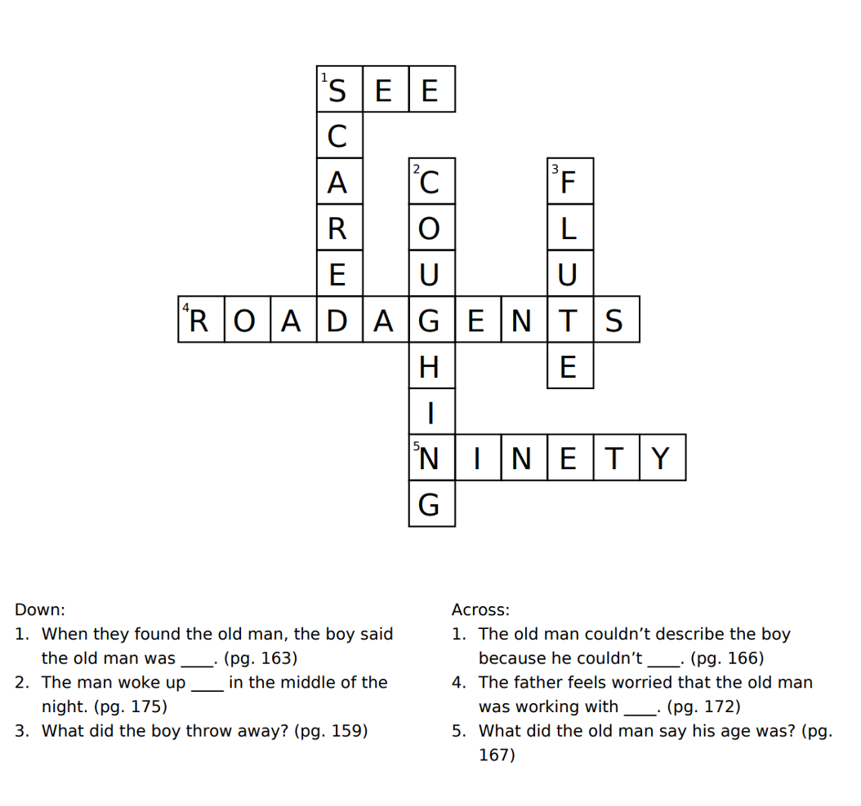
Crossword

Slide 10
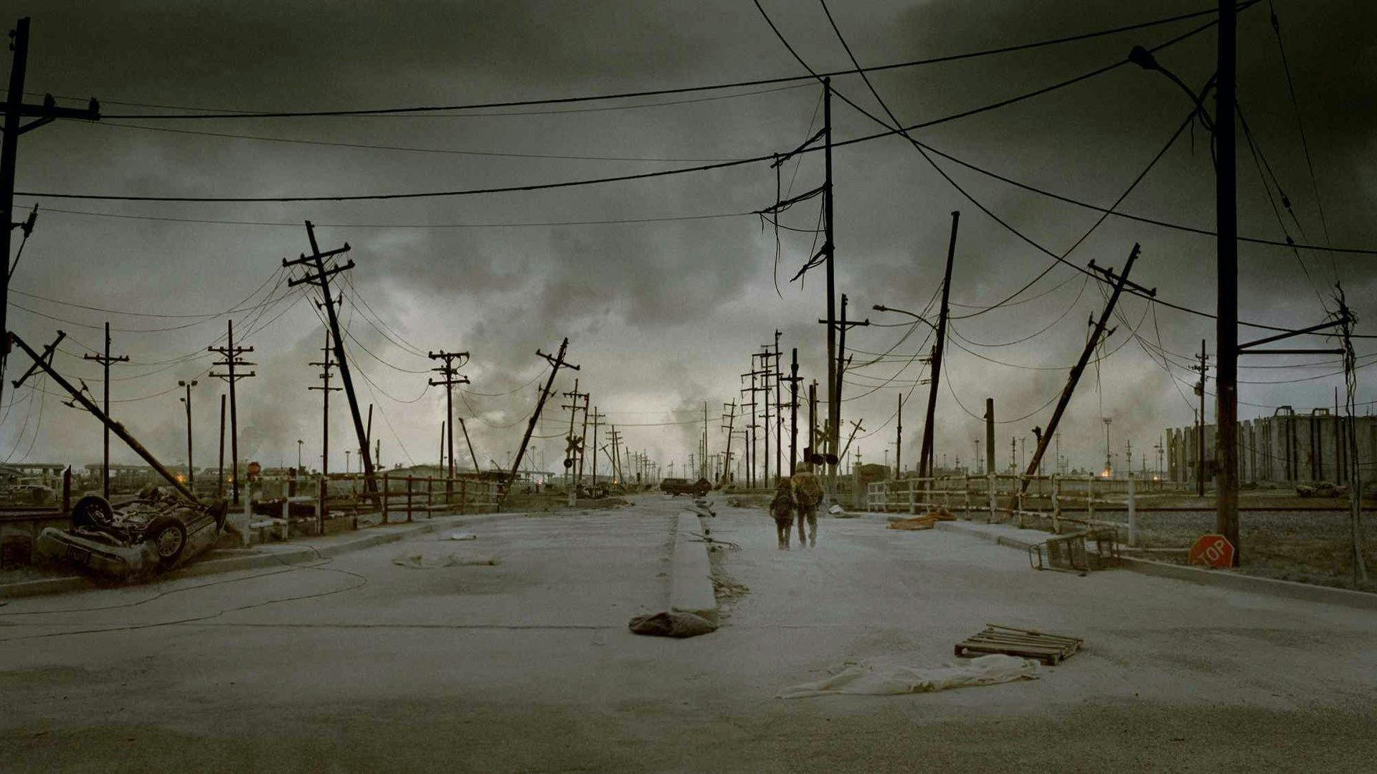
Do you have any predictions about how the book will end?

Slide 11

Next Week
Read pages 176-198

