Slide 1
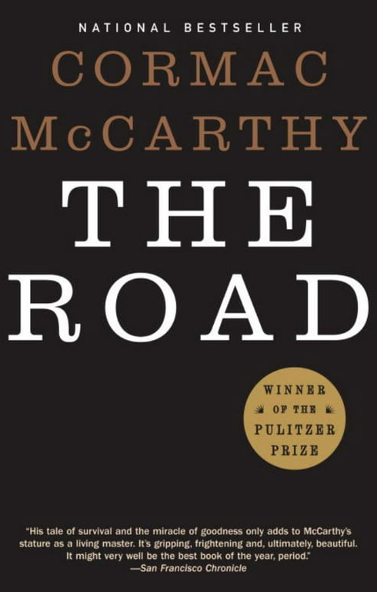
Pages 175-198
11/8/2024

Slide 2
How was your week?

Slide 3
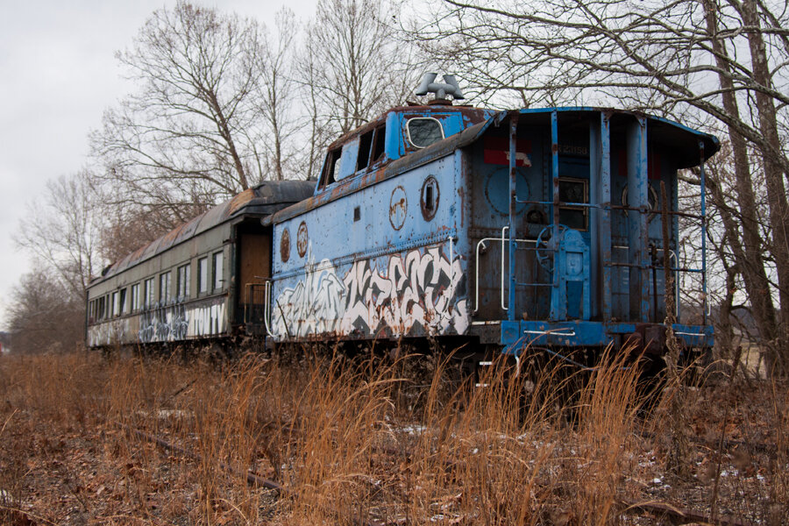
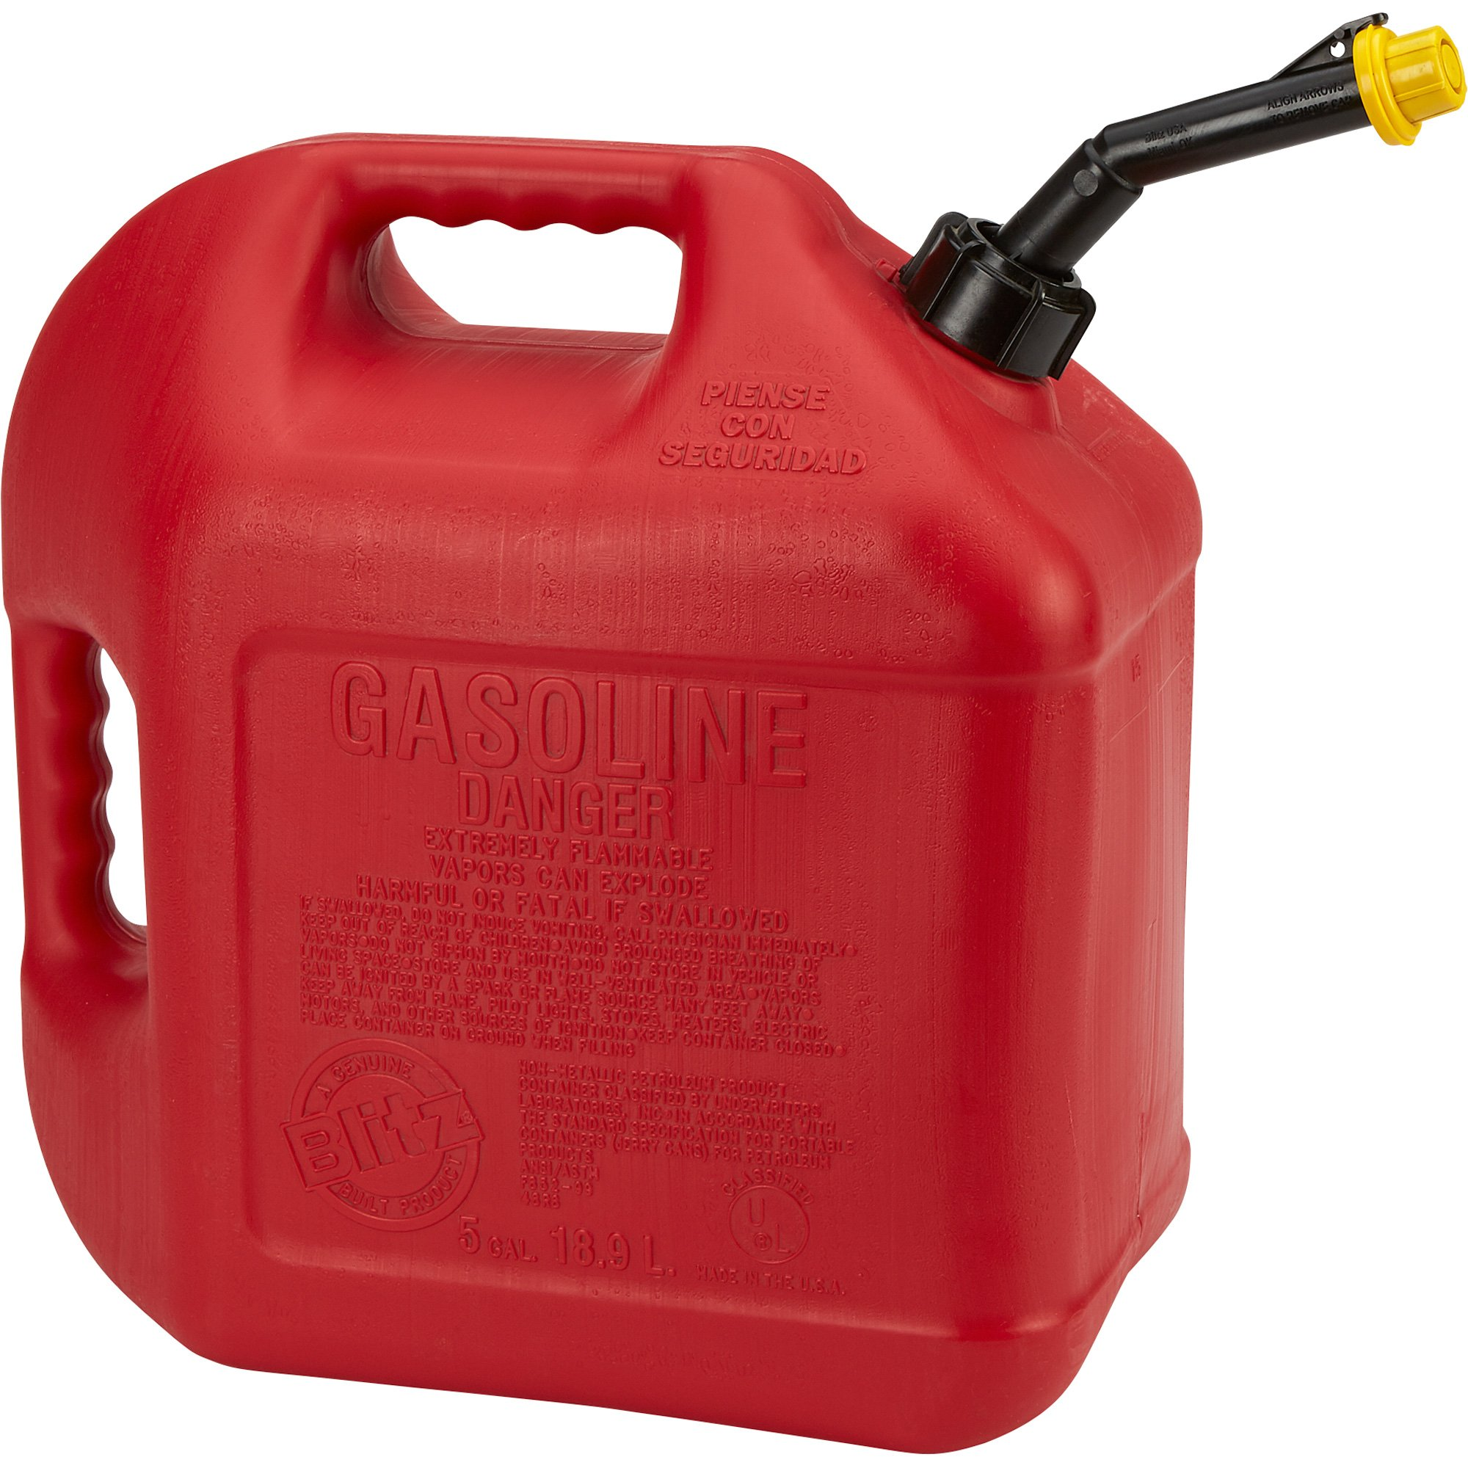
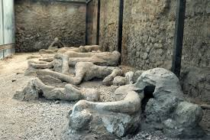


Summary

Slide 4
Summary
They ran out of gasoline.
They found an abandoned train.
They ran into people on the road, but they got away because of the man's pistol.
They enter a town full of people burnt into the road.
They discovered that people had been following them.

Slide 5
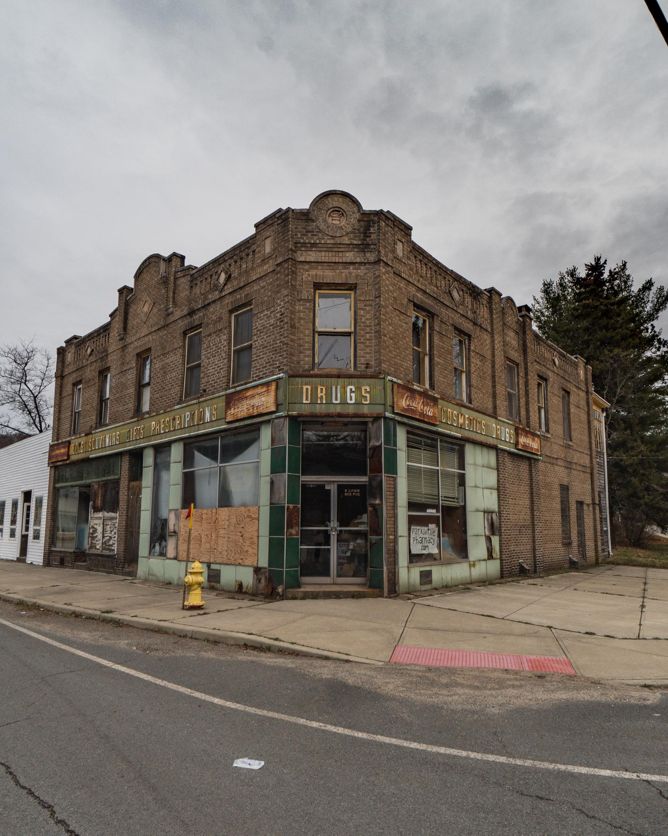
Question 1
On page 184, they find a drugstore. What did they see inside?
Why do you think the expensive electronics were not stolen when people looted the store?
If you needed to take things from a store during the end of the world, what would you take? Why?

Slide 6
Question 2
On page 186, the man gets very sick and catches a fever. He tells the boy, “It’s all right. I’m going to get better. You’ll see.” Before, the man has been very honest with the boy and he told him that they might die or starve.
Why do you think he keeps telling the boy that he will not die from his sickness?
Have you ever told a lie to spare someone’s feelings? What did you tell them?

Slide 7


Question 3
Agree
Disagree
On page 189, the boy has a nightmare. The man says, “When your dreams are of some world that never was or some world that never will be and you are happy again then you will have given up.”
What does this mean?
Do you agree with the man?
Why or why not?

Slide 8
Question 4
On page 191, they see people burnt into the road. The boy is not bothered by the scene in front of him.
Why do you think he is untroubled by something so disturbing?
Do you think it is better to be sensitive to upsetting events, or is it better to be unbothered? Why?

Slide 9
Are there any parts of this section you would like to talk about?
Are there any parts that surprised you?

Slide 10
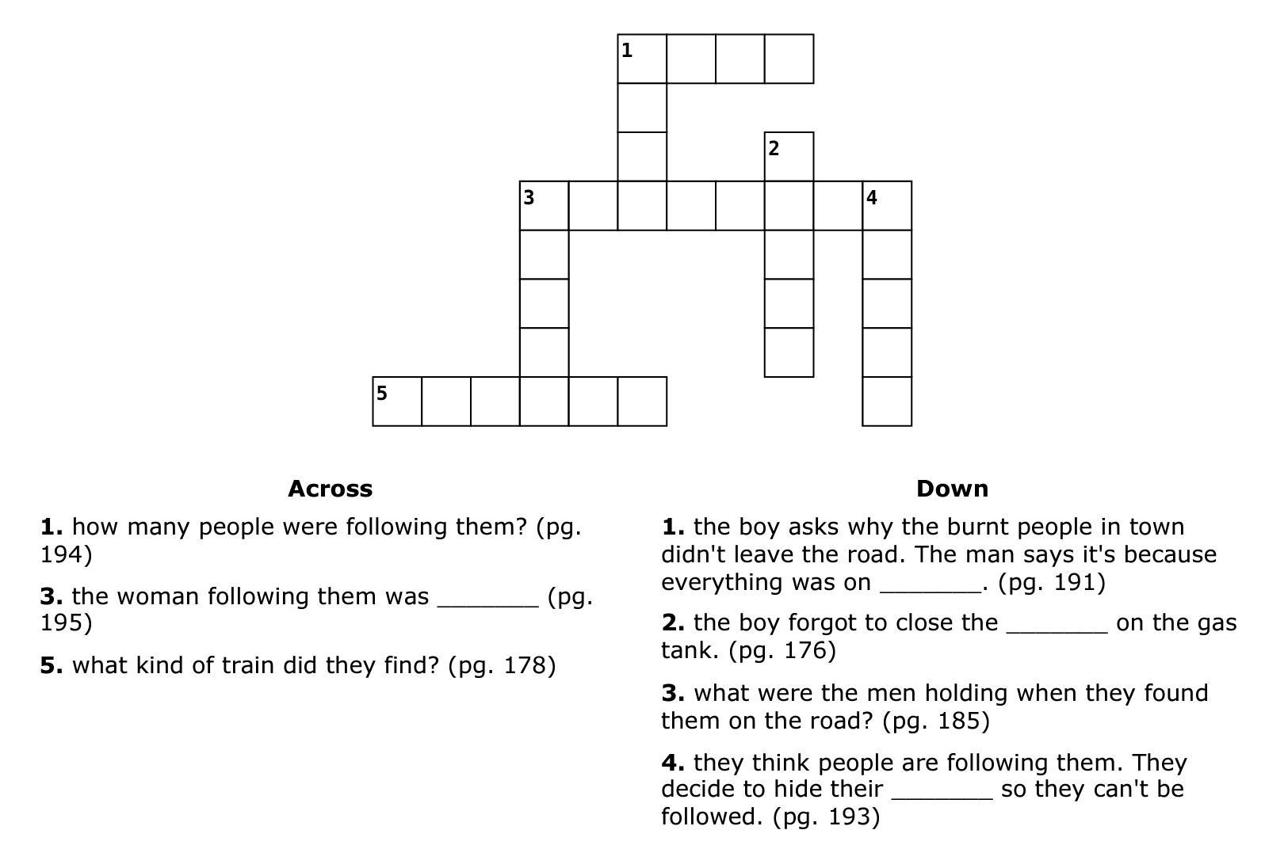
Crossword
F O U R
I
R
V
P R E G N A N T
I
L
R
P
V
A
E
E
S
D I E S E L
H

