Slide 1
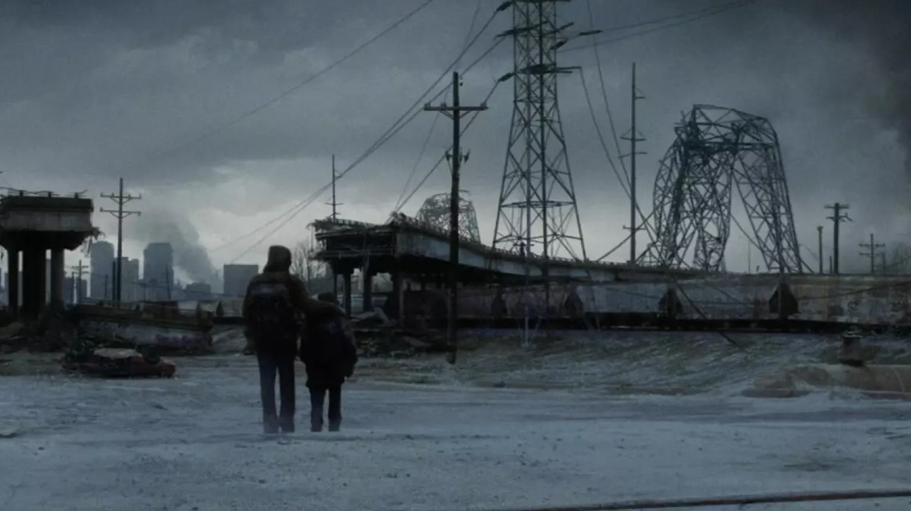
The Road
Pages 199-225

Slide 2
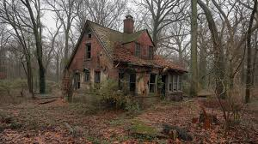
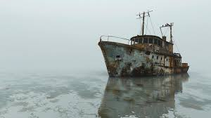
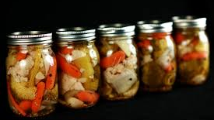
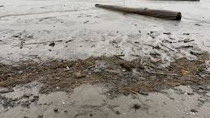

Slide 3
Summary
The man and the boy find a hidden house
They find old pickled vegetables
They eat and sleep there for 4 days
They reach the coast and the boy swims
The man explores an abandoned ship

Slide 4
On page 210, the man says, “I think maybe they are watching. They are watching for a thing that even death cannot undo and if they do not see it they will turn away from us and they will not come back.”
Who is watching them?
What does this mean?

Slide 5
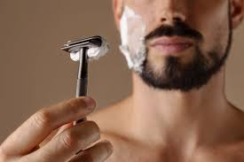
On page 212 the man shaves his beard again. Why do you think it is important to him to keep doing this?

Slide 6

What is something you do that you value when taking care of yourself (shaving, having a clean haircut, etc.)? Why do you value this?

Slide 7


On page 218, the boy goes swimming and comes out crying. “But when he looked the boy was crying. What is it? He said. Nothing. No, tell me. Nothing. It's nothing.”
Why do you think he was crying?

Slide 8
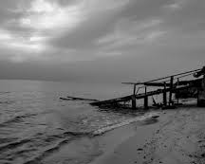
The man and the boy reached a beach.
Did they reach the coast they were aiming for the whole book?
Describe the beach they found.
Do you think they were disappointed with what they found?

Slide 9

Is there a time when you've felt deeply disappointed, like the characters in this book?
Was there something you did to feel better?

Slide 10
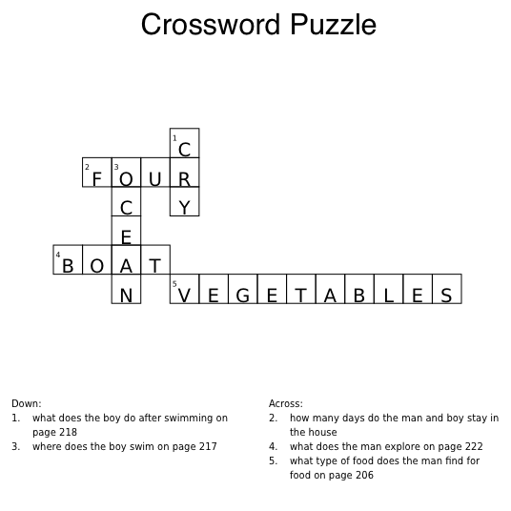

Slide 11
Are there any parts of this section you would like to talk about?
Are there any parts that surprised you?
Any confusing vocabulary?

Slide 12

The National Aphasia Association took a poll:
84% of the participants reported they do not have aphasia in their dreams.
16% stated that they still have aphasia when they dream.
Do you remember your dreams and whether you can easily speak, read, write, or listen?

