Slide 1
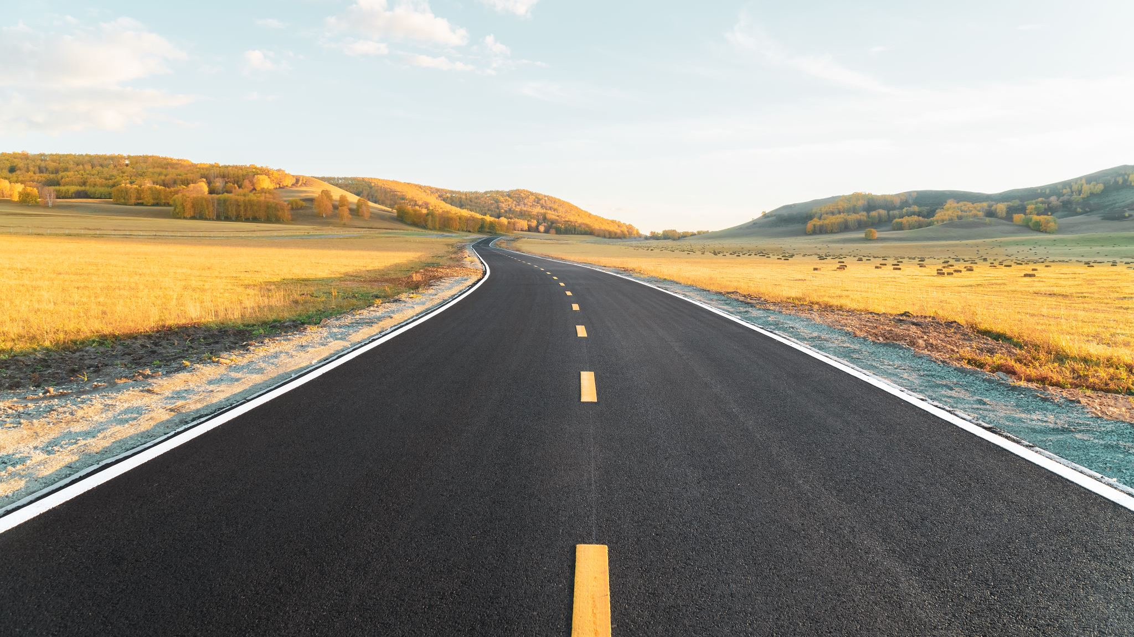
The Road
Pages 74-102

Slide 2
Quick reminder!
No group next Friday 10/11
Will resume the following week ☺

Slide 3
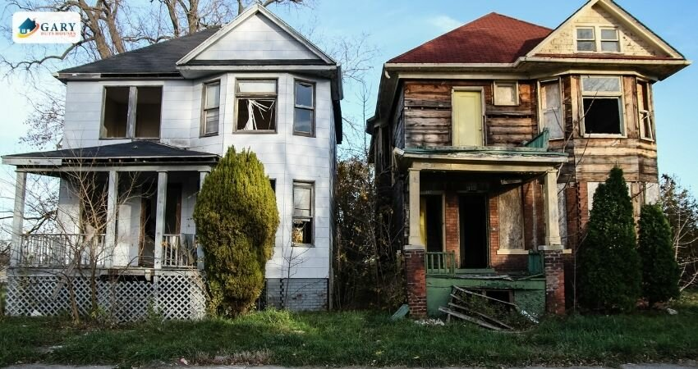
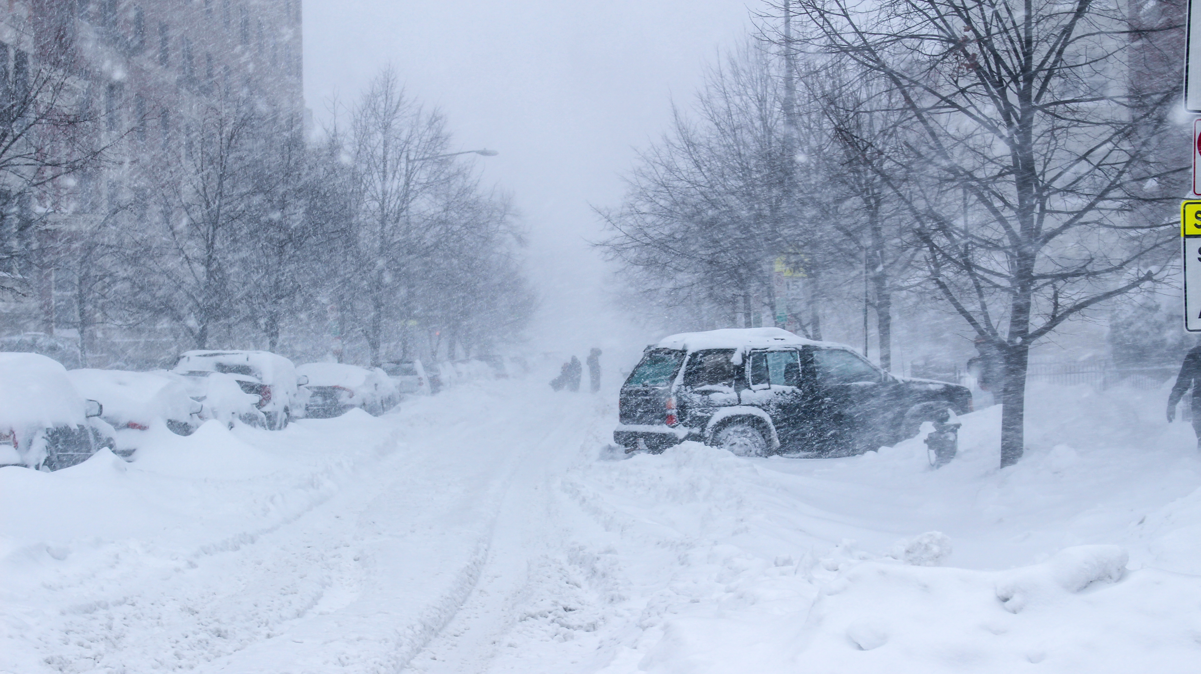
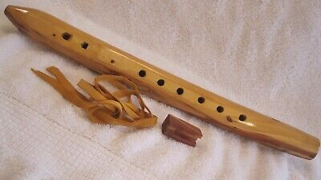
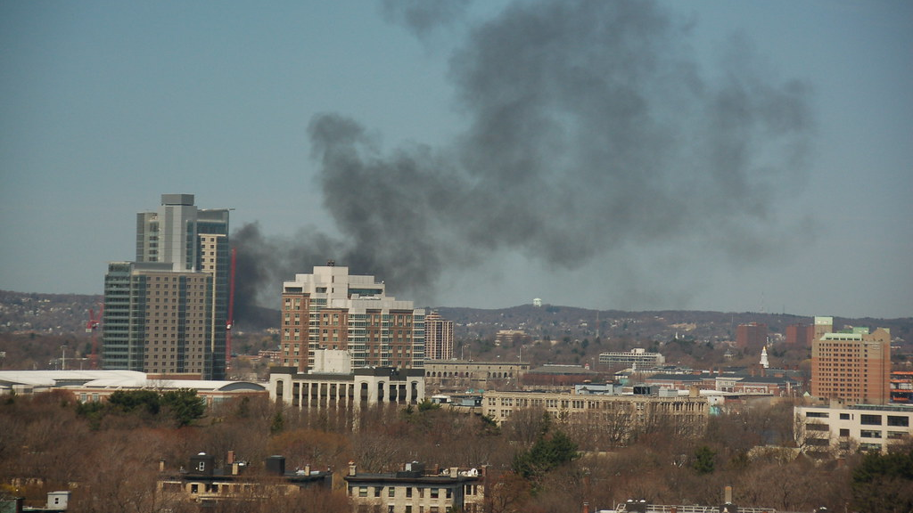
Summary

Slide 4

Brief Summary
The boy is upset, the man carves him a flute
They see smoke through binoculars
They decide to move towards the smoke, they need food
They scavenge in some houses
The bad guys pass by
Snowstorm

Slide 5
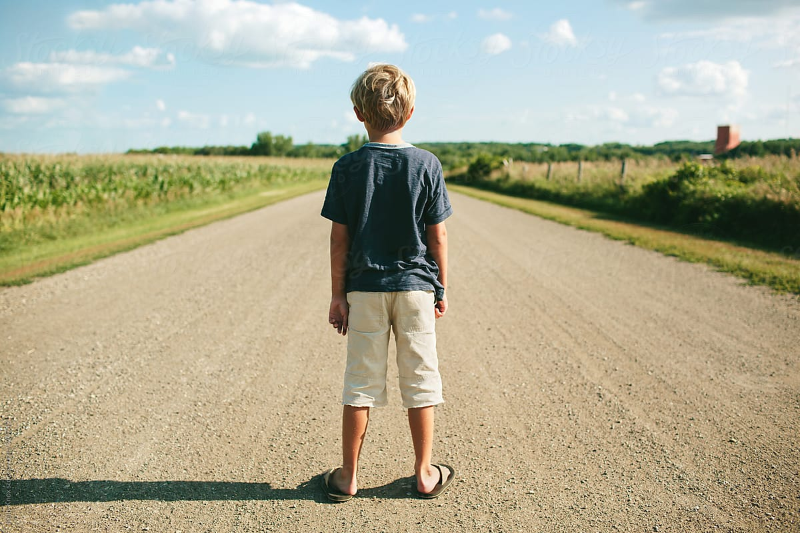
1. On page 84, the boy sees someone in the road. Who does the boy see? Do you think what he saw was real? Why or why not?

Slide 6
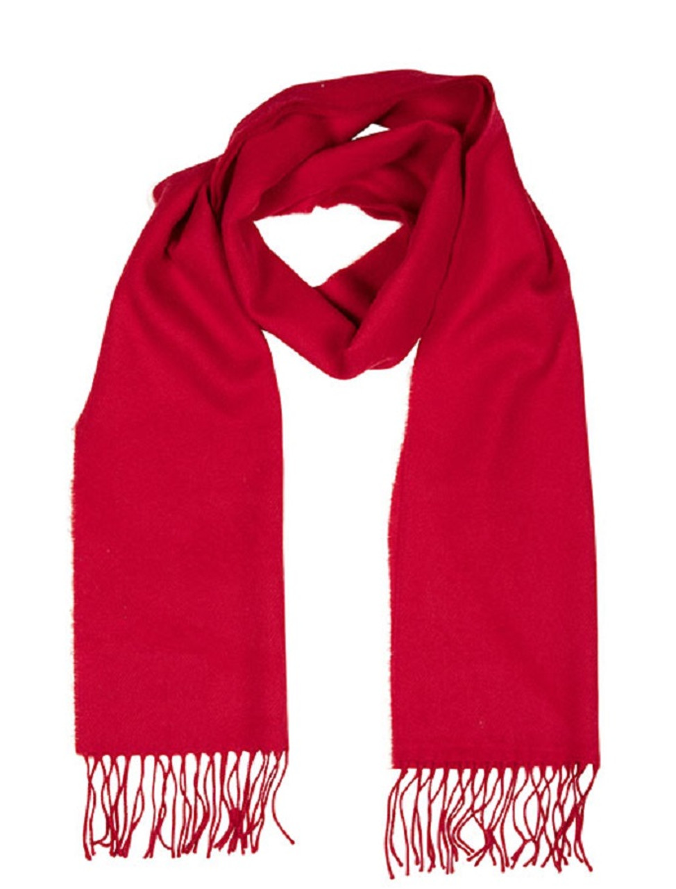
2. On page 91, the man and the boy see “the bad guys”. Describe what they look like, what they carry, and how many there are.
Why do you think they are considered “the bad guys”?
Any predictions?

Slide 7
3a. Go to page 77 and read this quote:
“He'd carved the boy a flute from a piece of roadside cane and he took it from his coat and gave it to him. The boy took it wordlessly. After a while he fell back and after a while the man could hear him playing. A formless music for the age to come. Or perhaps the last music on earth called up from out of the ashes of its ruin. The man turned and looked back at him. He was lost in concentration. The man thought he seemed some sad and solitary changeling child announcing the arrival of a traveling spectacle in shire and village who does not know that behind him the players have all been carried off by wolves.”
3b. In your own words, what is this passage trying to say?

Slide 8



3c. Do you listen to music?
What's your favorite band/song?
Has music ever helped you in any way (ex. put you in a good mood, reminded you of a good time, etc.)

Slide 9

4. On page 96, the trees keep falling down. Why are the trees falling down?

Slide 10

5. The man and the boy get stuck in a snowstorm. What is your favorite memory of being stuck in a snowstorm?

Slide 11

6. What is a word that you came across when reading that you did not know the meaning of? Look up the definition.

Slide 12
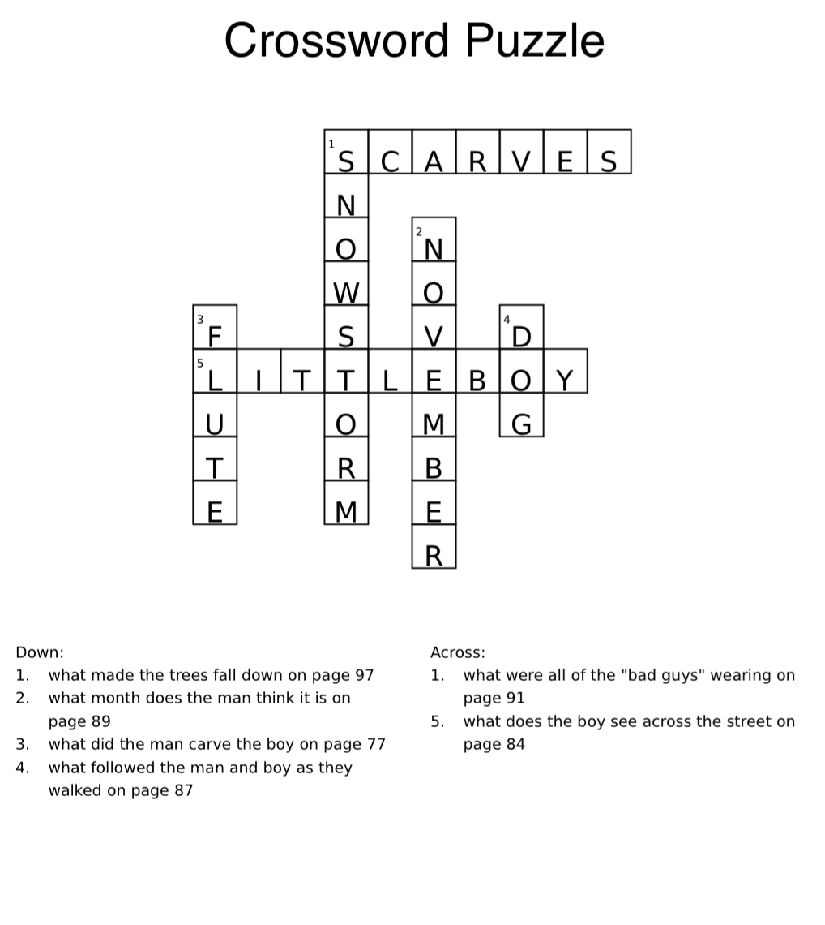

Slide 13

Let’s discuss!
We get the first clue of what month it is on page 89. What month does the man think it is?
What month did you think it was?
Why didn’t they leave on their adventure south earlier?
Where do you think they are in the world?

