Slide 1
The Maid
By Nita Prose
Chapters 4 & 5

Slide 2
How was your week?

Slide 3
Character List
Molly – Narrator; maid at the hotel
Mr. Snow – Hotel manager
Mr. Black – Wealthy businessman; dead
Giselle Black – Mr. Black's second wife
Mrs. Black – Mr. Black's first wife
Victoria Black – Mr. Black's daughter
Mr. Preston – Hotel doorman
Wilbur Brown – Molly's ex-boyfriend

Slide 4
Character List
Rodney Stiles – Hotel bartender; went on a date with Molly last year
Cheryl ("Chernobyl") - Molly's supervisor
Sunshine & Sunitha – Molly's fellow maids
Juan Manuel – Hotel dishwasher
Mr. & Mrs. Chen – Regular guests at the hotel
Detective Stark – Detective investigating Mr. Black's death

Slide 5
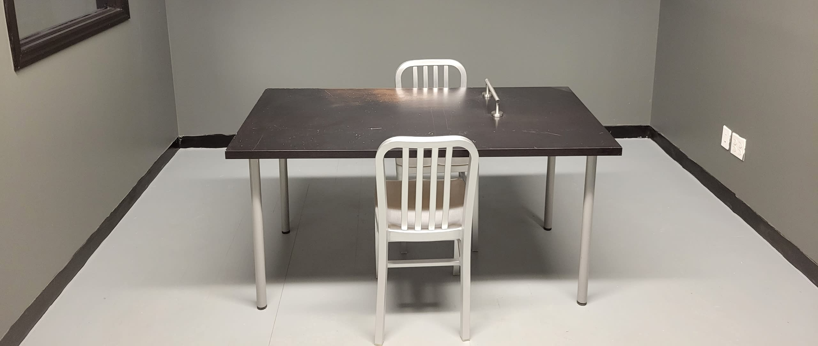

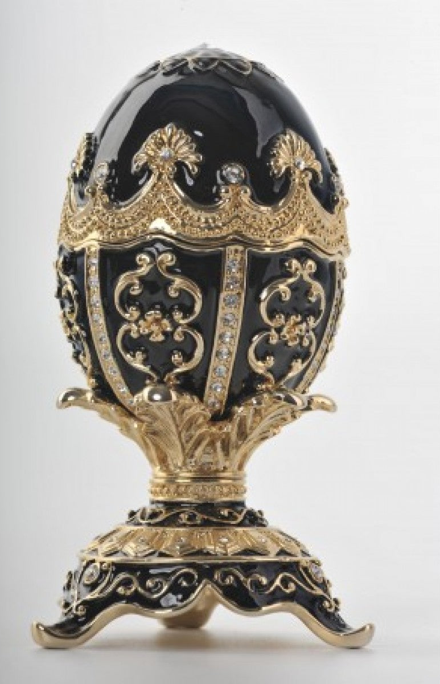


Summary
Chapter 4
Chapter 5

Slide 6
Summary
Chapter 4
Detective Stark investigates Molly
Molly thinks about her friendship with Giselle
  Giselle gave Molly a makeover in her hotel bathroom
Molly lies to Detective Stark and says she has never talked to Giselle before
Chapter 5
Molly thinks about growing up with gran raising her
  She thinks about her ex-boyfriend, Wilbur, and how he stole the Fabergé
  She thinks about gran's struggle with pancreatic cancer
Mr. Snow calls Molly and asks her to come into work the next day

Slide 7
On pages 40 – 43, Detective Stark starts to investigate Molly.
What does Detective Stark think of Molly?
How do you know?
Question 1

Slide 8
On page 45, Giselle says that she always has paparazzi following her and her husband watching what she is doing. She says she would rather be invisible like Molly.
Why do you think she would rather be invisible?
Which would you rather choose: to be in the public eye or to be invisible? Why?
Question 2

Slide 9
On page 51, Giselle talks about her marriage and Mr. Black’s behavior.
What is revealed about him?
How does this make you feel about Mr. Black?
How does this make you feel about Giselle?
Question 3

Slide 10
At the end of Chapter 4, what is Molly’s response when Detective Stark asks her if she has ever talked to Giselle?
Do you agree or disagree with her decision to lie?
Which do you think is more important: honesty or loyalty? Why?
Question 4

Slide 11
What happened to the money in the Fabergé?
Do you agree or disagree with Molly’s decision to lie to gran? Why or why not?
Question 5

Slide 12
Do you have any predictions for what will happen next?

Slide 13
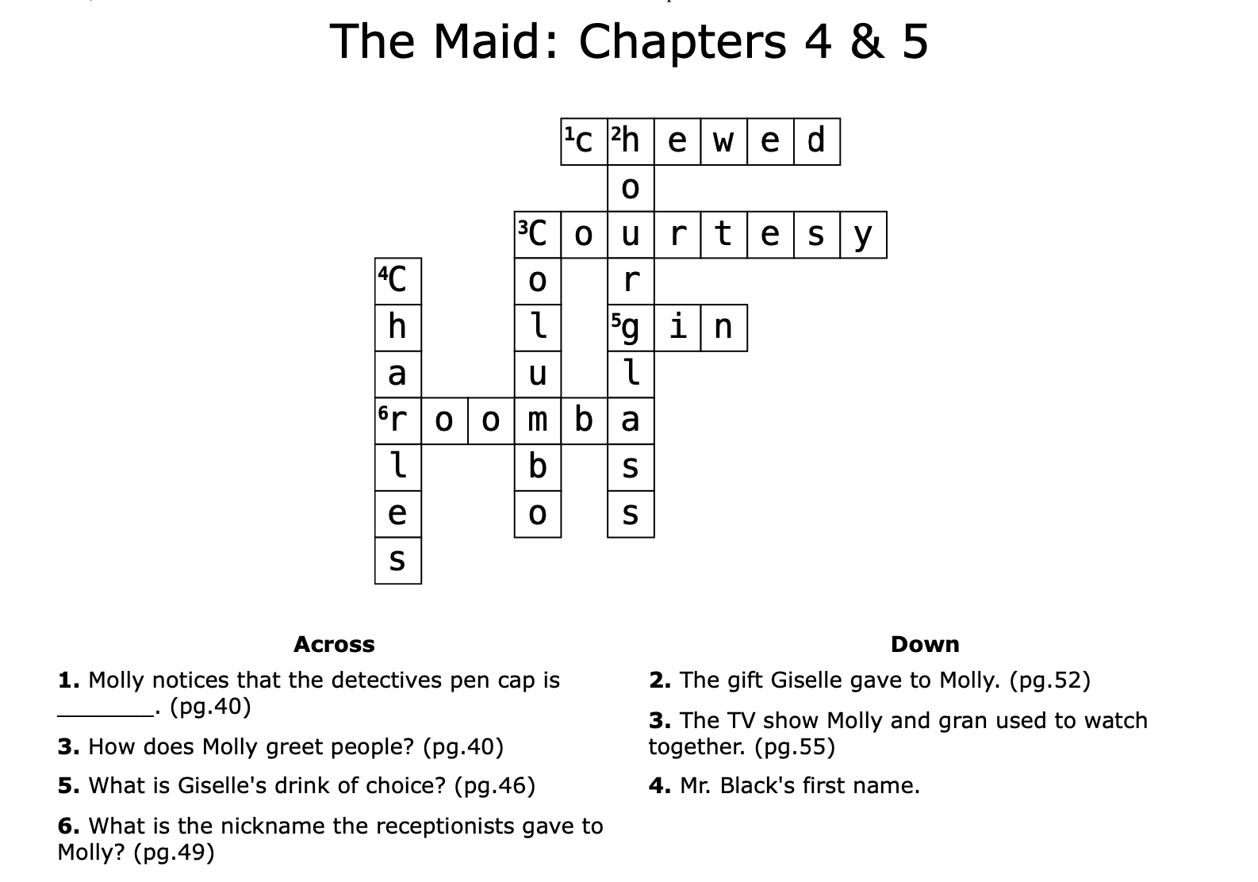
Crossword

