Slide 1


01
The Maid
Chapters 10 & 11
By Nita Prose

Slide 2
How was your week?
Anything to share?

Slide 3
Character List:
Molly – Narrator; maid at the hotel ​
Mr. Snow – Hotel manager ​
Mr. Charles Black – Wealthy businessman who is a regular guest at the hotel ​
Mrs. Giselle Black – Mr. Black's second wife ​
Mrs. Black – Mr. Black's first wife ​
Victoria Black – Mr. Black's daughter ​
Mr. Preston – Hotel doorman ​
Wilbur Brown – Molly's ex-boyfriend​

Slide 4
Rodney Stiles – Hotel bartender; went on a date with Molly last year and a second date after Mr. Black’s death ​
Cheryl ("Chernobyl") - Molly's supervisor ​
Sunshine & Sunitha – Molly's fellow maids ​
Juan Manuel – Hotel dishwasher; Molly gives him a key card because he is going through financial difficulties ​
Mr. & Mrs. Chen – Regular guests at the hotel whose room Molly cleans ​
Detective Stark – Detective investigating Mr. Black's death​
Mr. Rosso – Molly’s landlord who demands his rent

Slide 5
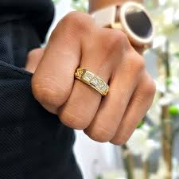
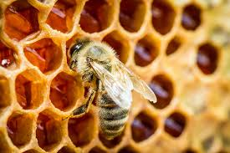
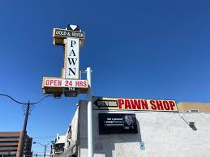
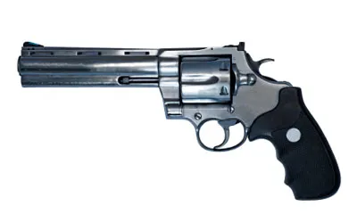
Summary

Slide 6
SUMMARY
Molly thinks about her gran and their routines together.
Molly goes to her landlord's door and pays him $200 towards her overdue rent, reassuring him the rest will come later that day.
Mr. Preston gives Molly another warning about the company that she keeps.
Rodney asks Molly to put Juan Manuel's duffel bag in the Black's Suite after she's done cleaning it as he will be staying there now.

Slide 7
SUMMARY
Molly goes into the Black's Suite and cleans up as the investigation is finished. She notices how disheveled everything looks and wonders what will happen to Giselle.
Molly decides to hide the gun in her vacuum, in a clean bag, before she can give it back to Giselle.
While changing the vacuum bag, something falls out of it. She finds Mr. Black's wedding ring and has an idea of what to do with it.
Molly goes on her lunch break to a pawn shop and sells Mr. Blacks ring for rent money.

Slide 8

Question 1
Molly has routines that she does everyday that she continues since her Gran passed away.
Are there any routines that you do everyday?
How do you feel when you aren’t able to do them?

Slide 9

Question 2
On page 122, Molly says “ Every worker bee has her place in the hive...This hotel is a hive, and every worker in it is a bee. Without each and every one of us, there would be no honey”. How does this statement relate to your own experiences in your career?
In what ways do you agree or disagree with this statement?

Slide 10

Question 3
16
Molly remembers that Gran used to say "Good things come to those who work hard. Clean conscience, clean life" (pg 127). Do you believe this is true?
What steps have you taken in your life so far (education, work, relationships) that supports this?
Do you think it is possible to work hard in life yet not achieve success or happiness?

Slide 11

Question 4
What does Molly do with Mr. Black’s wedding ring?
Do you think this was the right thing to do?
Would you have done the same thing if you were in Molly’s position?

Slide 12
Question 5
What are some things that Molly has done up until this point that have surprised you?
What do you think will happen if she gets caught?

Slide 13
Question 6
16
Molly retrieves an item for Giselle Black from their suite. What is this item?
Would you do this to help a friend? Why or why not?
Have you ever put yourself at risk to help a friend?

Slide 14
Any new suspects?
Any predictions?

Slide 15
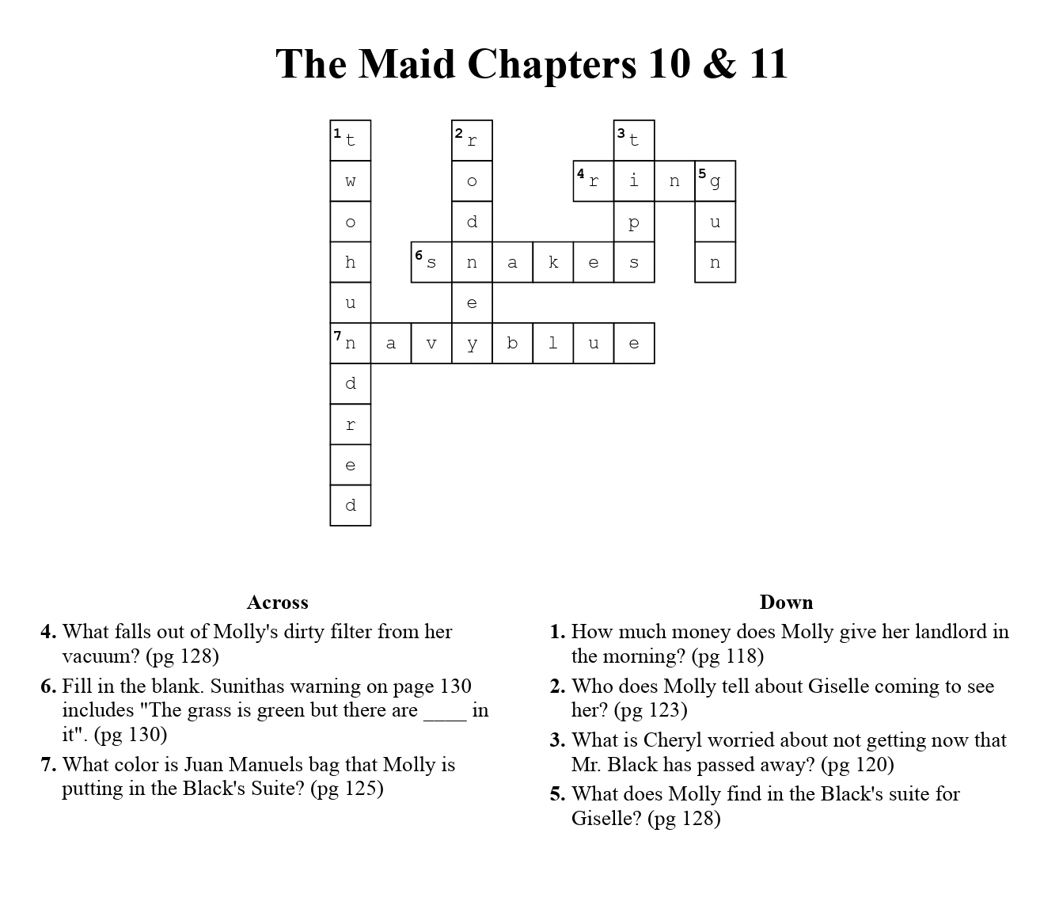
24

