Slide 1



The Maid
Chapters 22, 23, & 24

Slide 2
How was your Week?

Slide 3
Character List
Main Characters:
  Molly – Narrator; maid
  Mr. Snow – Hotel manager
  Mr. Black – Murder victim
  Giselle Black – Mr. Black's second wife
  Mr. Preston – Hotel doorman; Molly’s friend
  Rodney – Hotel bartender; involved in criminal activity at the hotel
  Cheryl - Molly's supervisor
  Juan Manuel – dishwasher; involved in criminal activity at the hotel
  Detective Stark – Detective investigating Mr. Black's death
  Charlotte – Mr. Preston’s daughter who works as a lawyer

Slide 4

Character List
Side Characters:
  Mrs. Black – Mr. Black's first wife
  Victoria Black – Mr. Black's daughter
  Wilbur Brown – Molly's ex-boyfriend who stole all of her savings
  Sunshine & Sunitha – Molly's fellow maids
  Mr. Rosso – Molly’s landlord

Slide 5



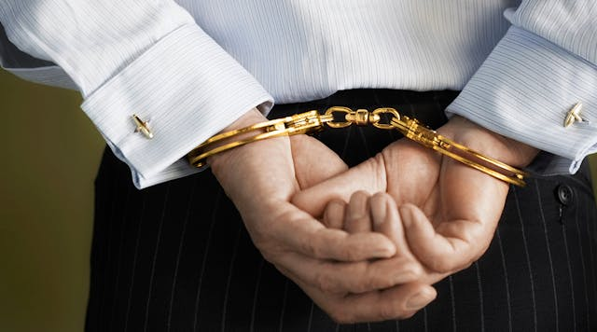
Summary

Slide 6
Summary
Chapter 22:
  Molly reports to Mr. Preston, Charlotte, and Juan Manual that her meeting with Rodney went smoothly
  Molly sees that the police are having a press conference soon to announce details of the murder case
  Mr. Preston plans to go to the hotel to get Rodney the key to the Black’s suite
  Molly invites Juan Manuel to stay with her since he has no where else to go

Slide 7
summary
Chapter 23:
  Molly puts on an elaborate performance at the front of the hotel pretending that she can’t get in
  Mr. Snow informs Molly that she no longer works at the hotel
  Mr. Preston steals Cheryl’s master keycard and Mr. Preston gives it to Molly
  Rodney shows up after Molly texts him for help in front of the hotel, and gives him the key

Slide 8
summary
Chapter 24:
  Molly waits across the street from the hotel and sees that the press conference announced that she is the primary suspect
  Molly calls Giselle and confronts her about telling lies
  Giselle admits to knowing about the drug operation and having a romantic relationship with Rodney
  Giselle apologizes to Molly and says she didn’t intend for it to play out this way
  Molly tells Giselle to leave the hotel and run away from there
  Molly sees Rodney leave the hotel in handcuffs, accompanied by Detective Stark with his duffle bag

Slide 9

Question 1
At the beginning of Chapter 22, Molly comes back to her apartment to share her success of fooling Rodney with Mr. Preston, Charlotte, and Juan Manuel. Did you think Molly was going to be able to pull this off? How do you think she felt when she was successful?
What is the most exciting news you’ve ever gotten to share or receive?

Slide 10


Question 2
Molly offers for Juan Manuel to stay at her apartment when he has nowhere else to go. What do you think about the friendship between Molly and Juan Manuel? How is Molly deciding who to trust?
How do you decide who to trust in your own life?

Slide 11

Question 3
In chapter 23, Molly put on an elaborate performance in front of the hotel as a part of her scheme to trick Rodney. If you were in Molly’s situation, what would you do to prove yourself innocent?
Have you ever had to tell an elaborate lie to help yourself or others?

Slide 12
Question 4
As Molly is waiting across the street from the hotel, she calls Giselle to confront her. Did you expect this from Molly? Molly suggests that Giselle could be a “good egg caught in a rotten basket”. Do you agree with this?
When was a time that you had to confront somebody? How did you feel?

Slide 13

Question 5
Molly remembers that Gran said, “If you want to know where someone is going, don’t watch their mouth, watch their feet”. What does this mean? Do you think Molly should take this advice? Why or why not?

Slide 14
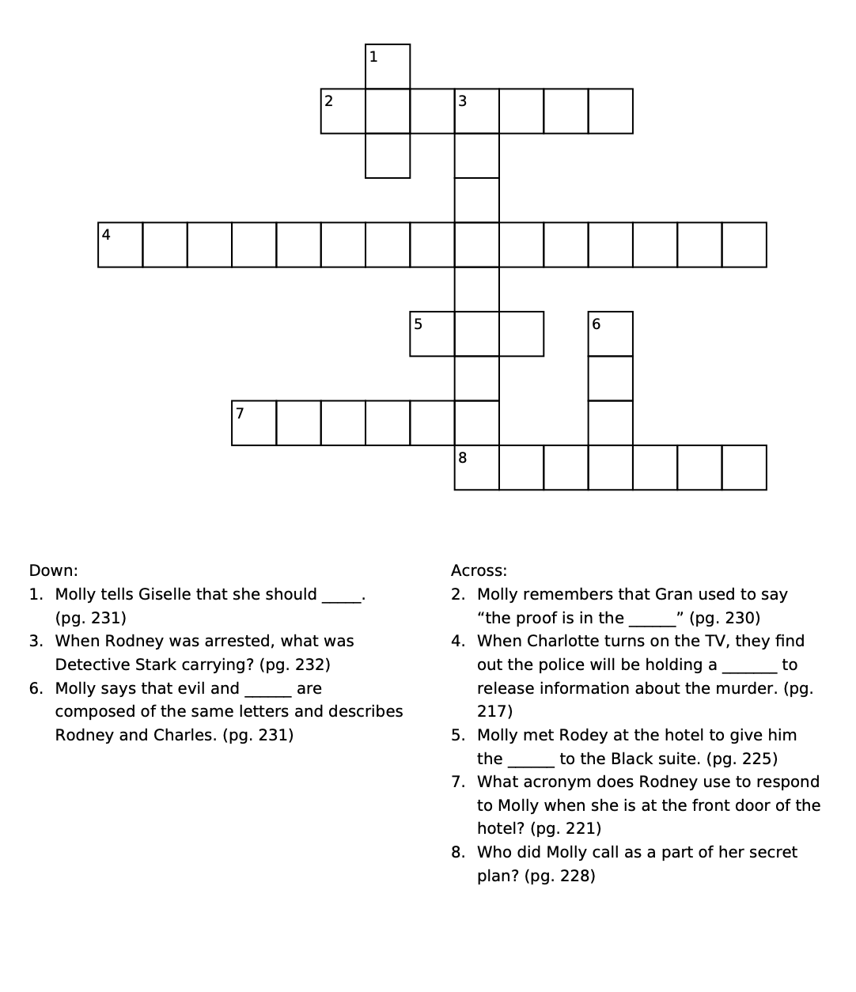
Crossword

Slide 15
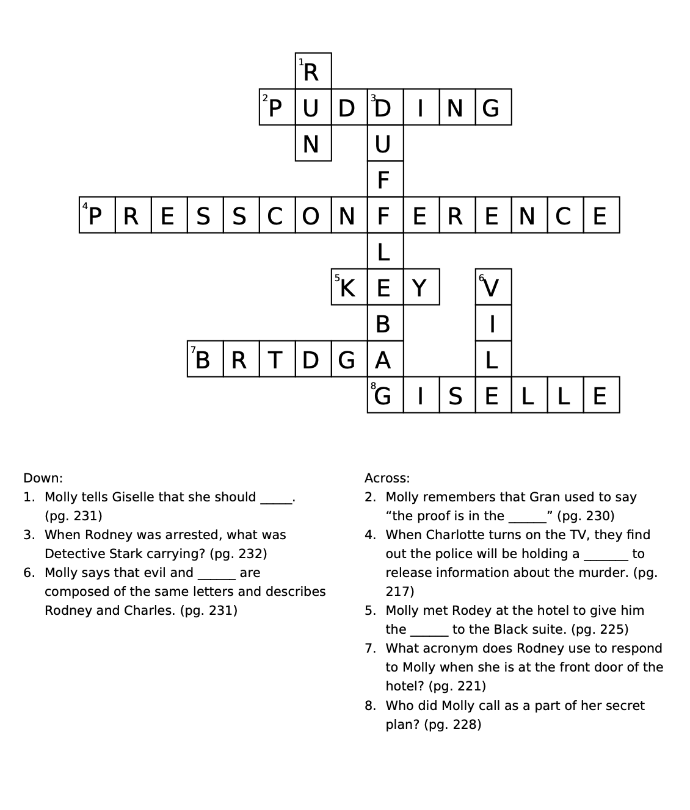

Slide 16

Any final predictions or suspects?

Slide 17

NExt week
Finish the book!

