Slide 1
The maid chapters 25 ,26 ,27 and Epilogue
HOMICIDE

Slide 2

How was your week?

Slide 3
Character list
Main Characters:
  Molly – Narrator; maid
  Mr. Snow – Hotel manager
  Mr. Black – Murder victim
  Giselle Black – Mr. Black's second wife
  Mr. Preston – Hotel doorman; Molly’s friend
  Rodney – Hotel bartender; involved in criminal activity at the hotel
  Cheryl - Molly's supervisor
  Juan Manuel – dishwasher; involved in criminal activity at the hotel
  Detective Stark – Detective investigating Mr. Black's death
  Charlotte- Mr. Preston's daughter who works as a lawyer
CRIME

Slide 4
Character list Continued...
Side Characters:
  Mrs. Black – Mr. Black's First Wife
  Victoria Black – Mr. Black's daughter
  Wilbur Brown – Molly's ex-boyfriend who stole all of her savings
  Sunshine & Sunitha – Molly's fellow maids
  Mr. Rosso – Molly’s landlord
  Ricky – Sunshine's son, new maid at the hotel
CRIME

Slide 5

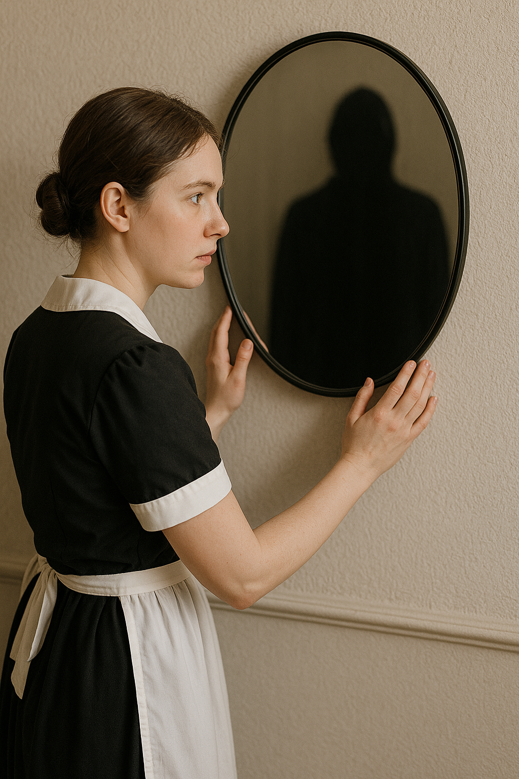
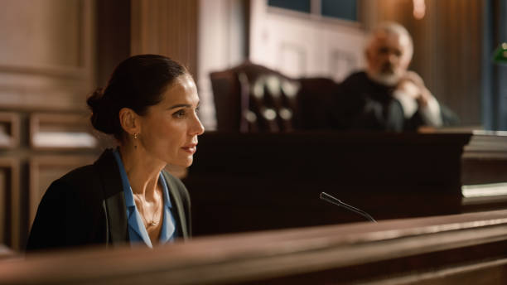
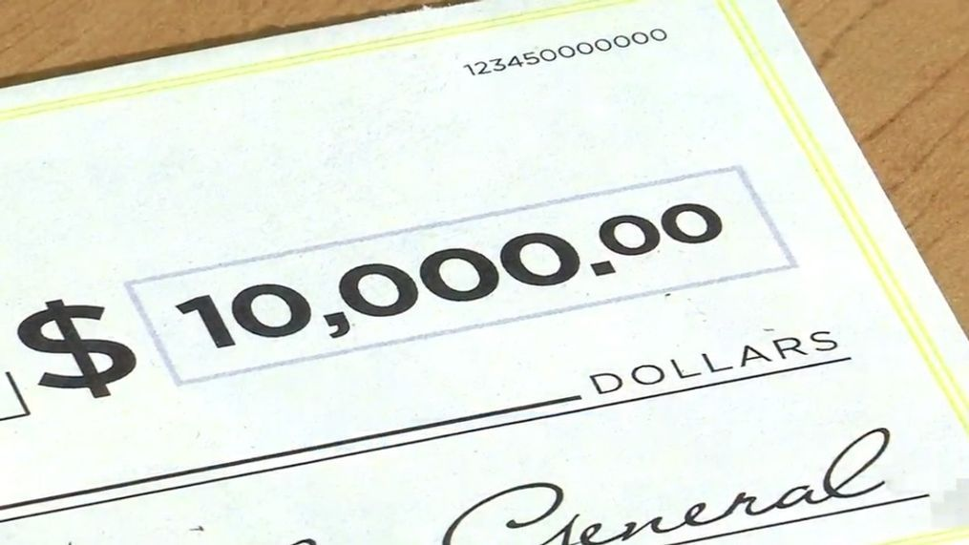
Summary

Slide 6
Summary: Chapter 25
Molly walks home after seeing Rodney arrested where she finds Juan Manuel who set up a dinner for her.
They are visited by Charlotte, Mr. Preston, and Detective Stark, who come bearing news that Molly is innocent.
Detective Stark tells Molly that she needs her co-operation in Rodney's case.
Juan Manuel details his involvement with Rodney and that he would help with the case.
Charlotte, Mr. Preston and Juan Manuel talk after Detective Stark leaves and Mr. Preston reveals his true relationship with Molly's grandmother.
Juan Manuel stays the night and Molly remembers the night her gran passed away.

Slide 7
Summary: Chapter 26
Molly wakes up in her grans bed and remembers that Juan Manuel stayed the night in her room.
Juan Manuel and Molly make breakfast together and they speak of his family.
Mr. Snow calls Molly and apologizes. He also offers her to come back to the Regency Grand when she's ready.
Juan Manuel is also offered his job at the hotel and he and Molly decide to go and get ice cream on their day off.

Slide 8
Summary: Chapter 27
Molly walks back into the Regency Grand hotel with a new position, Head Maid.
It is revealed that Molly is now dating Juan Manuel and they are living together.
Molly recalls being in court testifying against Rodney along with Juan Manuel.
New information is revealed about the day of Mr. Black's death, Molly remembers seeing someone in the mirror holding a pillow but faints before she can tell who it is.
She receives a surprising $10,000 from Giselle with a note, "Debt of Gratitude," recognizing that Giselle has recieved her desired villa in the Cayman Islands.

Slide 9
Summary: Epilogue
Molly reflects on the day that she found Mr. Black in his bed and seeing a figure in the mirror, only it is a woman.
She remembers coming to from fainting and talking to the figure in the mirror who was holding the pillow, Mrs. Black, the first wife.
Mrs. Black revealed that she had originally gone to the Blacks' suite to talk Mr. Black into giving their daughter, Victoria, a chance within the company.
Mrs. Black tells Molly that Mr. Black grabbed her then fell back on the bed where she then used the pillow to asphyxiate him.
Molly decided to help Mrs. Black by cleaning up the room by wiping down anything she touched and removing the pillow.
Molly advised Mrs. Black to leave the room and they agreed that neither of them saw each other that day or that Mrs. Black was ever in the room.

Slide 10
Click to reveal our killer...

Slide 11
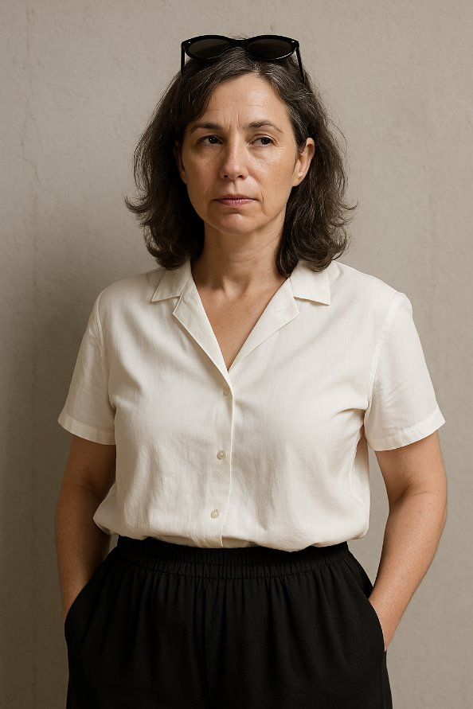
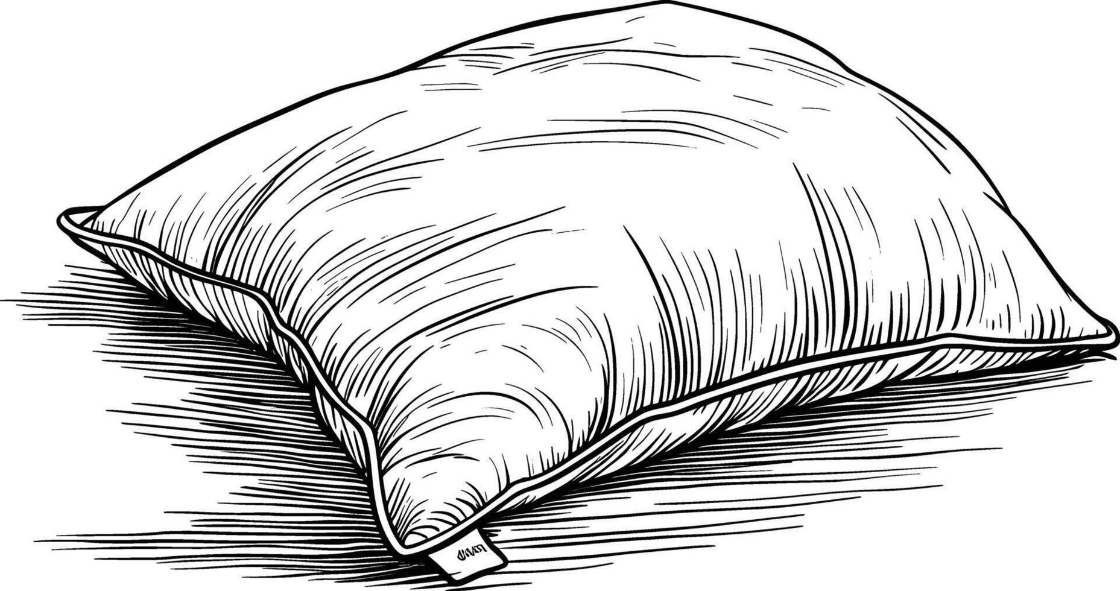

Slide 12
Question 1
On Page 247, Molly said to Detective Stark, "Perhaps you jumped to some conclusions about me. You expected certain reactions that you consider normal, and when you didn't see those reactions, you assumed I was guilty"
Why do you think Detective Stark jumped to these conclusions? What was Molly doing that made her seem "guilty"
Have you ever jumped to conclusions about someone and turned out to be wrong?

Slide 13
Question 2
Molly goes back to work at the Regency Grand and Mr. Snow acts as if nothing happened. Do you think Molly should have gone back to the hotel to work with the same colleagues after they all spoke badly of her when the investigation started?
Do you think you would go back to work there if you were Molly? Why or why not?

Slide 14
Question 3
It is revealed in Chapter 27 that Molly is now dating Juan Manuel. Do you think he is a good partner for her? Why?
Why do you think it took a while for Molly to know if she could trust him?

Slide 15
Question 4
On Page 285, Molly says, " The longer you live, the more you learn. People are a mystery that can never be solved. Life has a way of sorting itself out. Everything will be okay in the end. And if it's not okay, it's not the end". Do you believe any of these sayings are true? Which ones?
Can you think of any experiences in your life that relate to any of the sayings above?

Slide 16
Question 6
We now know whodunnit... Did you expect this?
Did you think Molly was capable of helping the true killer and keeping the secret?
Were there any clues throughout the book that could have led us to the real killer?

Slide 17
End of the book
What do you think?
Were you surprised?
Did you like the way it ended or wish it ended a different way?

Slide 18
Next Meeting...

Slide 19
