Slide 1

Aphasia Book Club: Week 1
Welcome Back!

Slide 2
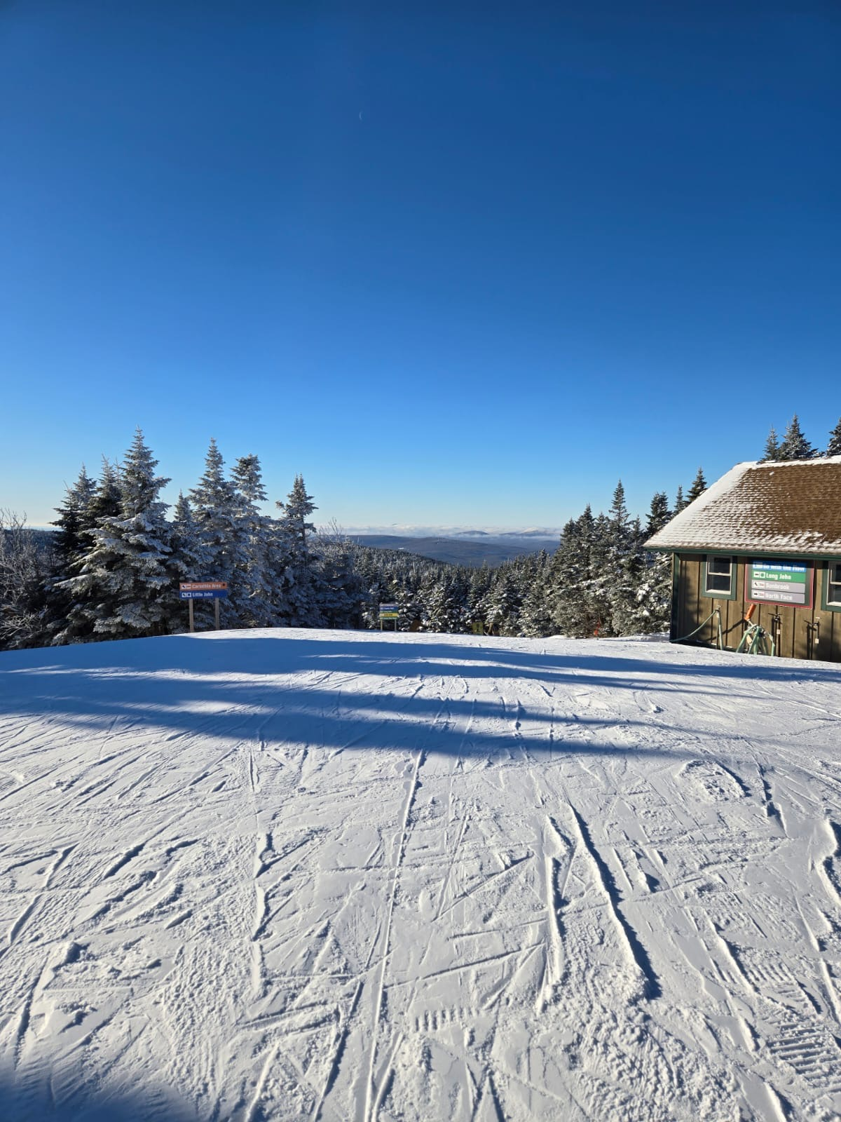
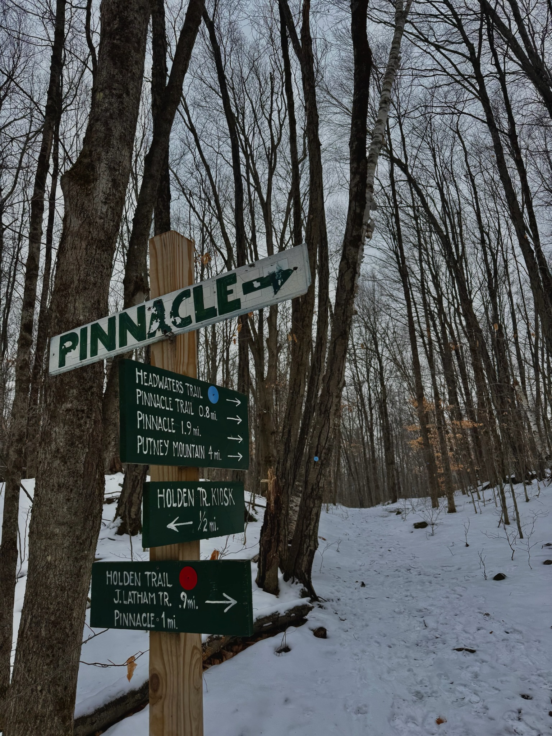
How was everyone’s break?
-Holidays
-Trips
-Family

Slide 3

The Maid by Nita Prose

Slide 4
The Maid Summary
Molly Gray is not like everyone else. She struggles with social skills and often misreads people’s intentions. But no matter—she still she throws herself with gusto into her work as a hotel maid at the five-star Regency Grand Hotel. She delights in donning her crisp uniform each morning and returning guest rooms to a state of perfection.

Slide 5
The Maid Summary Continued
But Molly’s orderly life is upended when she enters the suite of the infamous and wealthy Charles Black, only to find Mr. Black dead—very dead—in his bed. Perplexed by Molly’s unusual behavior, the police immediately suspect her of murder. She’s soon caught in a web of deception with no idea how to untangle herself.
Fortunately for Molly, friends she never knew she had join her in a search for clues about what really happened to Mr. Black—but will they be able to find the real killer before it’s too late?

Slide 6


Slide 7
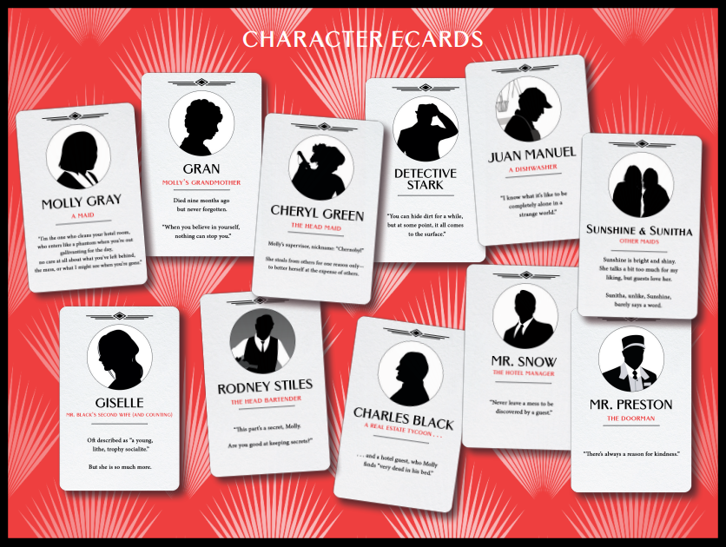
Notes:
There are a lot of characters to keep straight so we will make sure to provide character lists as we go!!

Slide 8

Feedback
Is there anything from last semester regarding
materials, discussions, the way we facilitate language that you would want changed?
Notes:
I.e.—is the font big enough? Are the questions too hard? Too easy? What would make things easier?

Slide 9

Goals
What are some goals for yourselves for this semester?
Notes:
Elaborating on your responses, writing out your homework on Worksheet A, using specifics, etc.

Slide 10
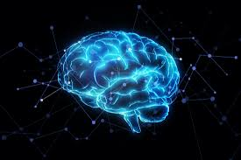
Questions
Do you all have any questions about strokes or aphasia for us or Dr. Mozeiko?

Slide 11
Language Activities
Get to know you! Share with everyone your favorite:
Trip that you have been on and why
Favorite hobby
Favorite book and why
Favorite food

Slide 12
Language Activity: Reflection Questions
What is one of your proudest accomplishments?
What advice would you give your younger self?
What makes you happy?
Who inspires you and why?
Notes:
Go around and answer each question one at a time

Slide 13
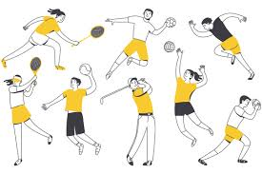


Language Activity: Debate
Who is/was the greatest athlete of all time?
Who is/was the greatest singer of all time?
Who is/was the greatest actor/actress of all time?

Slide 14
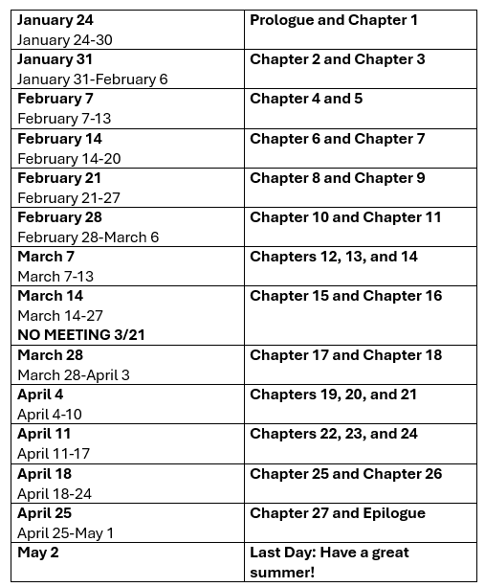
Reading Agenda:

Slide 15
Homework:
Read Prologue and Chapter 1
Worsheet A/B
Crossword

