Slide 1
The Road By Cormac mccarthy
Pages 131-159
10.18.2024

Slide 2

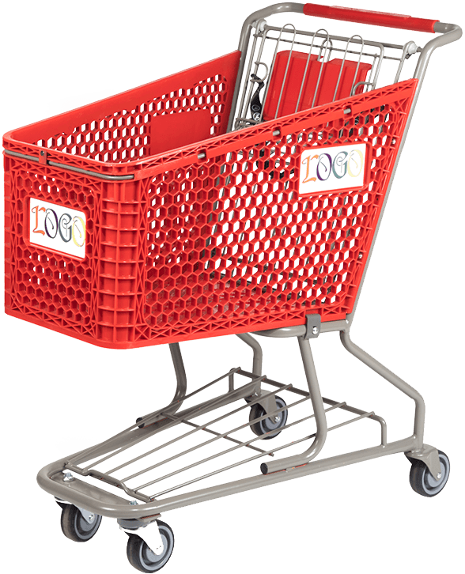

Summary

Slide 3

Summary
They find a buried hatch
Inside they find an abandoned bunker
They stay for a few days and sleep, shower, and cut their hair
They find a shopping cart in the town
They leave the bunker

Slide 4
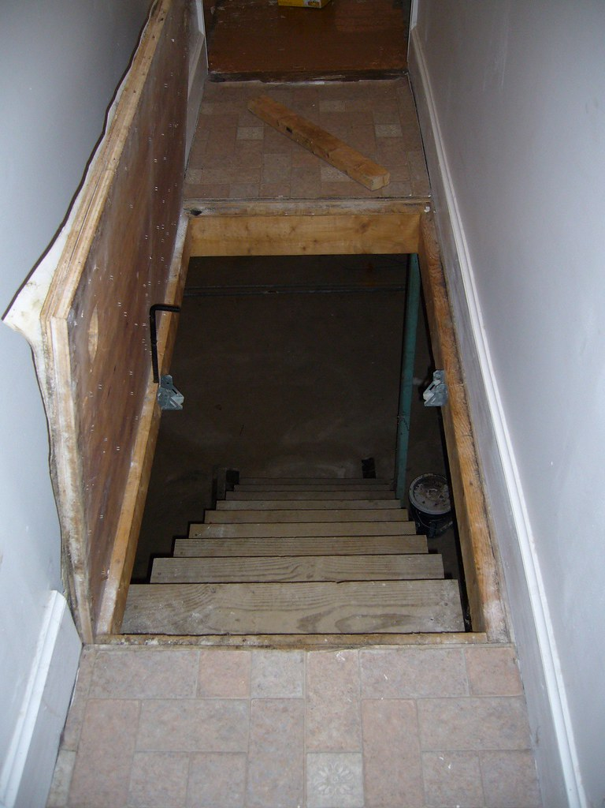
Worksheet a
1. On page 134, the man finds a hatch in the ground. The boy is afraid to open it. Why?
This Photo by Unknown Author is licensed under CC BY-SA

Slide 5
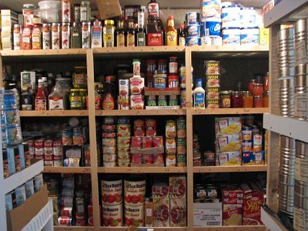
1b.
The hatch reveals a “richness of a vanished world” (page 139), showing that the boy had nothing to fear. What was something that you were afraid to do but turned out to be beneficial?

Slide 6
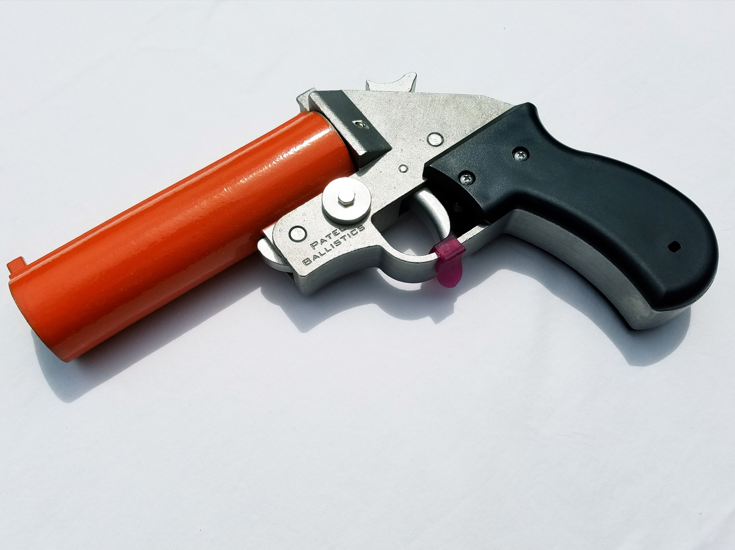
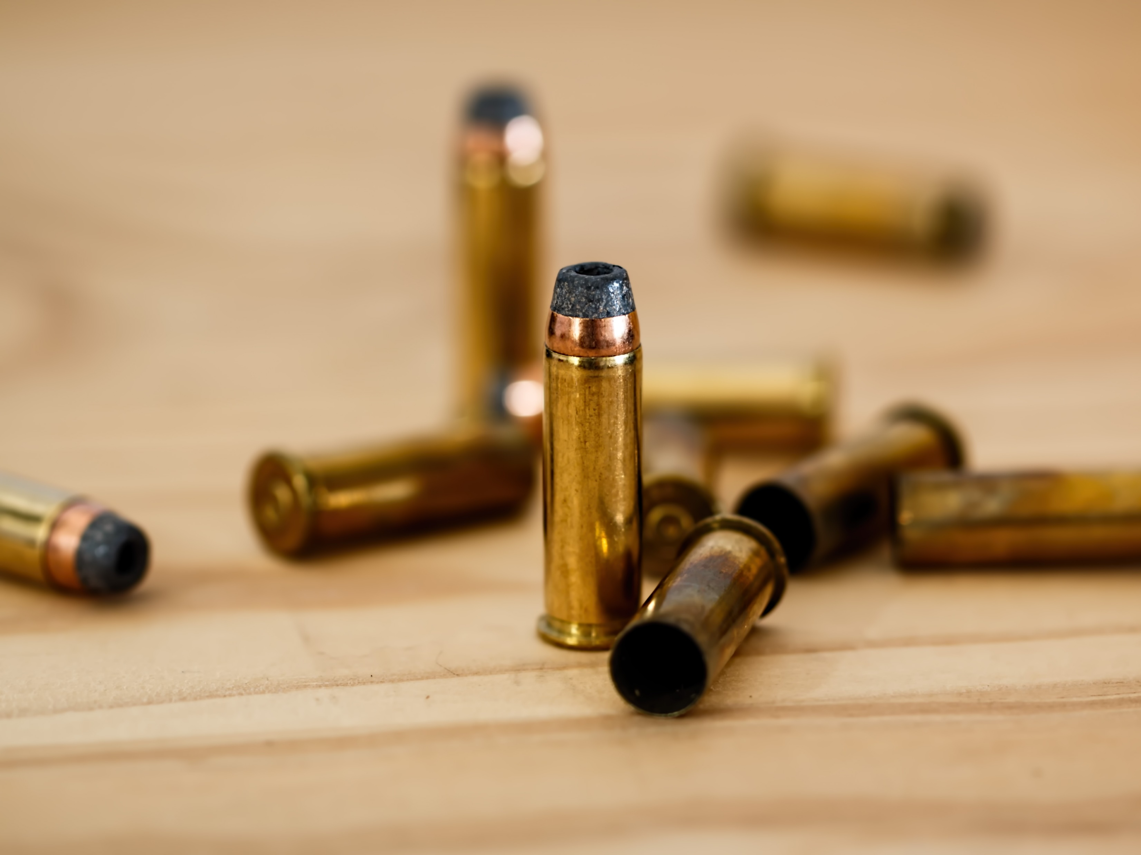
2. Page 149: What does the man use to fill the gun? Why do you think he did this?

Slide 7

2b. Can you recall at time you lied to make yourself look more impressive?
Did it work? What kind of impact did it have on your relationship with that person, if any?

Slide 8

3. On page 151, the boy says that he wishes they could stay in the bunker forever.
Why does the man say they need to leave? Do you think he’s right?

Slide 9

3b.
Think about a time you’ve had to leave something good behind. What was the reason? What was the outcome?

Slide 10
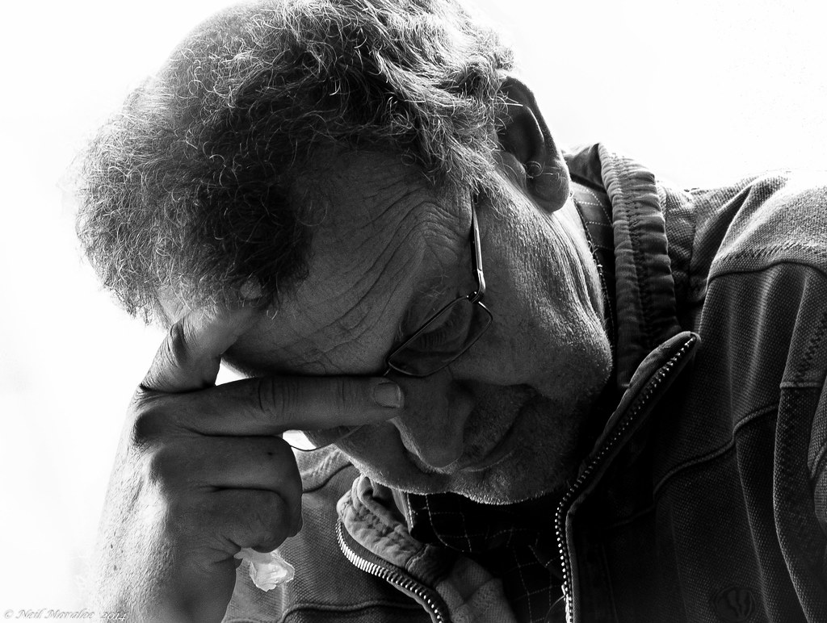
4. Page 154: Why does the man describe himself as an alien to the boy?
Why does he regret finding the bunker? Do you think this was a good experience for the boy? Why or why not?

Slide 11
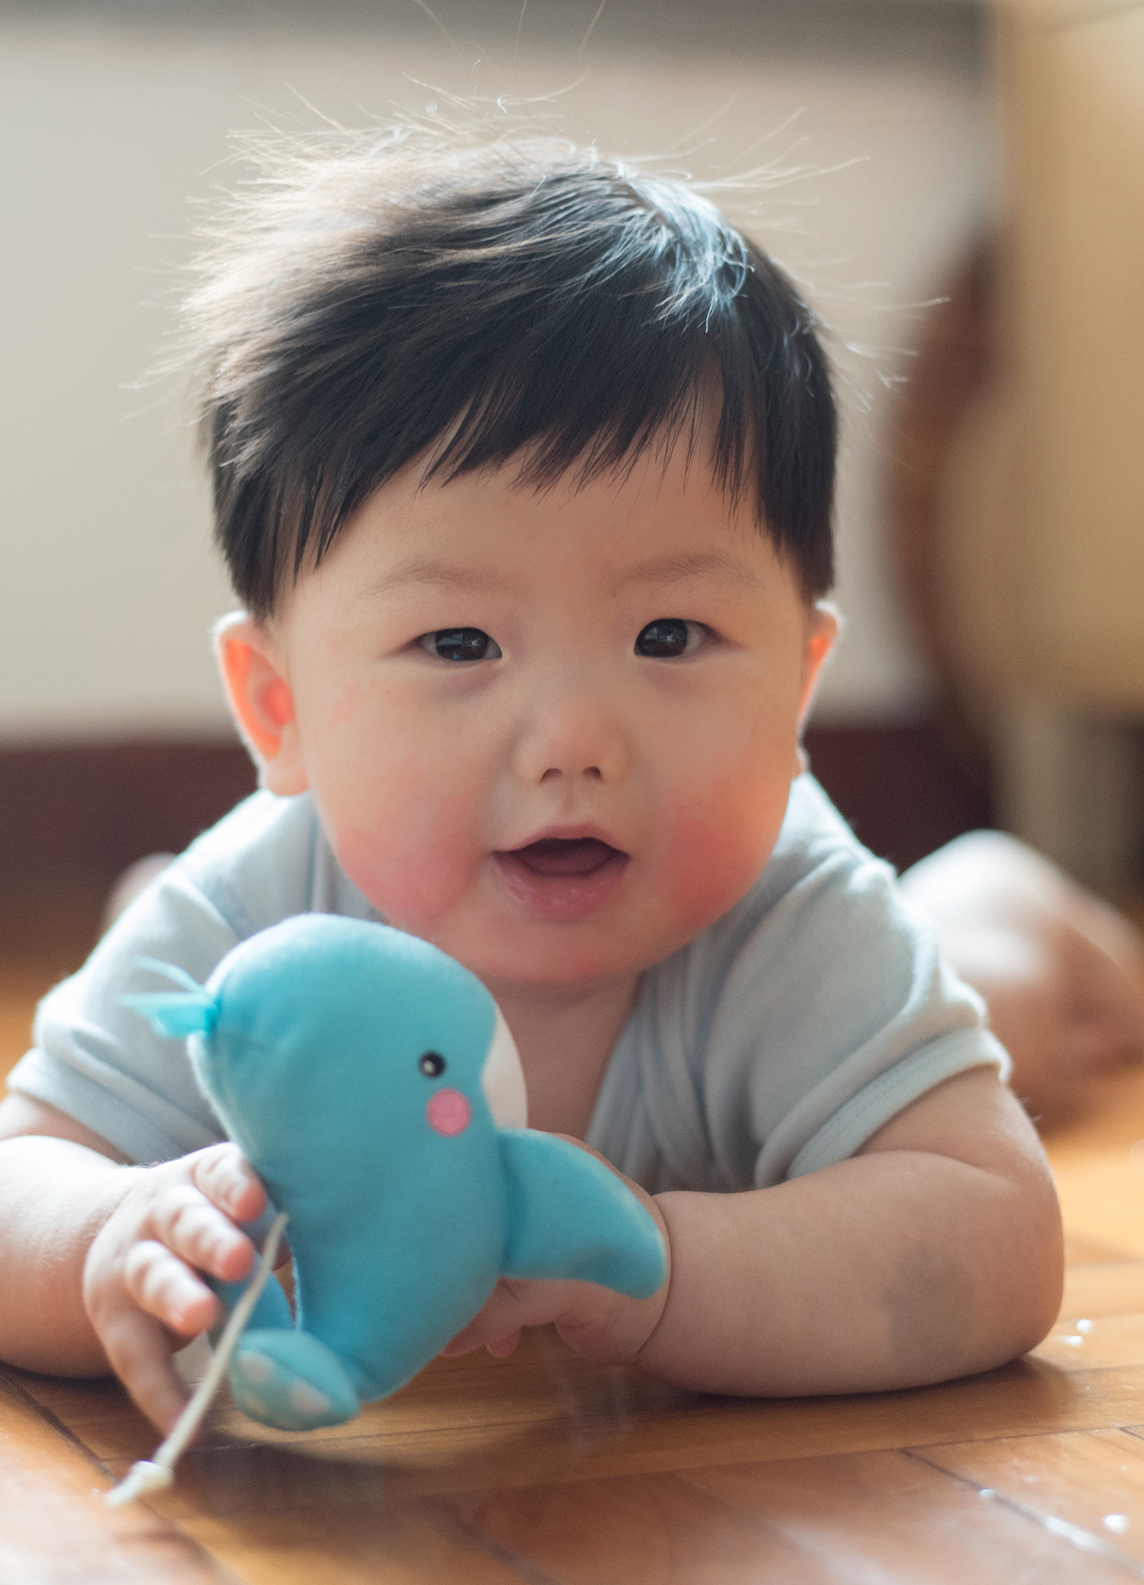
4b.
In your own life, do you believe in providing comfort for your children? Or should they learn about the harsh realities of life early on? What are the benefits and consequences of both approaches?

Slide 12
Crossword puzzle

Slide 13
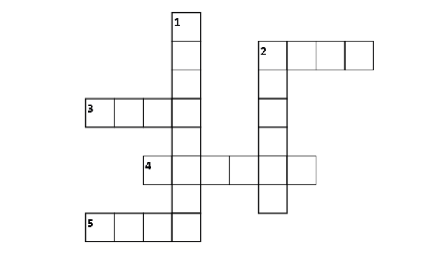
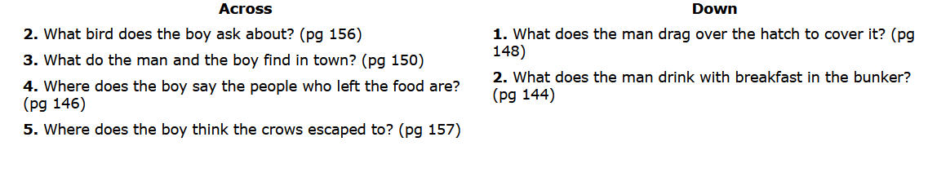

Slide 14
Next week:
Read pages 159-175

