Slide 1

The Maid by Nita Prose
Chapters 15 & 16

Slide 2
How was everyone's break?

Slide 3
Character List
Molly – Narrator; maid at the hotel
Mr. Snow – Hotel manager
Mr. Charles Black – Wealthy businessman who is a regular guest at the hotel
Mrs. Giselle Black – Mr. Black's second wife
Mrs. Black – Mr. Black's first wife
Victoria Black – Mr. Black's daughter
Mr. Preston – Hotel doorman
Rodney Stiles – Hotel bartender; went on a date with Molly last year and a second date after Mr. Black’s death

Slide 4
Character List
Cheryl ("Chernobyl") - Molly's supervisor
Wilbur Brown – Molly's ex-boyfriend
Juan Manuel – Hotel dishwasher; Molly gives him a key card because he is going through financial difficulties
Mr. & Mrs. Chen – Regular guests at the hotel whose room Molly cleans
Detective Stark – Detective investigating Mr. Black's death
Mr. Rosso – Molly’s landlord who demands his rent
Charlotte – Mr. Preston’s daughter who works as a lawyer

Slide 5





Slide 6
Summary
Molly wakes up from a nightmare at her home to a knock on the door
Detective Stark places Molly under arrest for unlawful possession of a firearm, possession of drugs, and first-degree murder
Molly faints upon hearing that she is being arrested and wakes up in a holding cell
Detective Stark takes Molly to be interrogated and gives her a muffin and coffee
Detective Stark reveals that Mr. Black did not die of natural causes, but was asphyxiated

Slide 7
Summary Cont.
Detective Stark tells Molly that they know she pawned off Mr. Black's ring and accuses her of stealing it. Molly agrees that she sold the ring but did not steal it.
She reveals that Rodney, Cheryl and Mr. Snow all spoke poorly of Molly and her work in the hotel
Detective Stark takes Molly's phone
Molly calls Mr. Preston, and he shows up to the jail with his daughter, Charlotte, who is an attorney
Charlotte pays Molly's $800,000 bail and promises to represent her

Slide 8

Question One
After being arrested Molly is disgusted by the state of the cot and cell. Do you think she was distracting herself from the problem at hand?
Have you ever focused on something unimportant to distract yourself from something serious? Has it helped in the long-run?

Slide 9
Question Two
During the interrogation, Molly finds out about a lot of betrayals all at once. She hears that Mr. Snow, Cheryl, and Rodney all spoke poorly of her, leading to her arrest. How does she react to these betrayals? How does she feel?
Have you ever experienced a surprise betrayal at a hard time? How did it affect your state of mind?

Slide 10

Question Three
Throughout the interrogation, Molly admits to small crimes but overall insists she is innocent. Do you find this convincing? Do you think Detective Stark believes her at all?
Remember a time when you were falsely accused of something. How did you feel? How did you react? Was there anyone who believed you? How did it turn out?

Slide 11

Question Four
Molly uses her one phone call to reach out to Mr. Preston, and he immediately comes to her aid. How do you think this felt after so much betrayal? Did you expect Mr. Preston to protect Molly like this?
Is there a time in your life when someone unexpected supported you through a hard time? How did that feel? Are you still friends with them today?

Slide 12
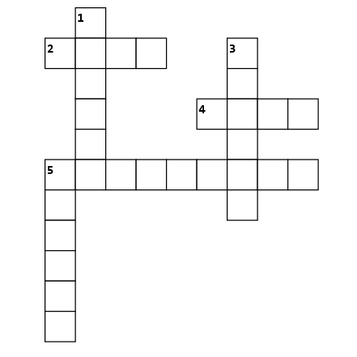
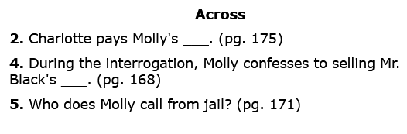
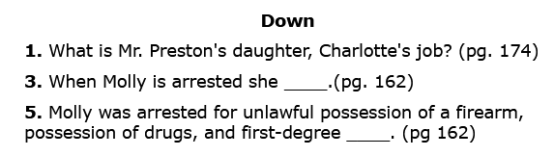

Slide 13
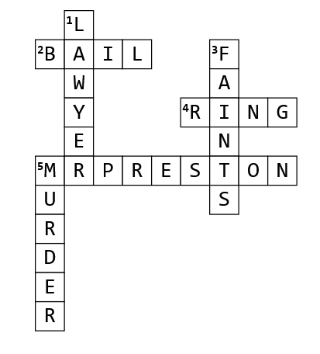

Slide 14

Any Predictions?

